Slide 1
Anela Latrik
Graphic Technology 2
Pd.2

Slide 2
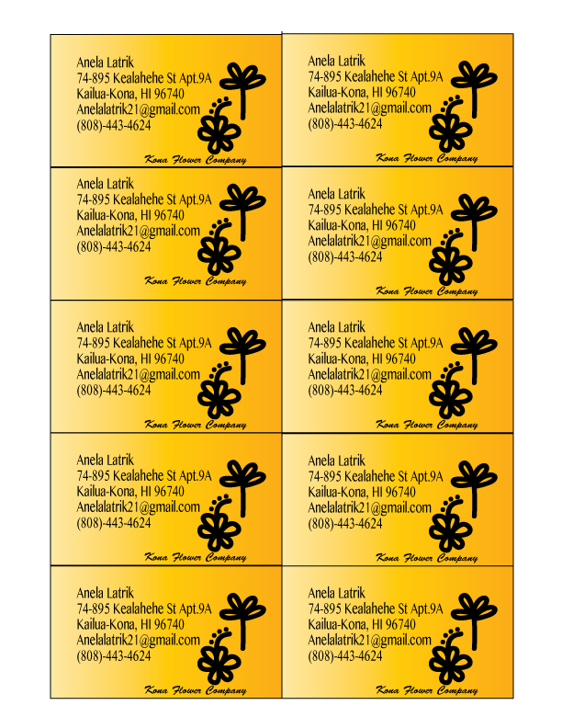
Business card

Slide 3
bumper sticker

Slide 4
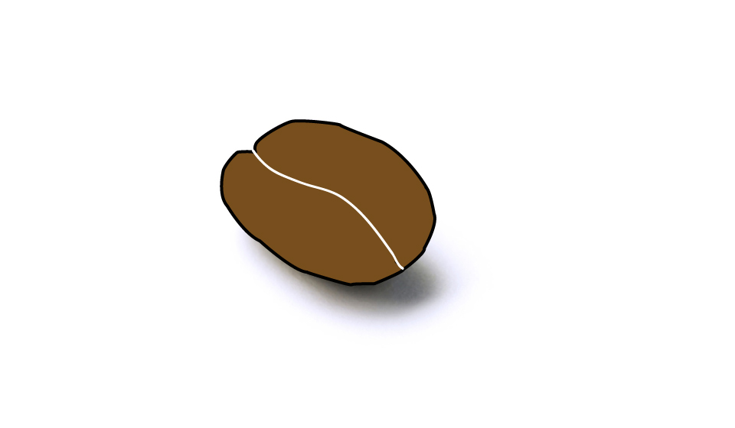
coffee beans

Slide 5
Snowman

Slide 6
direct selection

Slide 7
pumpkin

Slide 8
spirit week

Slide 9
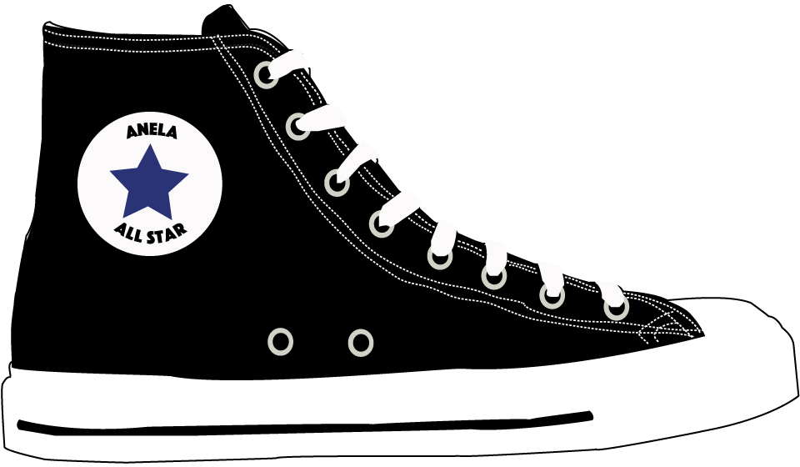
converse all star

