Slide 1
My Work
2015
Danielle Castillo
1st period
Graphic Design

Slide 2
Bumper Stickers
For the KHS sticker, I used a round font and showed what each letter of KHS stands for to display the values at this school. For my other sticker, I chose a bold statement which is usually seen with bumper stickers.

Slide 3
Spirit Week 2015
For my Spirit Week poster, I used the basic principles of graphic design like repetition and contrast. These principles make it easier for the audience to read and understand.

Slide 4
Powderpuff
For this project, I created a simple design with all the information located in one place. Also, I put a football for a visual.

Slide 5
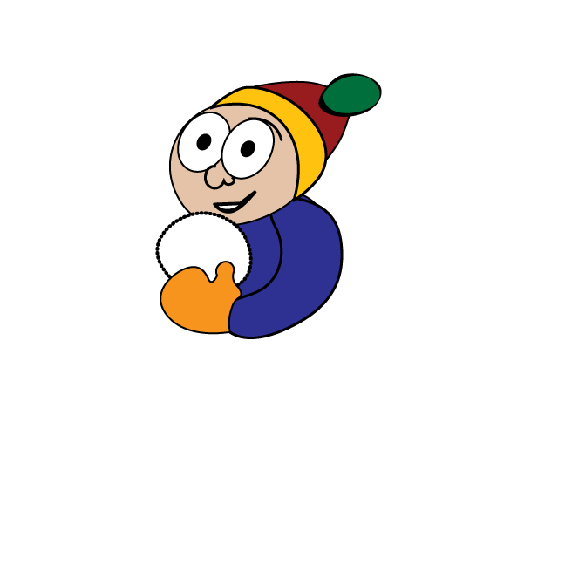
Snowball Boy
In this project, I followed a tutorial which mainly involved using the pen tool. This made me learn how vector art is created.

Slide 6
Dog with Saxophone
I used the pen and fill tool in this project where I outlined parts of the dog to get a clearer and better picture of it than the jpeg version. I learned how to use the pen tool more efficiently.

Slide 7
Business Card
For my business card, I chose an easy font that everyone could read. I also put my business card logo on the side.

Slide 8
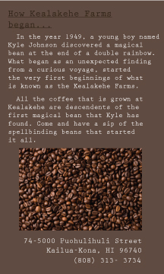
Kona Coffee Label - My Best Work
For this project, I used a color scheme and incorporated my own vector art. I think this is my best work because it displays my own art and sticks to a theme.
A Habit of Mind I applied to this project is “Applying Past Knowledge To New Situations” because I emulated designs that I often saw in coffee shops like Starbucks.

Slide 9
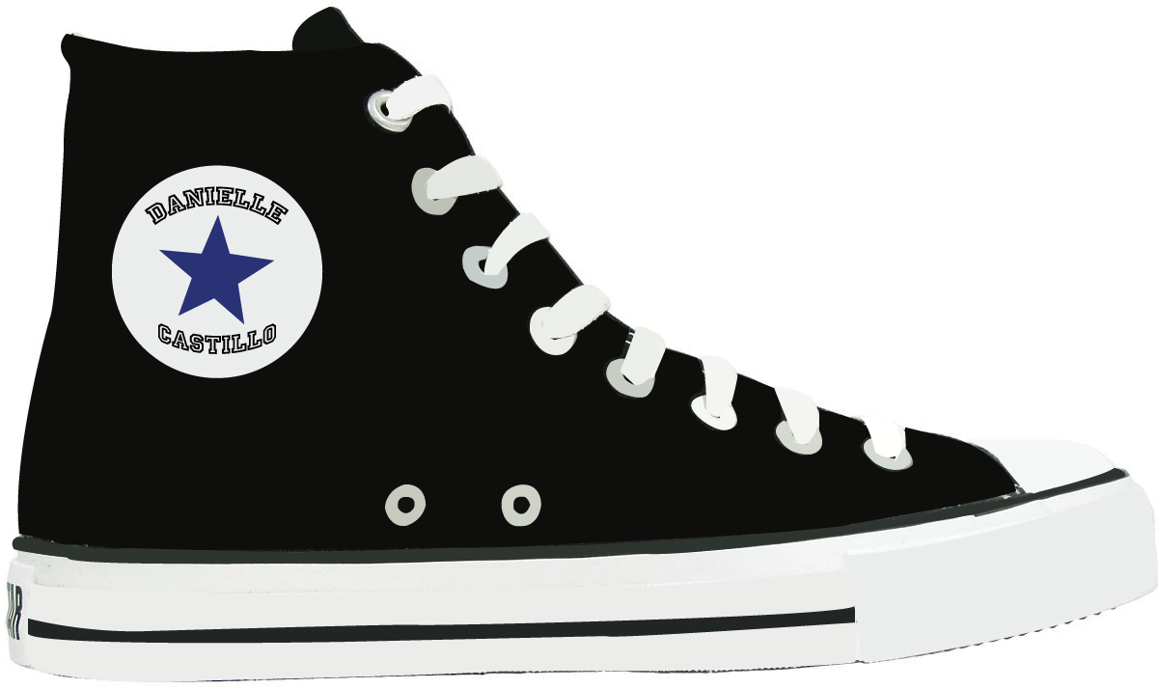
Converse Vector
For my converse vector, I mainly used the pen and fill tool. I put in my name on where the logo used to be.

Slide 10
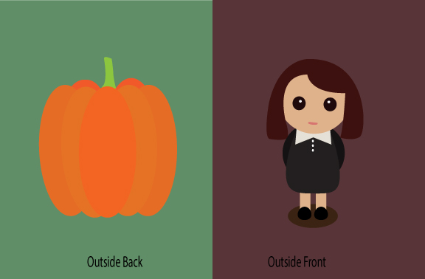
Thanksgiving Card
For this project I followed a tutorial to create my own vector art. I tried to create images that represented the holiday.

Slide 11
the other side...

Slide 12
Arts & Communications Pathway
For my logo, I made a painters color palette and brush to represent art. I also found a camera vector that I used to give readers a visualization of what you may do in the class.

Slide 13
fin

