Slide 1
AC Core Pathway Work
Jacey Magana
Period 4

Slide 2
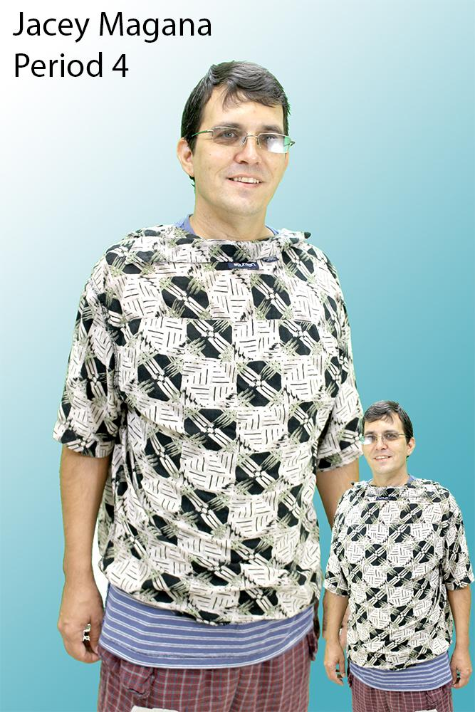
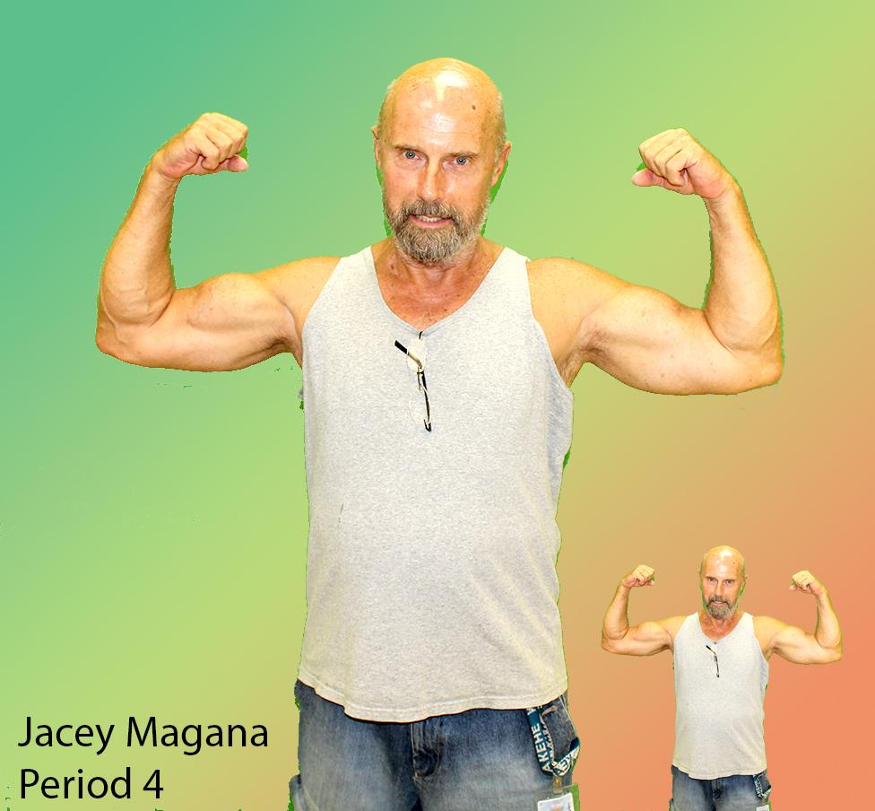
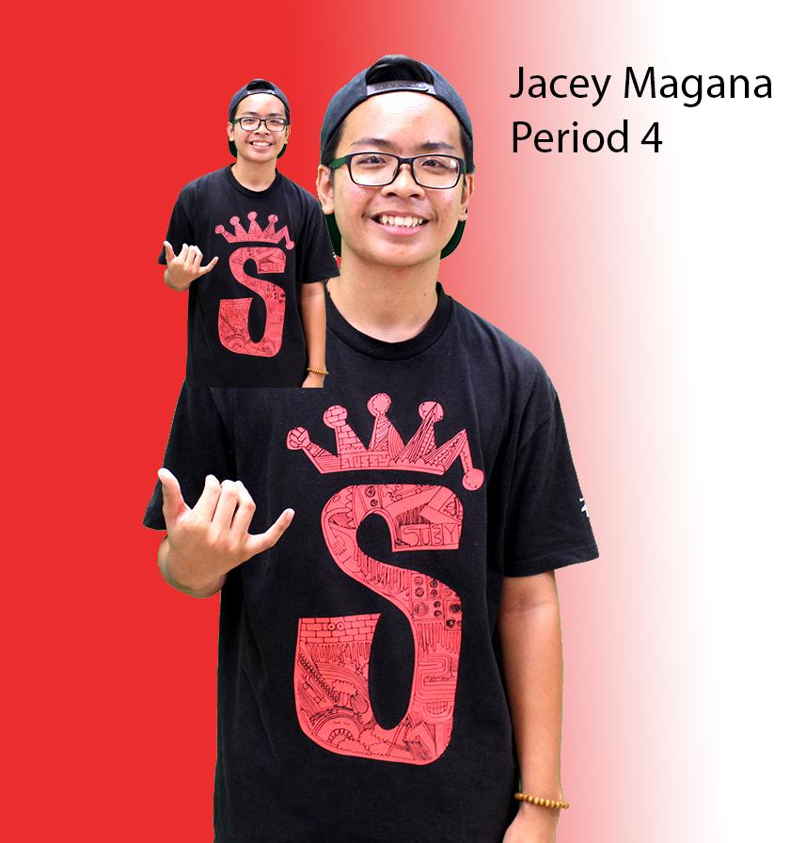
Photoshop Mini Me
I cut out the background for each and I duplicated them and minimized them to make a “mini me”. I did this without making them pixelated.

Slide 3
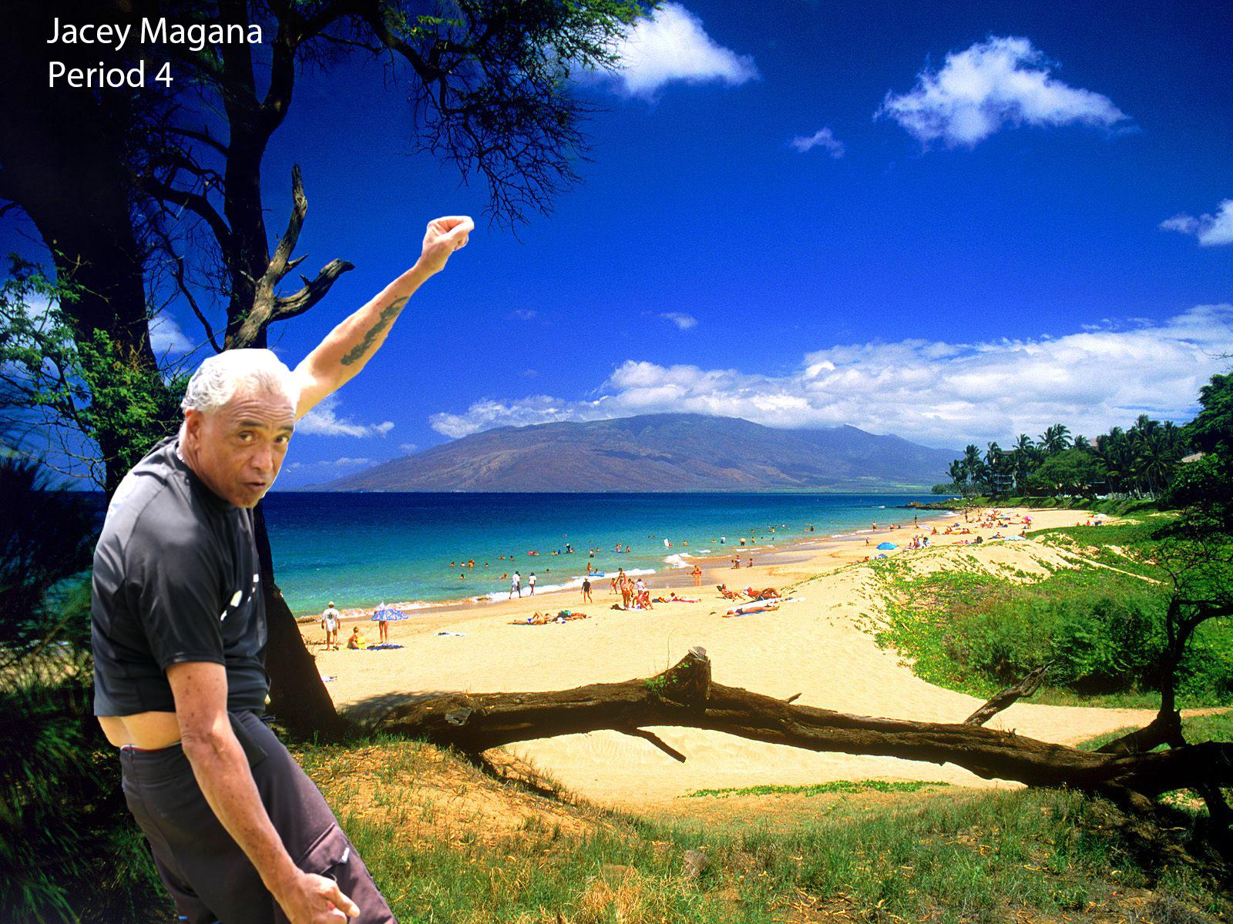
Kalei in maui Photoshop
I took a picture of kalei and used the eraser tool to take out everything in the background and pasted him onto a background of Maui.

Slide 4
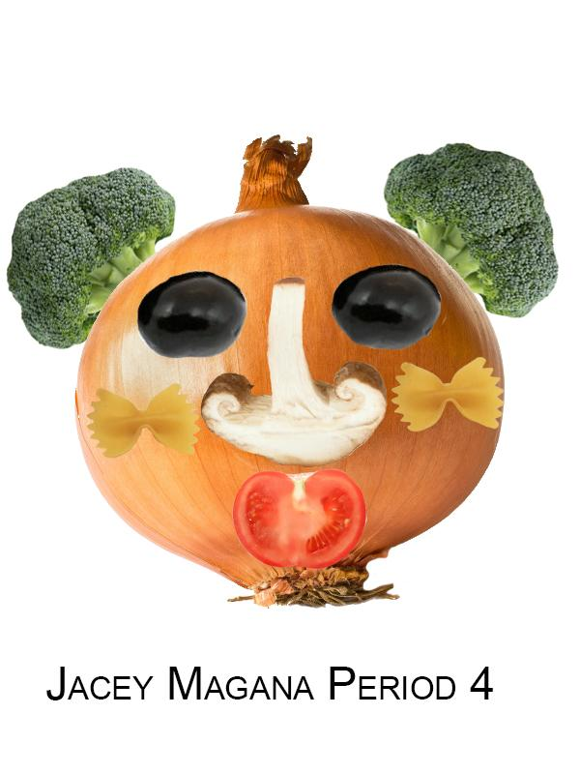
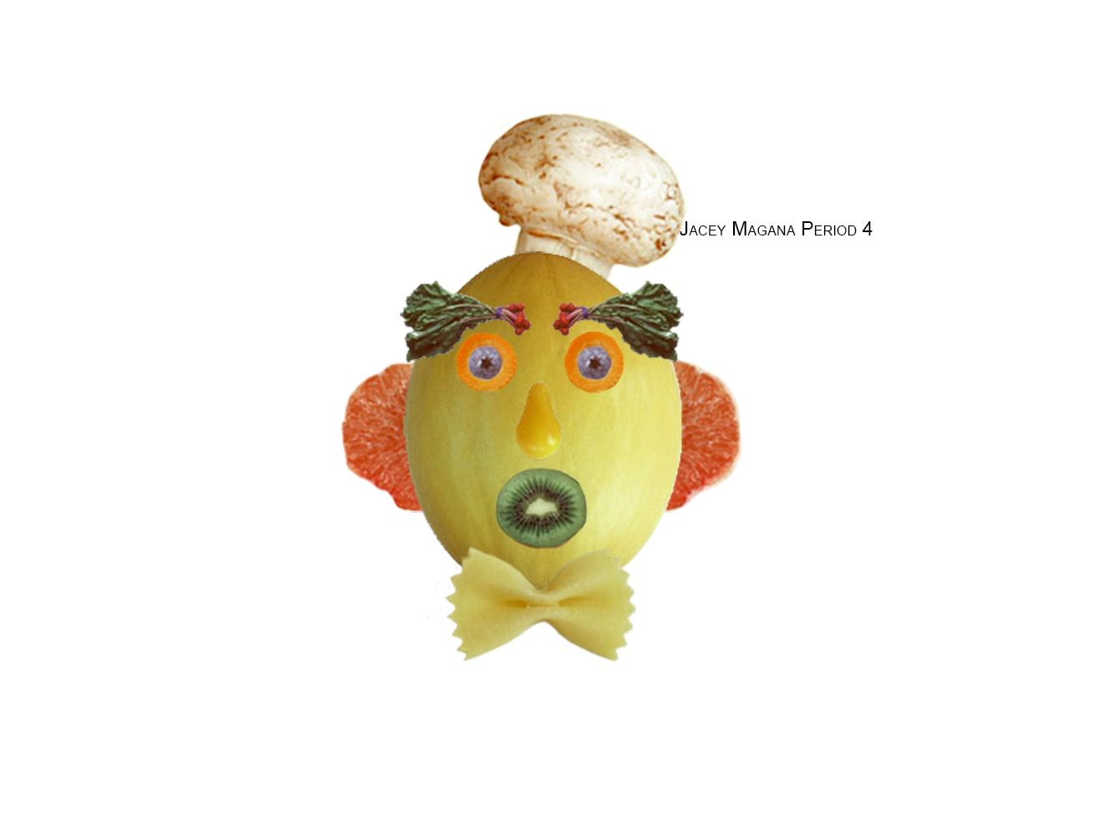
Veggie Man Project
I made a veggie man and used many different vegetables. I used the magic wand tool and the eraser tool to get everything in the background out.

Slide 5
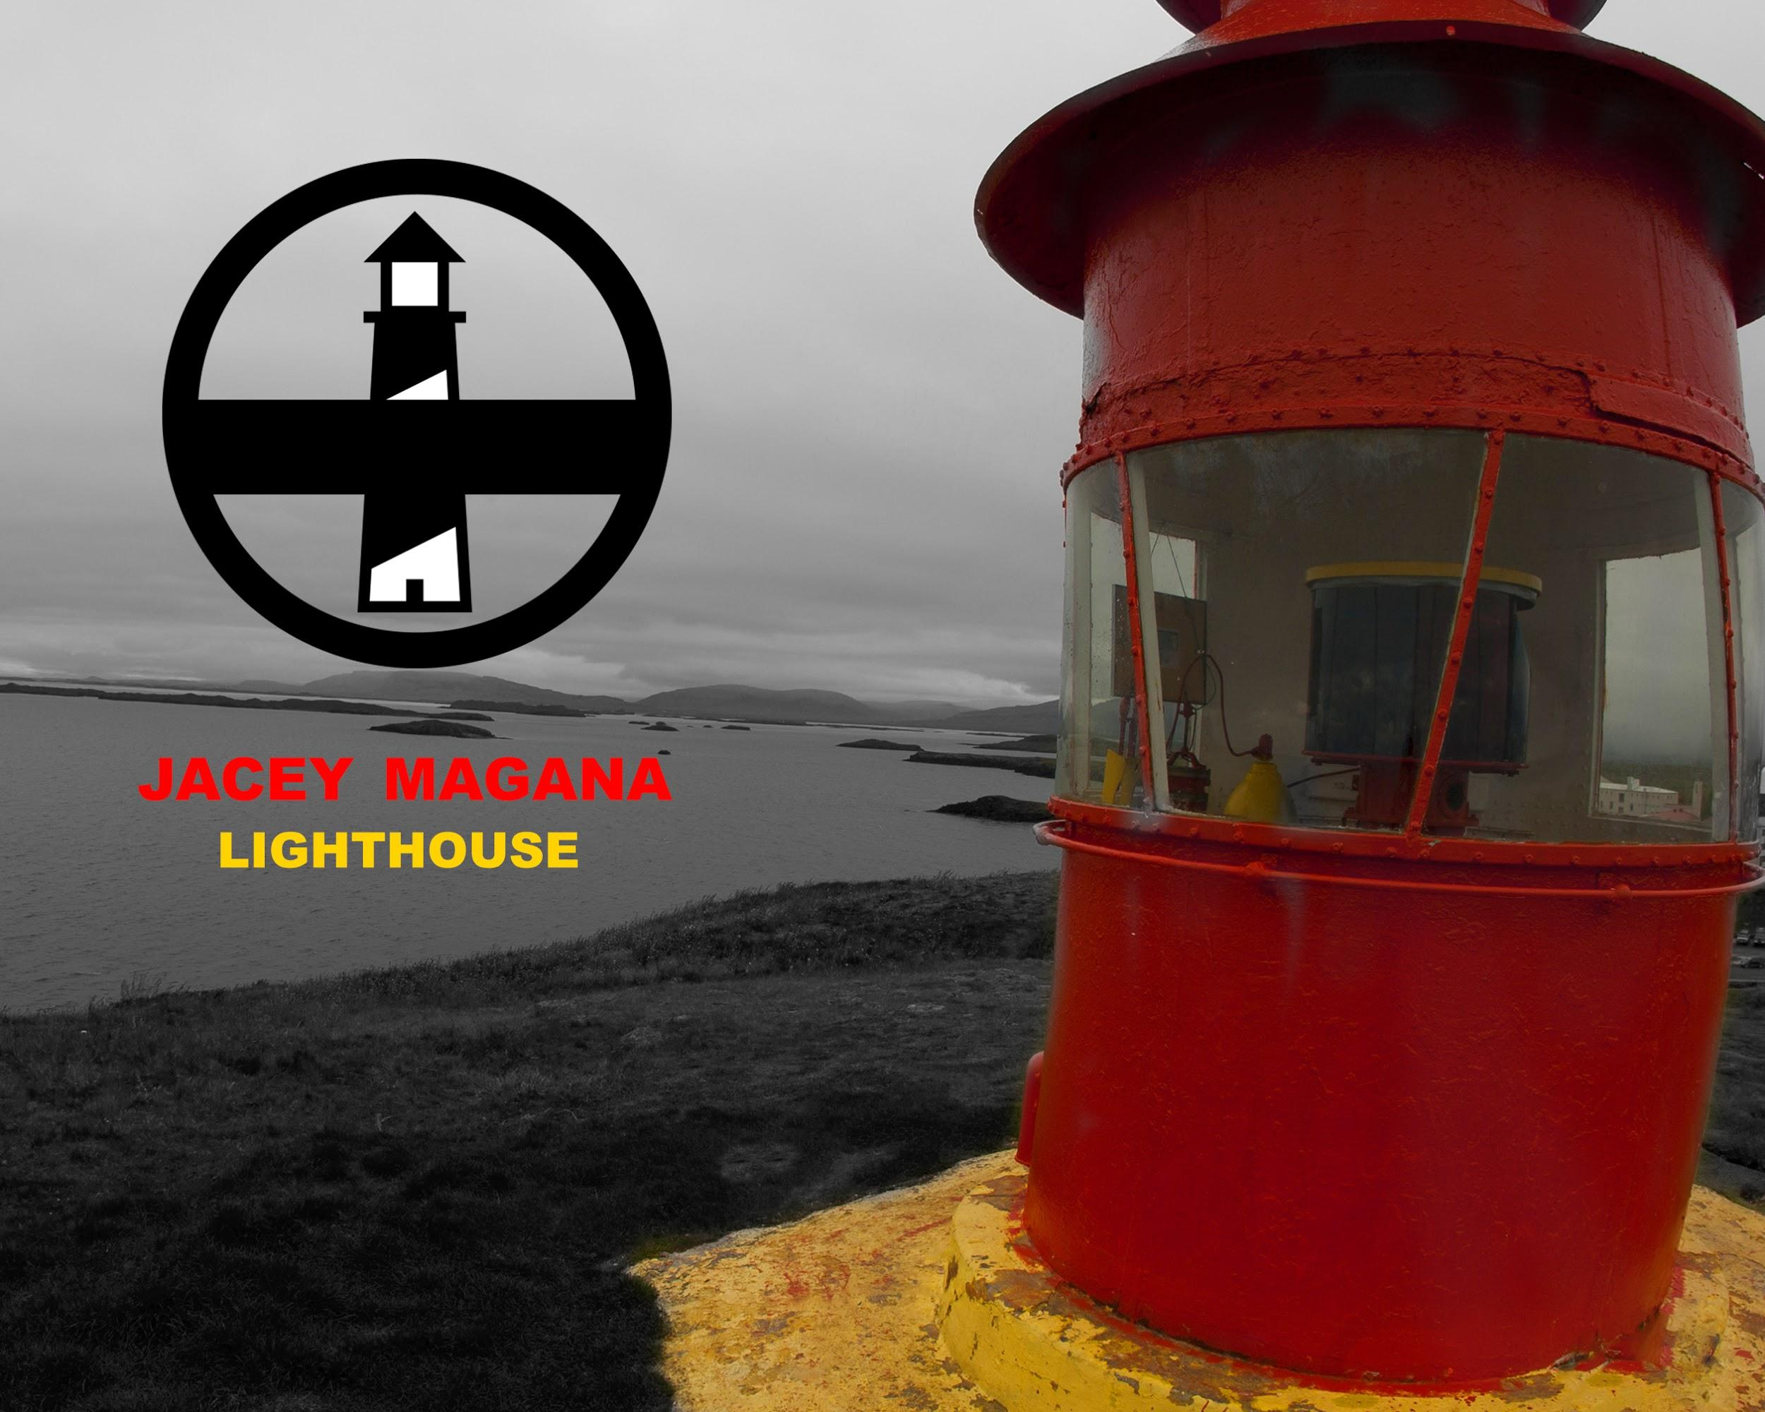
Lighthouse
I made a picture of a lighthouse and took the color out of the background and placed a logo of a lighthouse on the left of it.

Slide 6
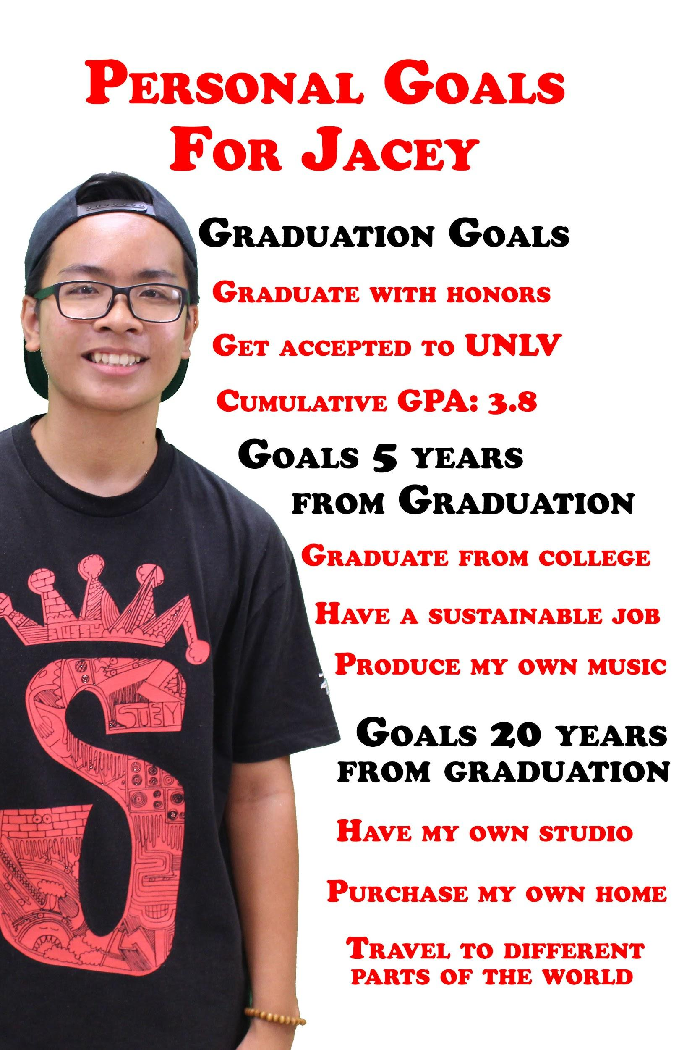
Personal Goals Poster
I did a poster on my personal goals and I listed the goals I have before graduation, goals 5 years from graduation and 20 years from graduation!

Slide 7
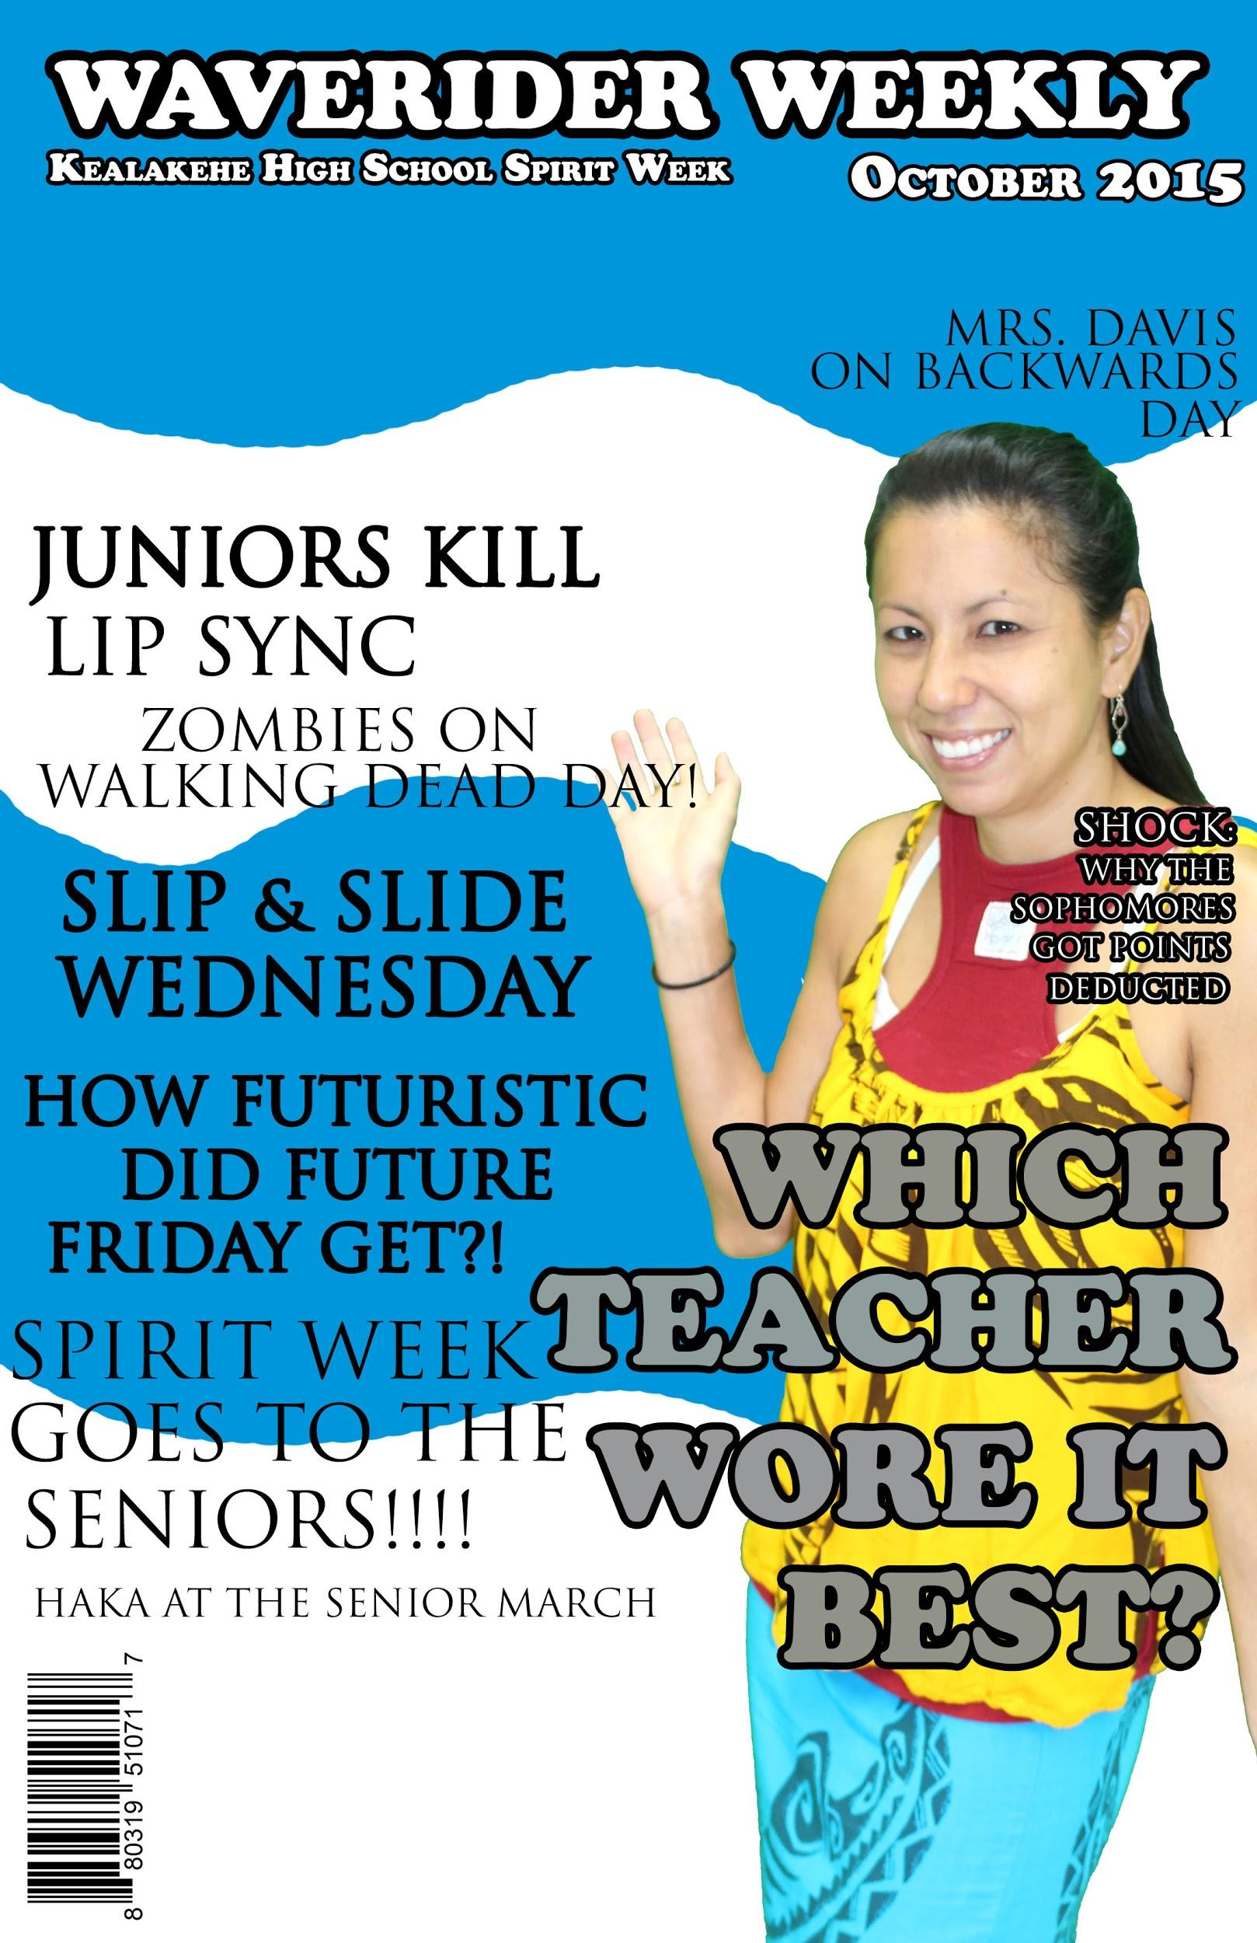
Cover Magazine
I did a magazine cover based off of the Kealakehe Waverider Weekly Paper and I did it on the spirit week of 2015-2016. I had several topics based on the day it was.

Slide 8
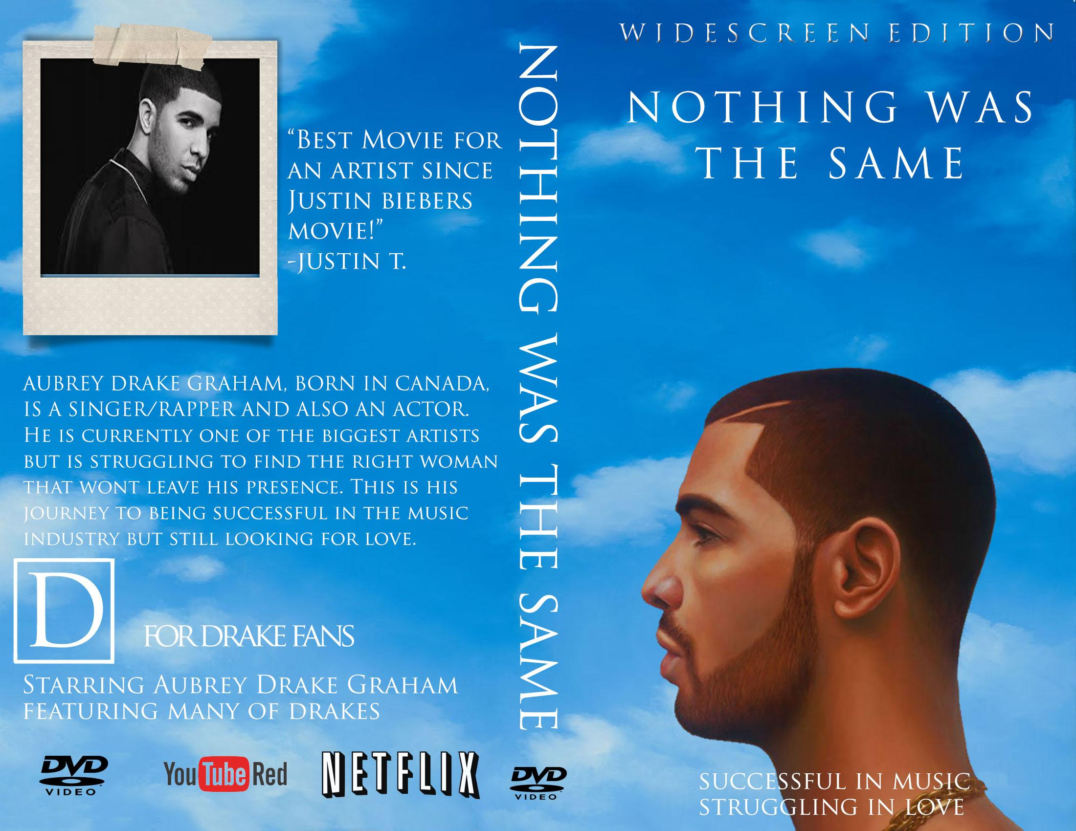
DVD Cover
I did a DVD cover on Drake and his life in the music industry and love life. This is my best work because I spent the most time out of all the other projects. One habit of mind that I used for this is to apply past knowledge to new situations because I used everything that I learned from this class and made it into a DVD cover.

Slide 9
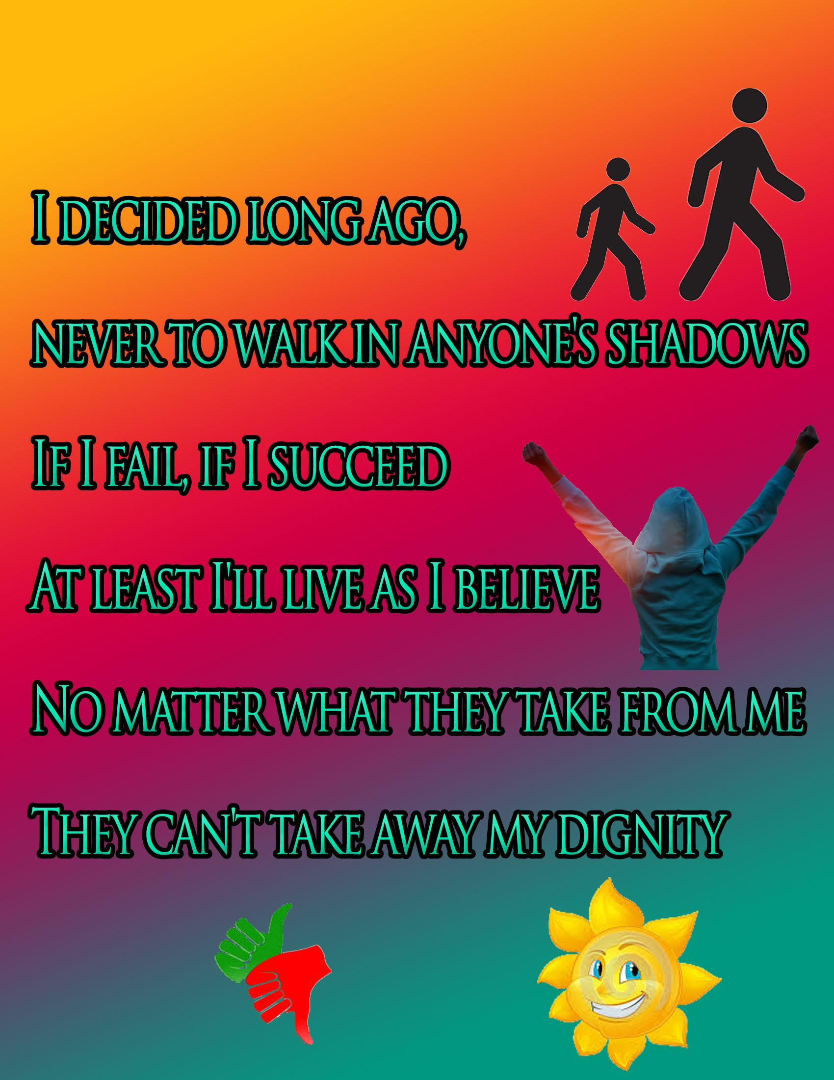
Illustrated Lyrics
I used lyrics from a song that was very inspiring. This quote spoke to me the most out of anything else.

Slide 10
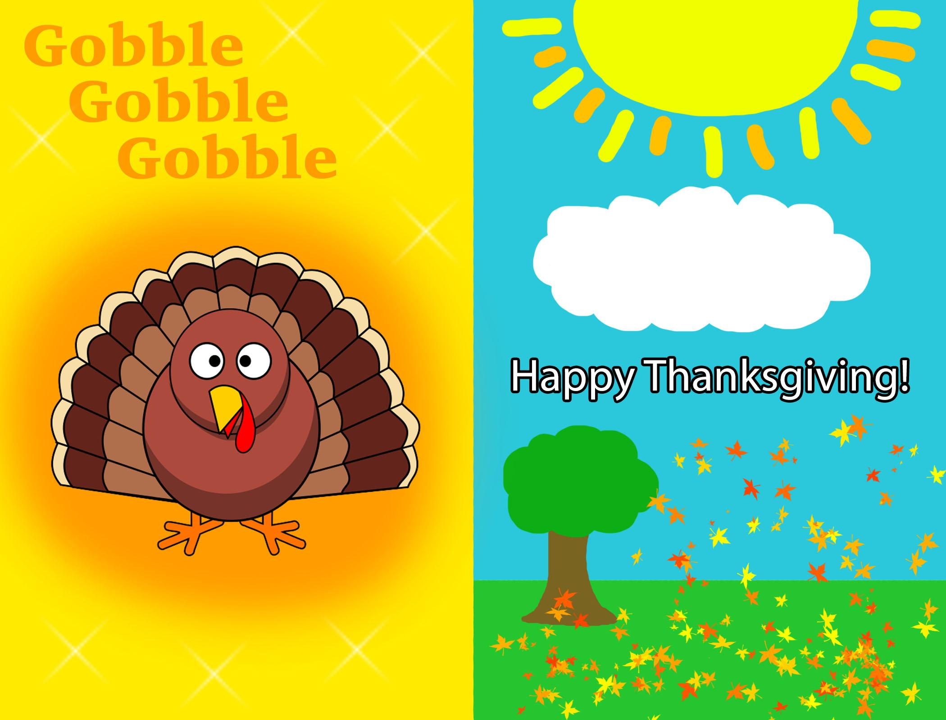
thanksgiving card
My thanksgiving card was to my family and how much I appreciate them. I made a design of a turkey and the outside with autumn leaves falling.

Slide 11
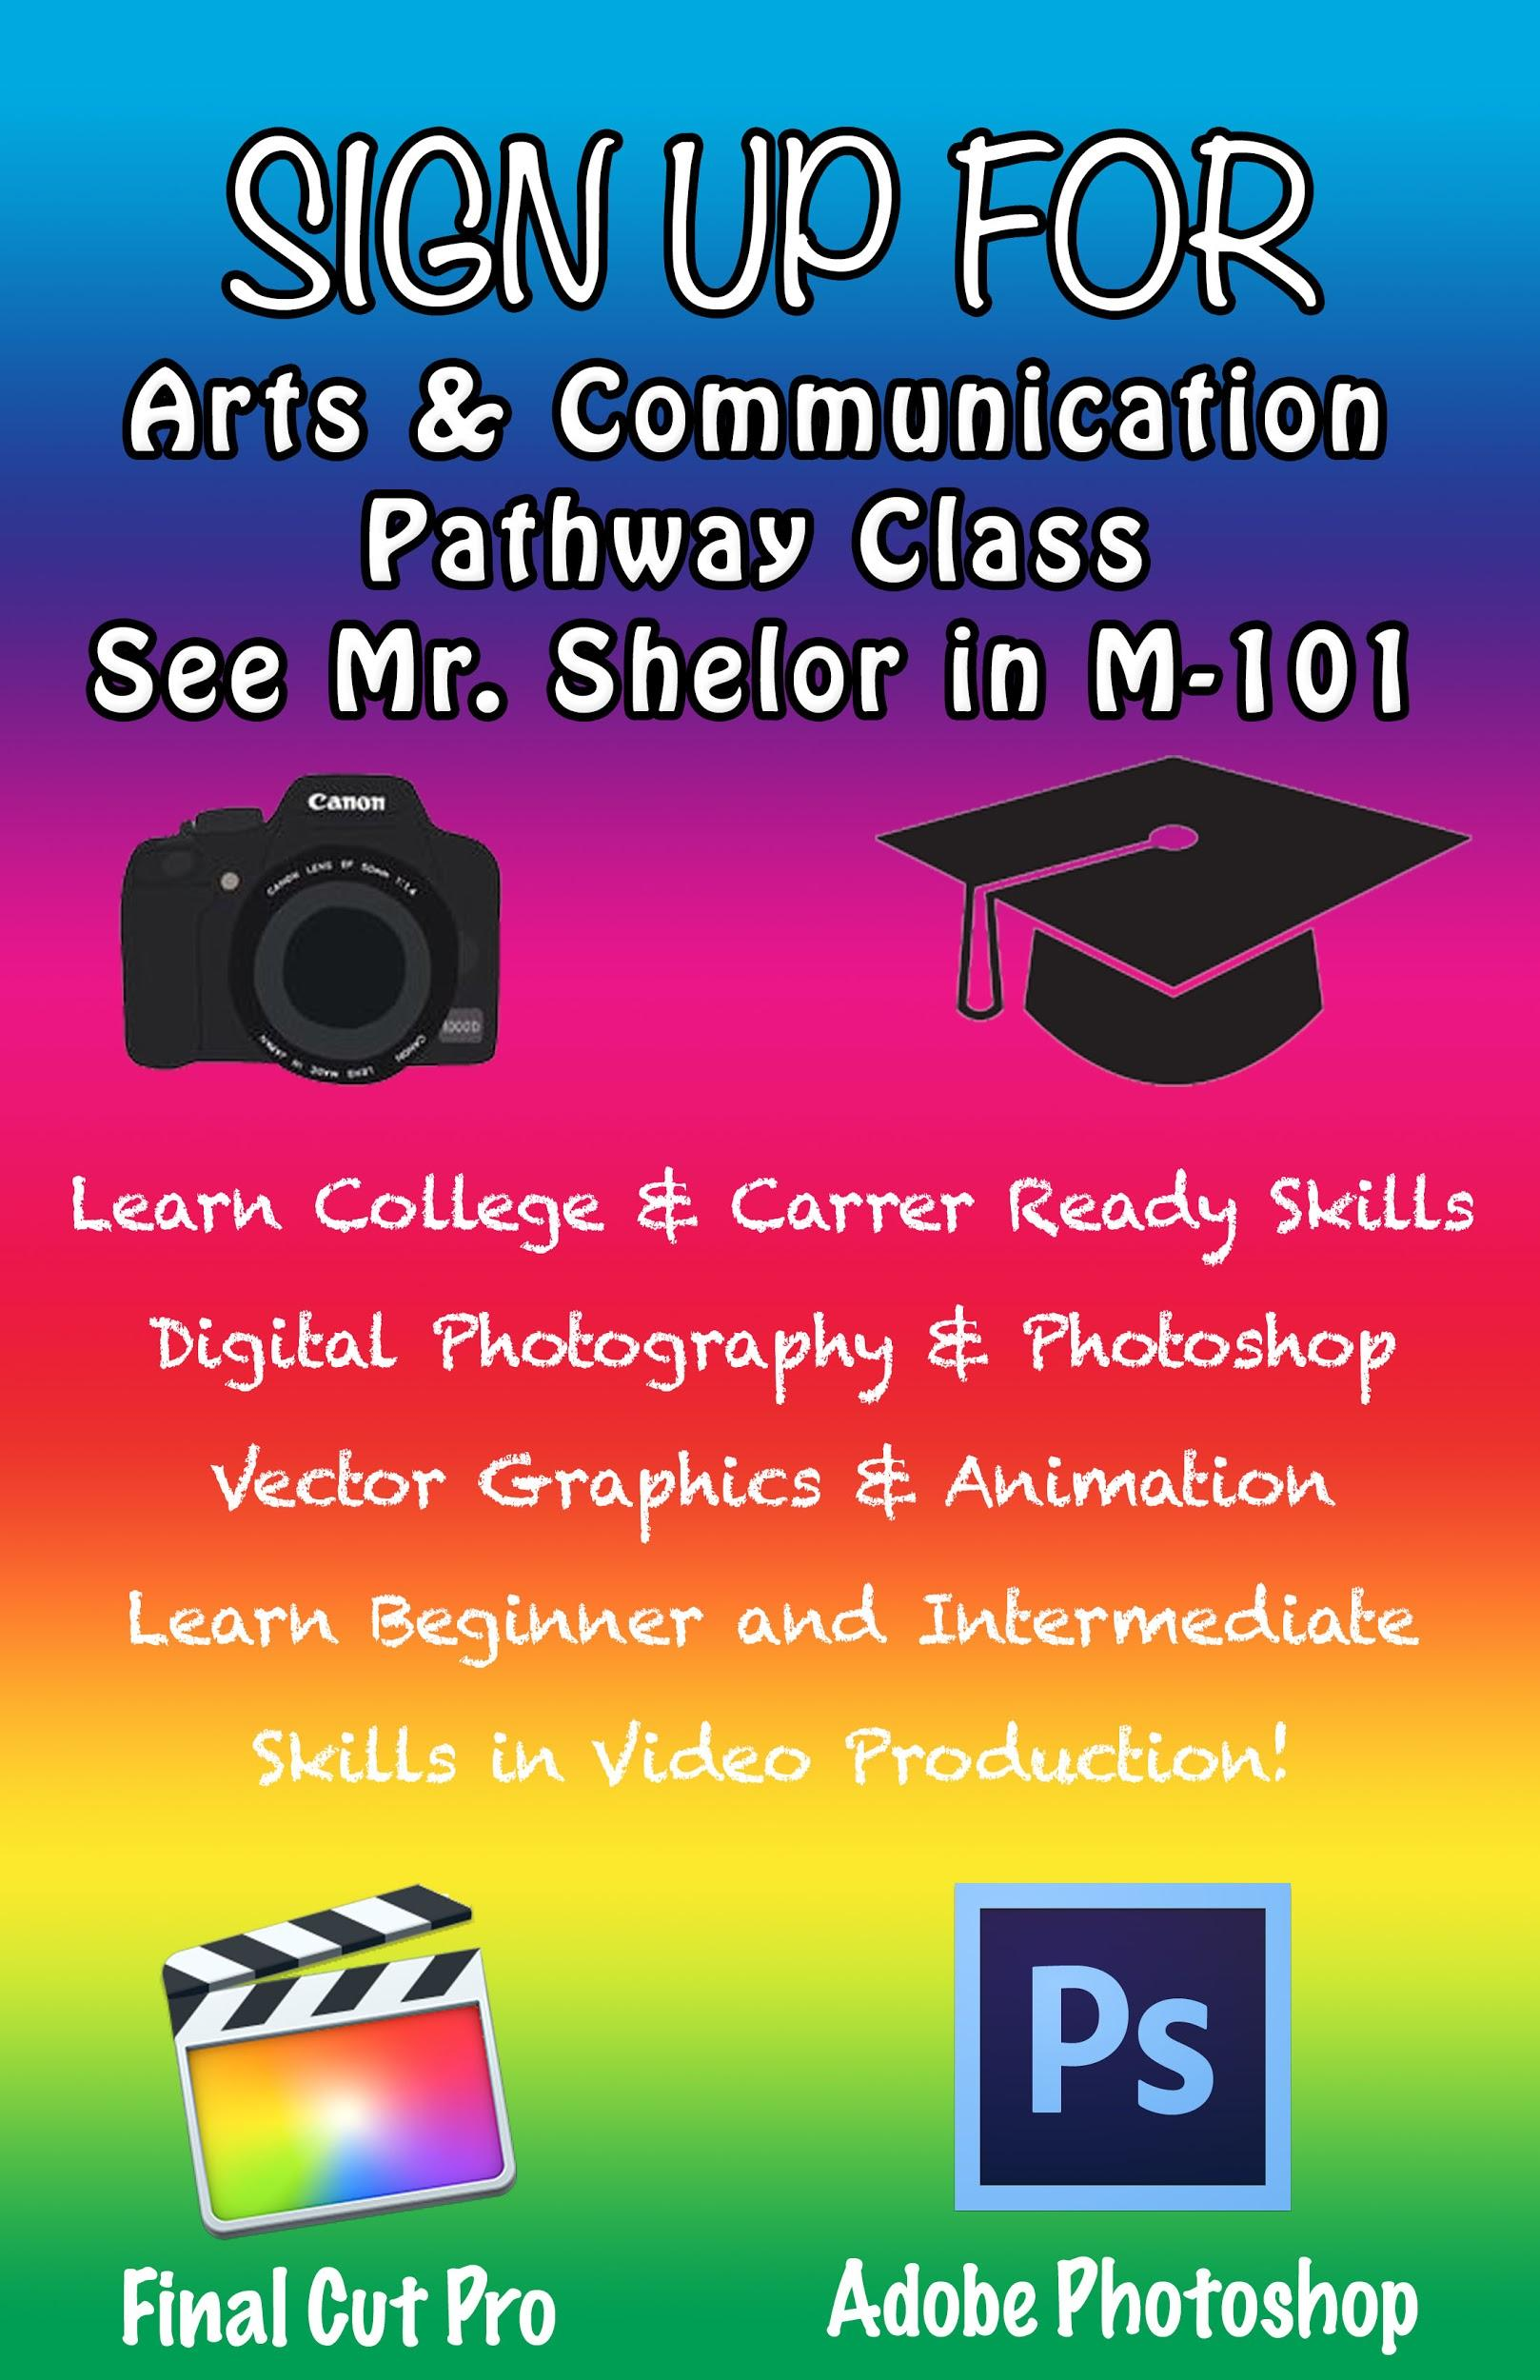
AC Core Pathway Class Poster
I did an Arts & Communication Pathway poster to promote this to the people that might want to take this class next year.

