Slide 1
What are the 4 Gestalt Principles?
Figure Ground
Closure
Similarity
Proximity

Slide 2
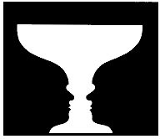
Figure-Ground
We tend to separate the important aspects of the figure from the surroundings (background). We focus or give our attention to the figure.
Real or imagined contour lines separate the figure and ground
Camouflage depends on difficulties with establishing contour lines
Reversible figures change the ownership of the contour lines

Slide 3
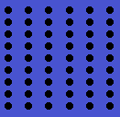
Proximity
Proximity is the grouping of elements that are close to each other to form an overall figure or pattern. Also known as ‘nearness’.

Slide 4
Similarity
When the elements of a stimulus or pattern have similar features (size, shape, colour) we tend to group them together. Similarity is stronger than proximity if the two are together in a stimulus.

Slide 5
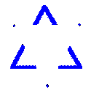
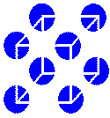
Closure
What do we see?
We perceive an object as a whole, despite it being actually incomplete. We group the individual elements to make ‘one’ by filling in the missing contour lines so that it makes sense.

Slide 6
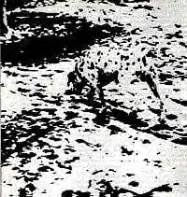
Fido?

Slide 8
Physiological factors affecting Visual Perception
Alcohol… Slows us down, changes coordination, reduces attention, concentration and ability to make judgements.
Old Age…cataracts, long-sightedness, age-related macular degeneration, retinal detachment, diabetic retinopathy, glaucoma. Our eyes age as we do and become more susceptible to disease and damage.

Slide 9
OPTICAL ILLUSIONS OR HOW EASY IT IS TO TRICK HUMAN BEINGS….

Slide 10
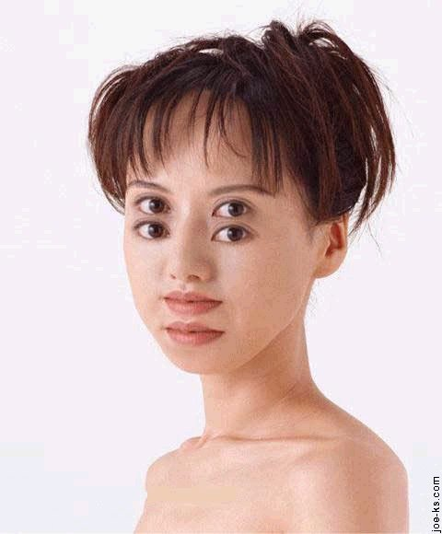

Slide 11
How do Optical Illusions work?
A visual stimulus misleads our perception (or meaning-making) of that stimulus.
This happens because we APPLY perceptual constancies to what we are seeing – they are our RULES.
We make a false judgement because we misjudge length, position, speed, direction or curvature.

Slide 12
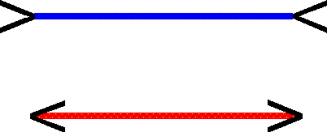
MULLER LYER Illusion
There are 2 theories to explain this illusion!
The Muller Lyer illusion consists of 2 lines that are equal in length to each other.
One has ‘arrow-heads’ attached.
One has fish-tails’ attached.

Slide 13
Theory of Perceptual Compromise
1. The length of the solid horizontal lines of each figure are actually equal in length.
BUT the length of each WHOLE figure is not the same.
3. The lengths between the added tips (heads or tails) is very different. We use closure to estimate the length and compromise somewhere between the actual length and the perceived length.

Slide 14
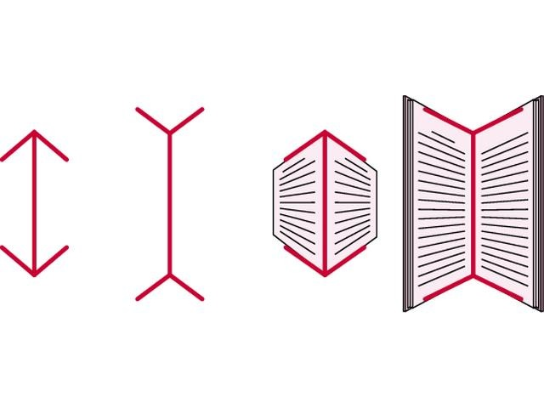
Diagram of Perceptual Compromise

Slide 15
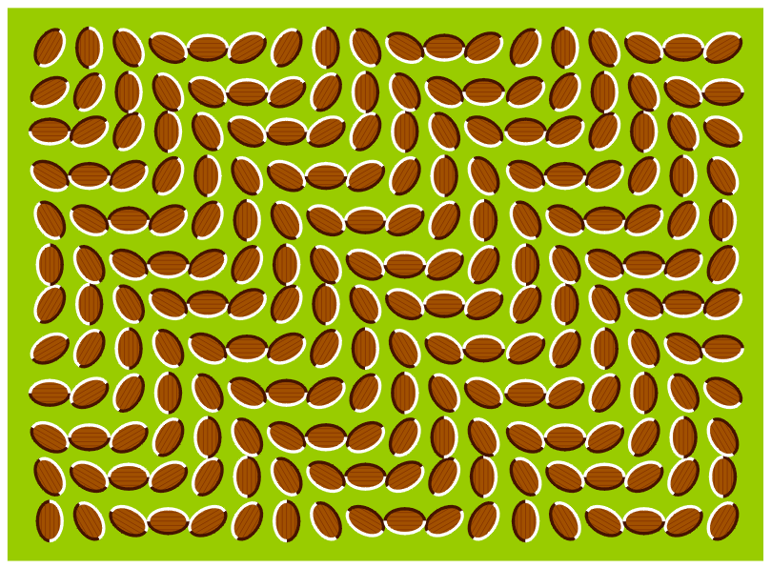
Is this picture REALLY moving?

