Slide 1
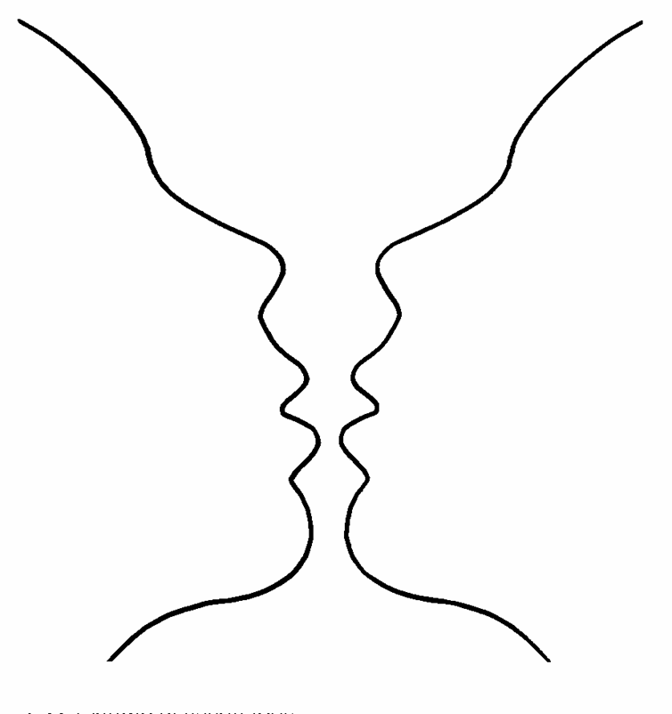
Gestalt Theories Of Visual Perception
The Gestalt theorists were the first group of psychologists to systematically study perceptual organization around the 1920’s, in Germany.
These theories attempt to describe how people tend to organize visual elements into groups or unified wholes when certain principles are applied.

Slide 2
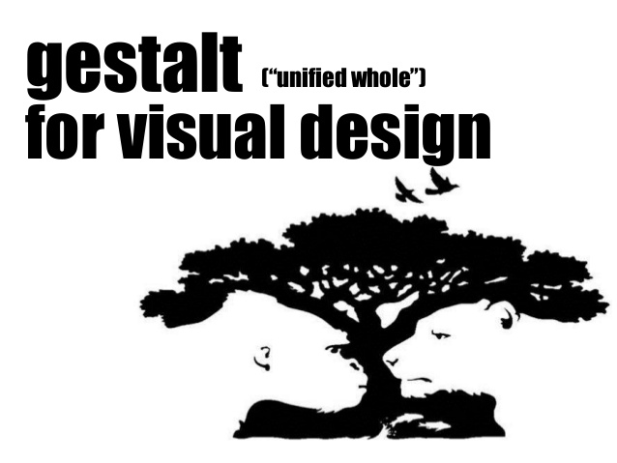
Gestalt means "organized whole")
Gestalt means when parts identified individually have different characteristics to the whole
(e.g. describing a tree - it's parts are trunk, branches, leaves, perhaps blossoms or fruit)
But when you look at an entire tree, you are not conscious of the parts, you are aware of the overall object - the tree.

Slide 3
Gestalt Visual Laws of Perception
Designers use visual principles drawn from gestalt theory to unify their designs.
- Figure/ ground
- Proximity
- Closure
- Continuation
- Similarity

Slide 4
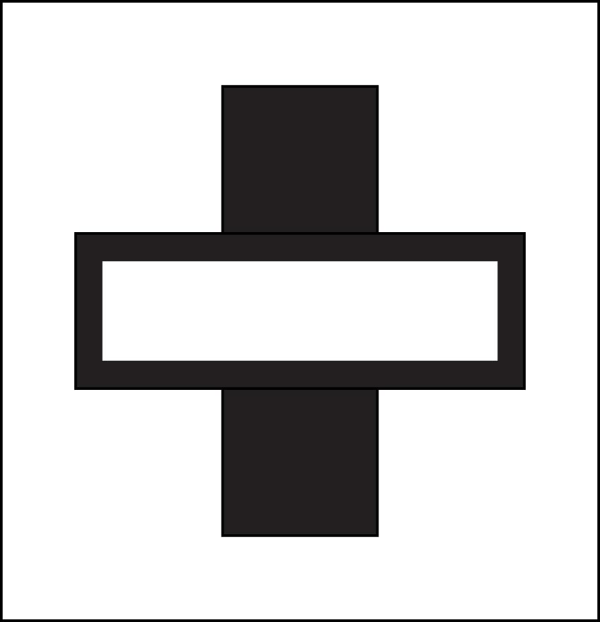
Gestalt Law: Figure/ground (1 of 3)
• This law helps us identify objects (figure) as distinct from their background (ground)
• Figures are positive elements, grounds are negative elements

Slide 5
Gestalt Law: Figure/ground (2 of 3)
• Reading words depends on the Gestalt Law of figure/ground
• Contrast between the black letters (figure) and white paper (ground) helps us perceive words.

Slide 6
Gestalt Law: Figure/ground (3 of 3)
• Awareness of negative/ positive space allows us to see layers of meaning.
• We see both the plus sign (figure) and the minus sign (ground).

Slide 7
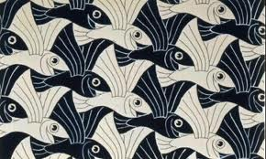
Figure and Background
Figure and background are not seen simultaneously, so when we look at this image our eyes have to switch their focus between black fish and white fish, never able to focus on both at any time. In this case, figure and ground are interchangeable.

Slide 8
Figure and Background 2
In this image, the eye will first focus on the dogs, as they are initially seen as the figure. When you change your focus to the ground, or seemingly negative space of the image, the eye adapts and uncovers the image of the Seattle space needle.

Slide 9
Figure and Background

Slide 10
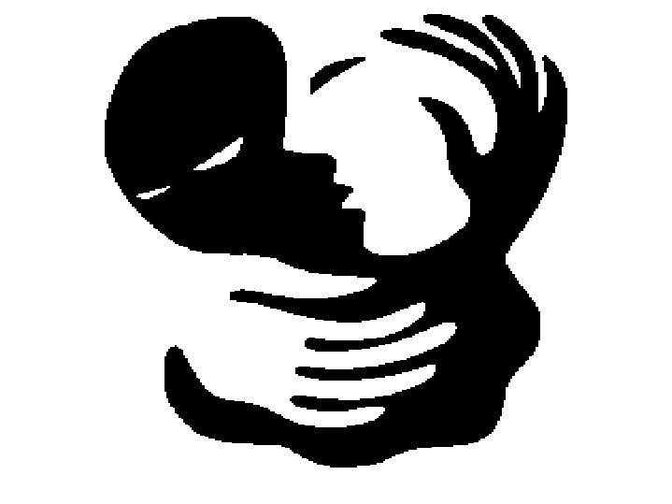

Slide 11
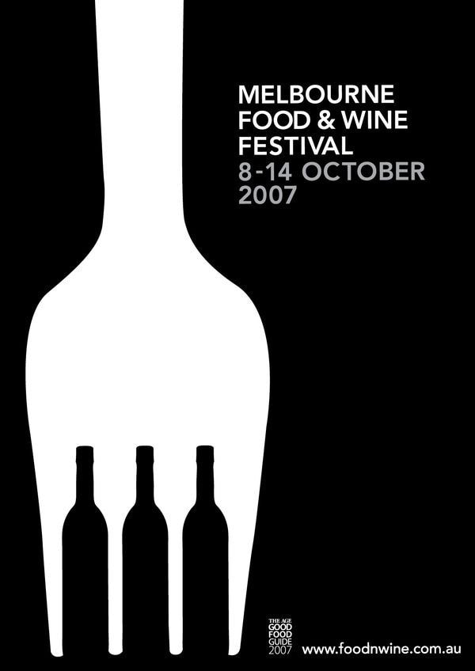
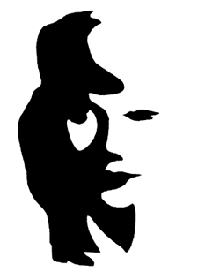

Slide 12
Figure and Ground

Slide 13
Figure and Ground
This poster for the film “Peter and The Wolf” exemplifies the great creative potential in using the figure-ground principle to your benefit. On one hand, you get the image of a long wolf’s body. When you shift to looking at the white in the image (previously ground) as figure, you immediately spot a man’s silhouette — which we can assume is Peter’s.

Slide 14
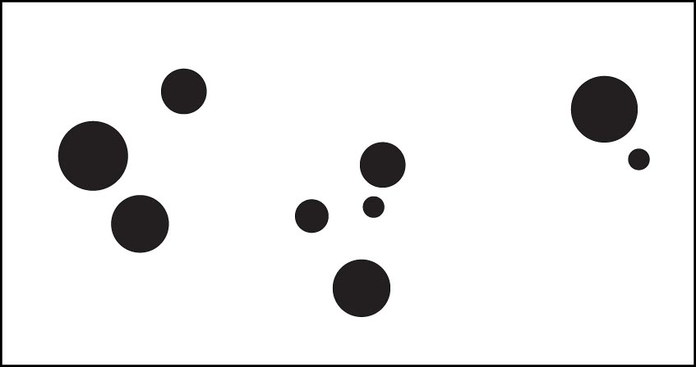
Gestalt Law: Proximity (1 of 2)
• Items that are located near each other seem part of a group.
• The closer items are the more likely the perception they are a group.

Slide 15
Gestalt Law: Proximity (2 of 2)
• Objects located near each other are perceived as part of a group.
• Instead of counting numerous distinct circles we see three “groups”.

Slide 16
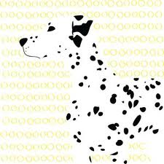
Proximity
When we look at this image, instead of seeing black spots and yellow circles we group the black dots together because of their proximity and similarity and see them as the figure of a Dalmatian.

Slide 17
Proximity 2
In this image, if the flying black person figures were more spread out that’s all we would gather from the image, little flying people. Instead, they are close in proximity, in our eyes forming the shape of a tree.

Slide 18
The principle of proximity is also effectively applied in Unilever’s logo. Since the small figures are laid out closely to each other, you can easily perceive the cluster as a U (in Unilever). According to their brand site, their logo was designed to include “25 icons, each of which represents something important to Unilever”.

Slide 19
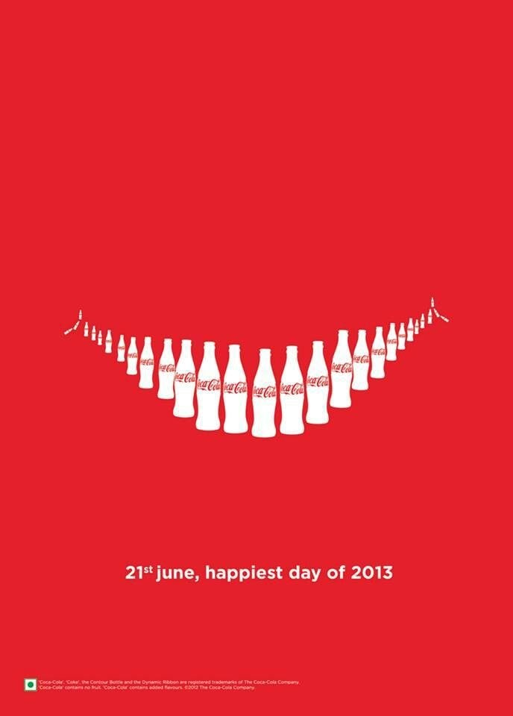
Coke wanted to convey happiness (one of its core brand values) by creating the shape of a smile using bottles. The fact that they are placed near each other in such a deliberate fashion helps the
viewer perceive that smile.
Proximity

Slide 20
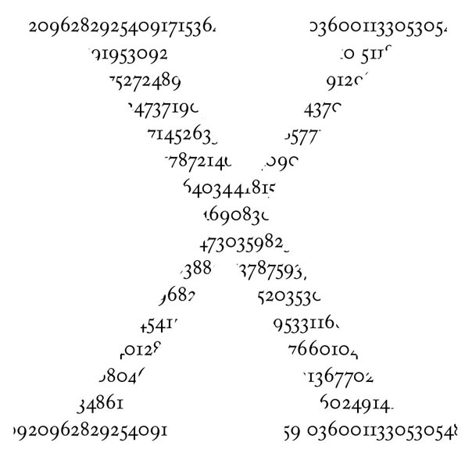

Slide 21
Gestalt Law: Closure (1 of 2)
• We have a tendency to visually close gaps in a form.
• The more familiar the form the faster we visually close the gap.
• Closure occurs because we seek to make the forms stable out mind

Slide 22
Gestalt Law: Closure (2 of 2)
• We visually close forms.
• The O and the U are easily read as letters despite missing parts.

Slide 23
Closure
Thought to be a survival adaptation, our brain takes incomplete information and makes it whole. Although the white space between the black animal figures is not outlined or finished, our mind reads them as animals.

Slide 24
Closure 2
Although this is seemingly just a group of curved dashed lines, we perceive this as an image of a circle. We close the space between the lines to make sense of the given and absent information.

Slide 25
Closure

Slide 26
Closure

Slide 28
Closure

Slide 29
Closure

Slide 30
Gestalt Law: Continuation (1 of 2)
• We seek relationships between shapes, especially repeating shapes.
• The eye follows along a line, curve, or sequence of shapes identifying visual relationships.

Slide 31
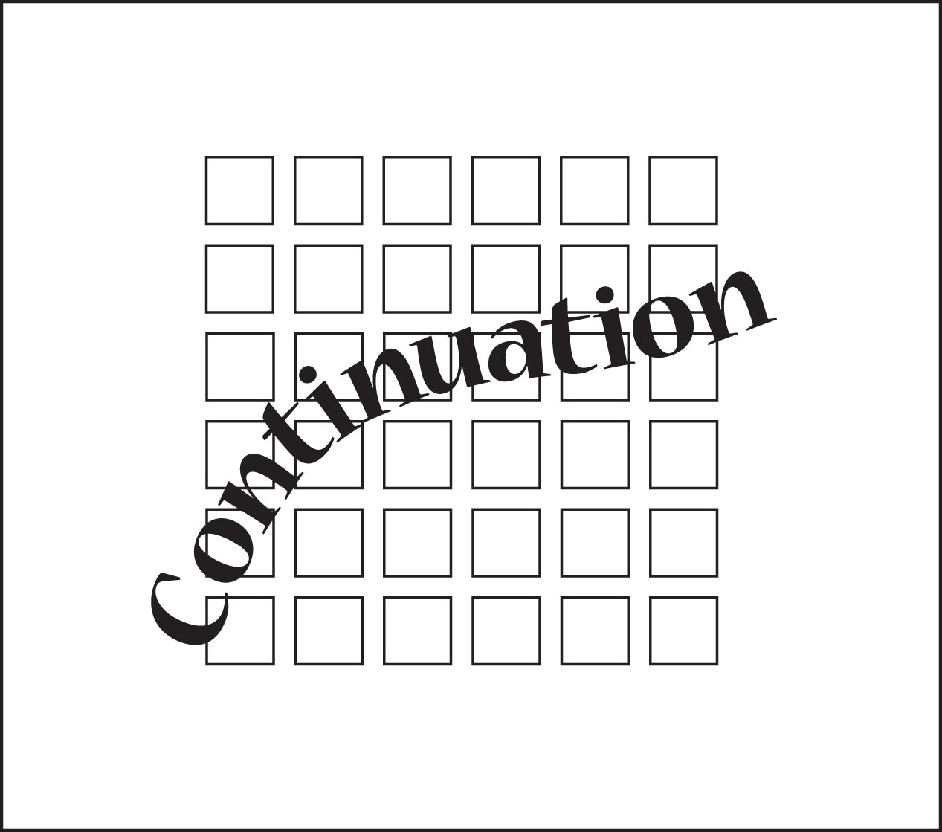
Gestalt Law: Continuation (2 of 2)
• Continuation occurs even when the eye tracks over negative and positive shapes.

Slide 32
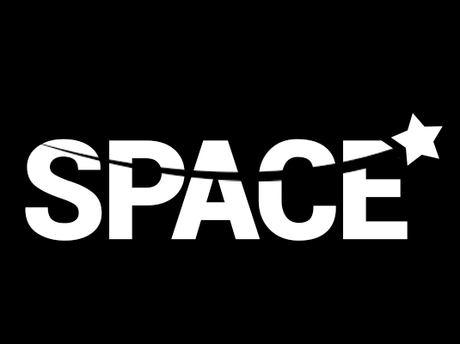
Continuation

Slide 33
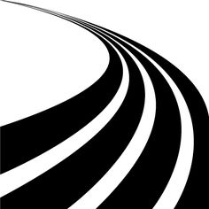
Continuation

Slide 34
Continuation

Slide 35
Continuation

Slide 36
Continuation

Slide 38
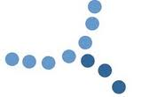
Continuation
The lighter blue line of dots are visually preferred because they move in one direction, the curved line giving it a relaxed feeling even though they are separate shapes.

Slide 39
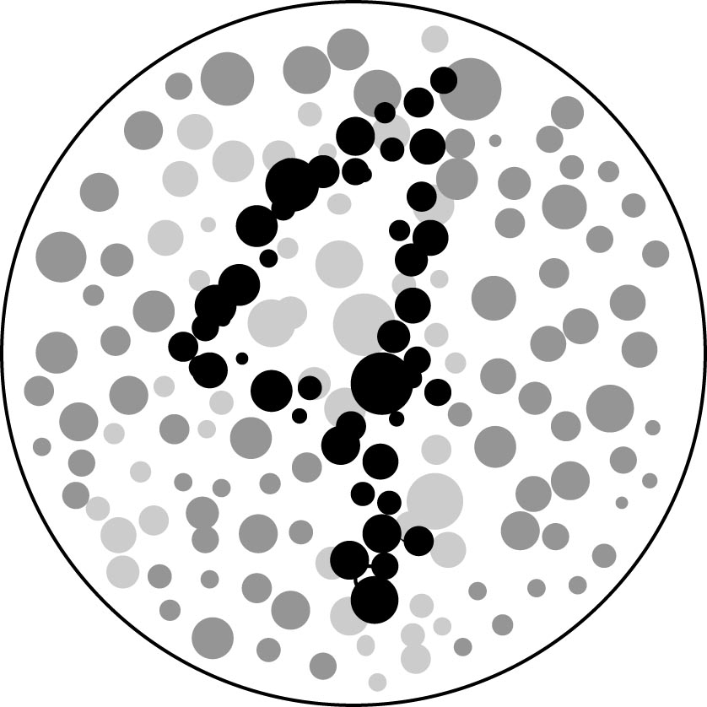
Gestalt Law: Similarity (1 of 2)
• Visual elements similar in shape, size, color, proximity, motion, and direction are perceived as part of a group.
• This gestalt law draws heavily on the design principle of repetition.

Slide 40
Gestalt Law: Similarity (2 of 2)
• We seek patterns, easily grouping the black dots into a number 4.

Slide 41
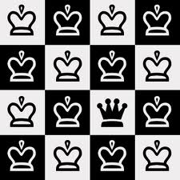
Similarity
If this image only contained the rounded crowns, our brain would group them as two different sets, black and white crowns. But there’s another element- the one pointed crown. That one is not like the others, so the similarity of the black and white rounded ones is strengthened. The pointed crown is the outcast.

Slide 42
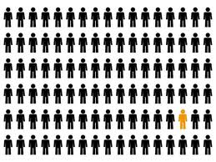
Similarity 2
This image also exemplifies similarity in that the little black people are seen as one group, and the yellow is another. Although all the same shape, our brain organizes then into two groups. One of these things is not like the other.

Slide 43
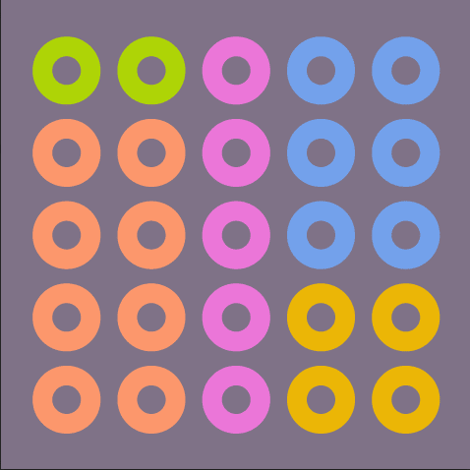
Our mind perceives the similarly colored circles not as individual circles but as combining to form rectangles, squares and lines separate from those of another color.
Similarity

Slide 44
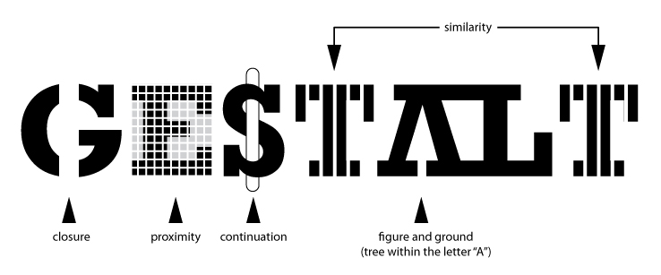

Slide 45
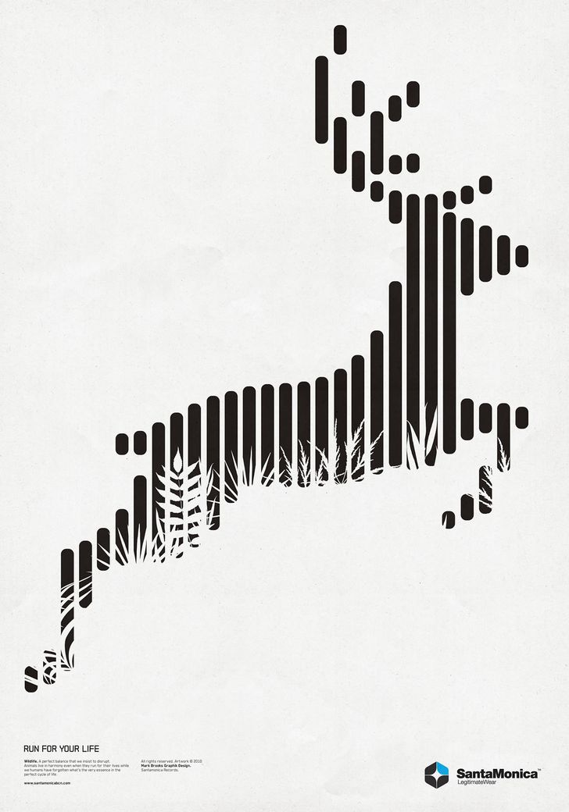
Our mind perceives each of the proximate vertical bars to combine and form a single image of a deer.
Proximity & Closure

Slide 46
The principle of continuity seems very obvious but we rarely pay conscious attention to it when it’s used in visual presentation. It indicates that our brain tends to follow continuous lines and unified shapes, even when they are made of disconnected dots and lines.
In an classic advertising example below, our brain perceives the fragmented lines as a continuous whole, which makes the IBM logo even more iconic and symbolic of unification than its previous versions. Leveraging the law of continuity, the logo made of stripes of the same color creates an enduring impression.
Similiarity-Continuity-Proximity & Closure

Slide 47
What is the Principle of Repetition?
• The principle of Repetition is formed by repeating visual elements such as lines, shapes, images, textures, and so on.

Slide 48
Why Use Repetition? (1 of 2)
• Repeating visual elements forms a visual rhythm
• Repetition strengthens a design and makes it more unified and cohesive.
• Use of repetition implies to the reader that there is a consistent organizational scheme in place.
• Visual elements do not need to be identical to invoke repetition.

Slide 49
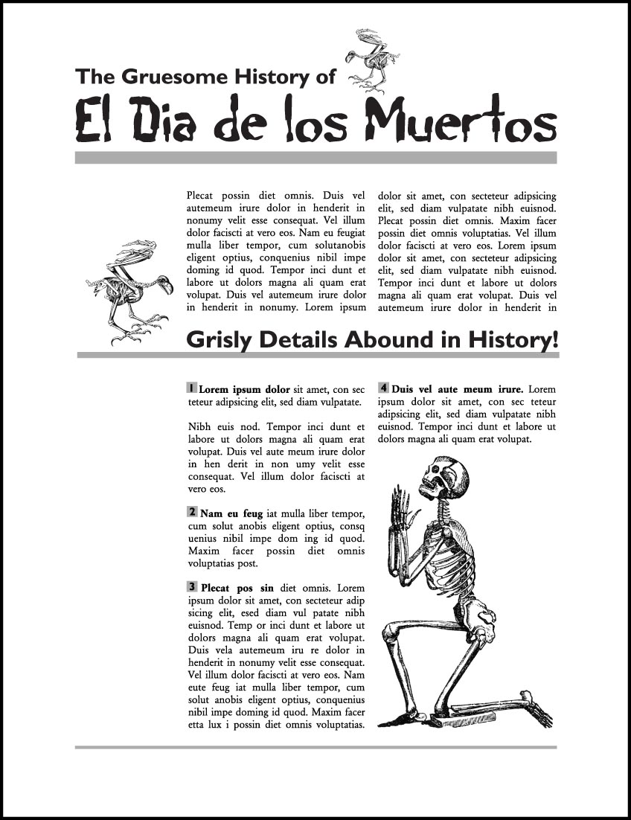
Why Use Repetition? (2 of 2)
• Visual elements can vary yet still invoke repetition.
• The gray rule lines vary in thickness, yet still form a repeating pattern.
• The skeletons are conceptually related and form a unified repeating motif.

Slide 50
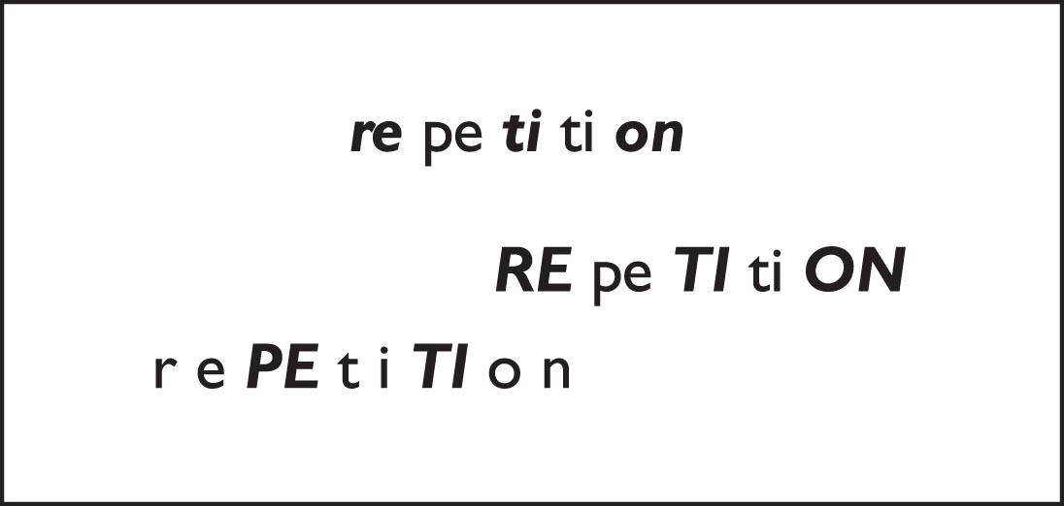
Repetition Example (1 of 5)
• Key to successful repetition is selecting which elements to repeat.
• Simple changes to letters in a word can change how the word “sounds” in the reader’s mind.

Slide 51
Repetition Example (2 of 5)
• Visual elements do not have to be identical to form a sense of repetition
• Visual elements that are similar and conceptually related invoke the principle of repetition.

Slide 52
Repetition Example (3 of 5)
• The illustrations are similar in style and concept (all delicate objects) and give the impression of repeating elements.
• Repeating the top of the column in the background and in the logo unifies the design.

Slide 53
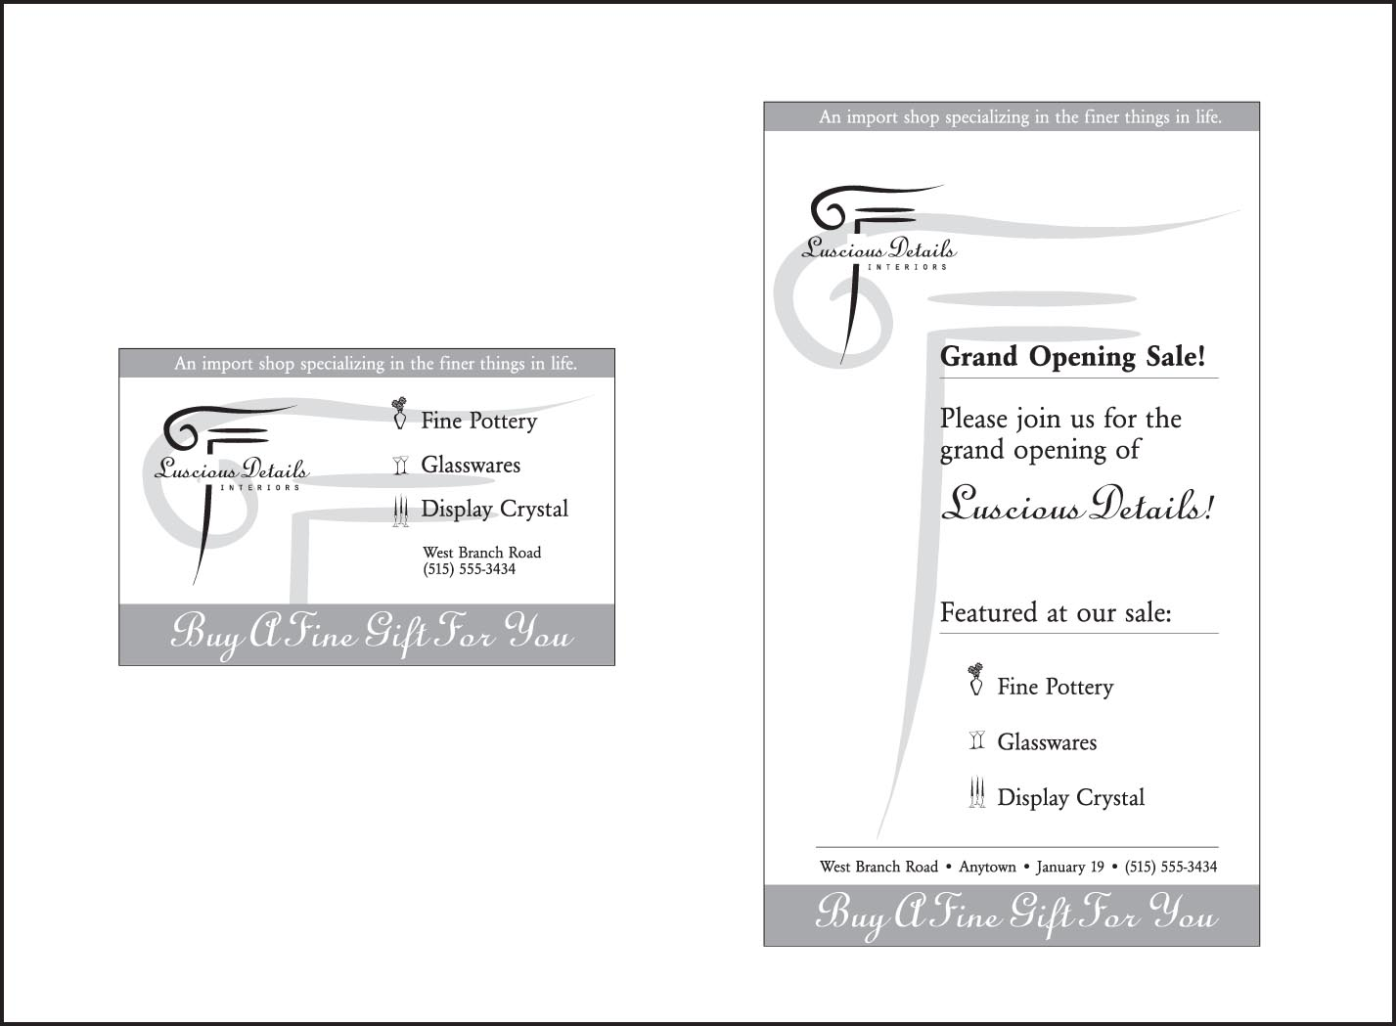
Repetition Example (4 of 5)
• Using repeating elements across two different types and sizes of pages helps unify them.

Slide 54
Repetition Example (5 of 5)
• Setting and consistently using a typographic master plan unifies designs across single or multiple page documents.
• A good typographic master plan speeds design decisions and simplifies type choices.
• Consistent use of only a few typefaces forms a strong repeating element that dramatically strengthens designs.

Slide 55
Too Much of a Good Thing (1 of 2)
• It is possible to overuse repetition
• Repeating exactly the same element can result in a crowded and boring layout.
• Slightly varying visual elements relieves visual boredom, i.e. instead of one single thickness of line using several thicknesses of lines.

Slide 56
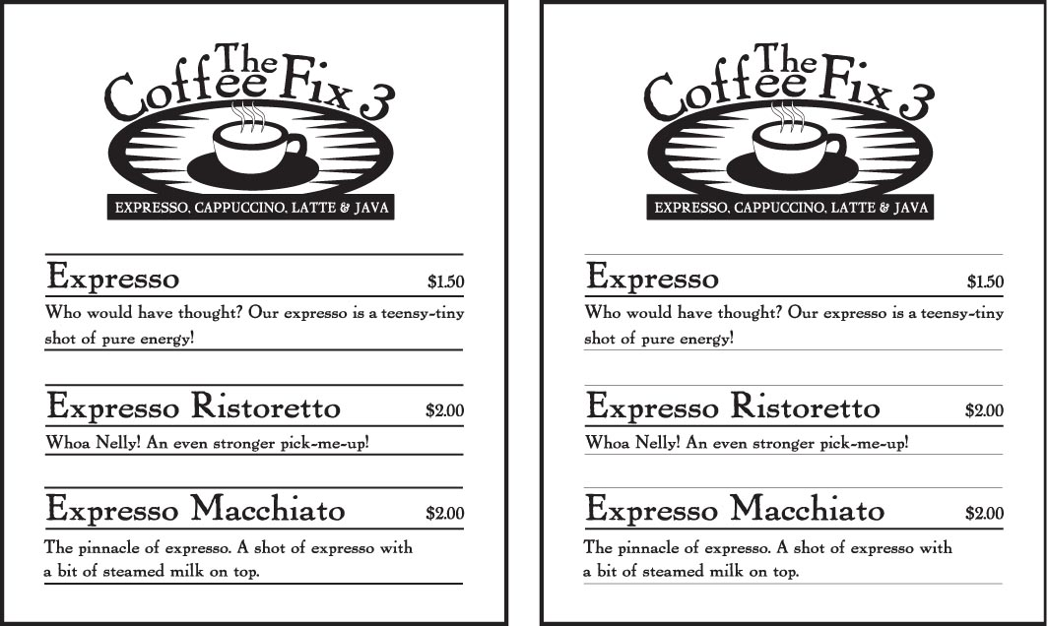
Too Much of a Good Thing (2 of 2)
• Slightly varying visual elements relieves visual boredom.
• The left image uses one thickness of line, which becomes overly repetitive.
• The right image consistently uses several thickness of line, adding visual interest.

Slide 57
Chapter Summary
• Repetition is achieved by repeating lines, shapes, images, colors, textures, and other visual elements on a page.
• Good repetition can unify single or multiple-page designs.
• The principle of repetition works best when used with other design principles

Slide 58
Compare the two logos below. One of the figures has an overall better gestalt and seems more unified? Name 3 of the 5 incidences of repetition in the figure on the right.

Slide 59
• Unity is achieved when all the elements on a page look like they belong together. • Unified designs make it easier for a reader to read, remember, and absorb the message. • The human eye seeks patterns and the unifying visual connections between elements.
Unity and Gestalt (1 of 4)

Slide 60
Unity and Gestalt (2 of 4)
• The principle of repetition draws on the ability of the human mind to see patterns and draw conclusions.
• When we see things that are the same or similar, we naturally see visual connections between elements.

Slide 61
Unity and Gestalt (3 of 4)
• In the early 1900’s German psychologists coined a term “Gestalt” to explain why a strongly unified design seems greater than its individual parts.
• Designers use the term gestalt to refer to a structure, configuration, or layout whose specific properties are greater and more unified than the simple sum of its individual parts.

Slide 62
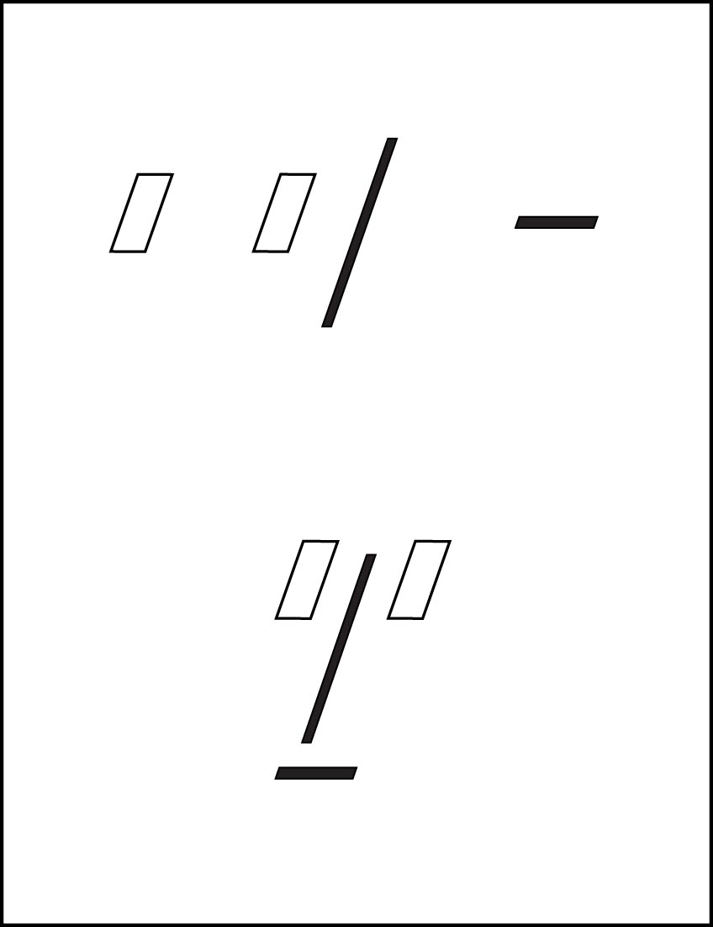
Unity and Gestalt (4 of 4)
• The top figure shows individual parts.
• The bottom figure shows gestalt in action.
• When the individual parts are placed in close proximity, we see a “face”.

