Slide 1
How to develop your
Visual Branding Strategy
Powerpoint Templates

Slide 2
What’s
yours?

Slide 3
What is Visual Content?
Eye-catching images
Educational videos
Infographics
Images are social media friendly

Slide 4
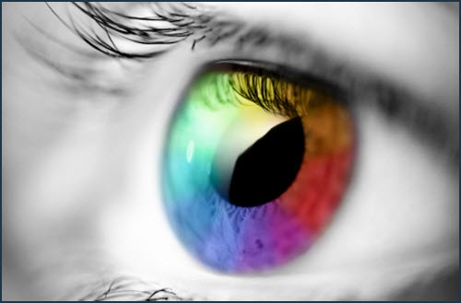
What is Visual Content?
90% of information transmitted to the brain is visual. Visuals are processed 60,000X faster in the brain than text.

Slide 5
Do customers love images?
Let us count the ways ….
Image Posts receive 94% more page visits and engagement than those without.
60% are more likely to click on a
business whose images appear
in search results.
67% consider detailed images carry more weight than product information or customer ratings.

Slide 6
Develop your company’s Visual Story
Try answering the following questions to start developing your company’s visual story.
Don’t use technical terms like SEO or ROI.
Get out your thesaurus to find words that are more descriptive!

Slide 7
Develop your company’s Visual Story
What does your company’s name mean?
Does it have a different meaning or a play-on-words?

Slide 8
Develop your company’s Visual Story
What do your most loyal customers
love about your company?

Slide 9
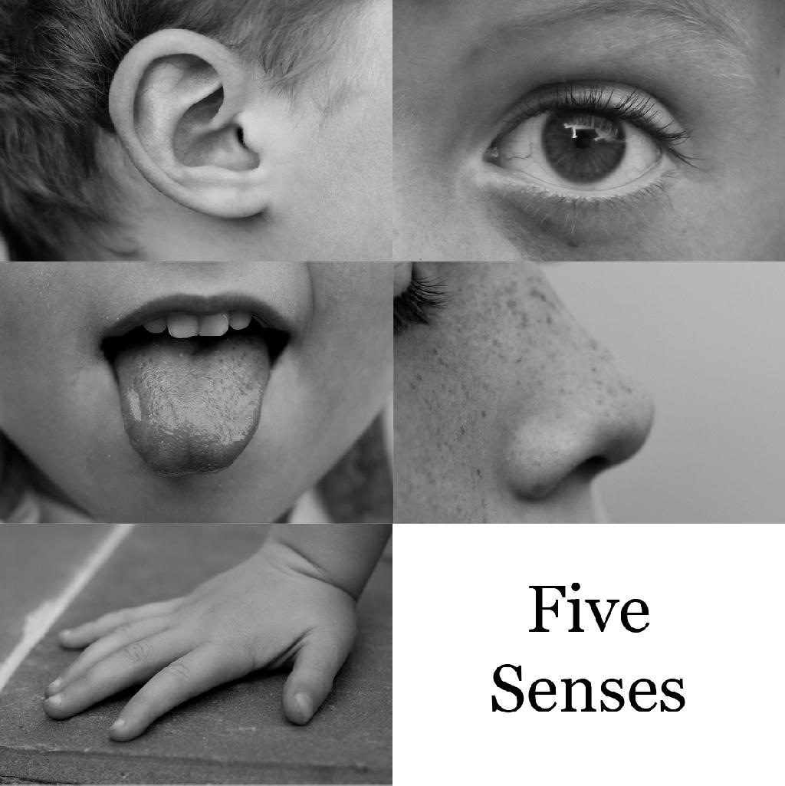
Develop your company’s Visual Story
Think in terms of your five senses.
If you had to describe your company using your senses, what images, colors, textures or even smells come to mind?

Slide 10
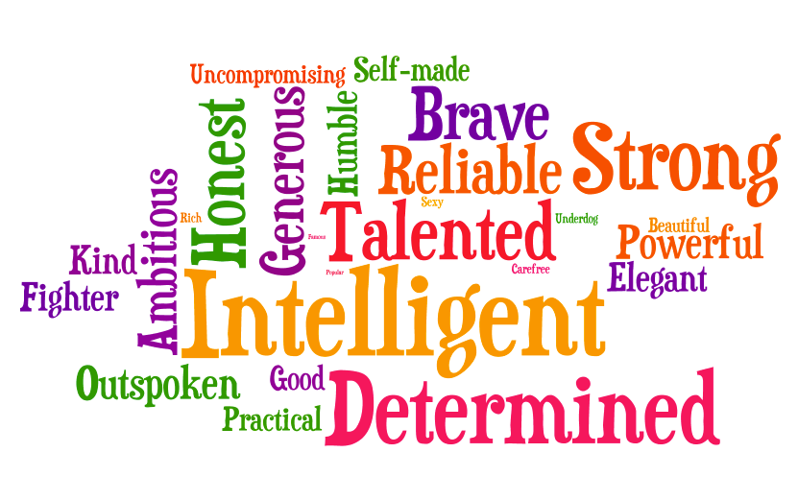
Develop your company’s Visual Story
Can you name five adjectives that describe your company’s personality?

Slide 11
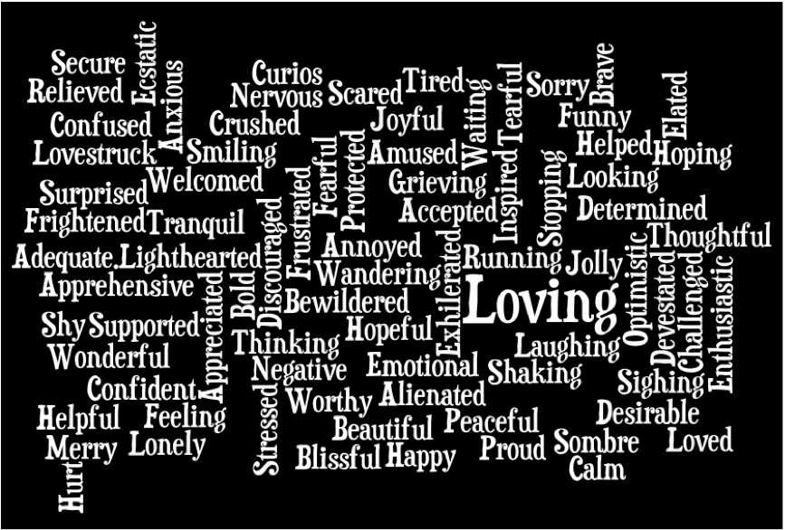
Develop your company’s Visual Story
Try to avoid the literal meaning of these images but instead focus on colors, textures, objects and the feelings they evoke.

Slide 12
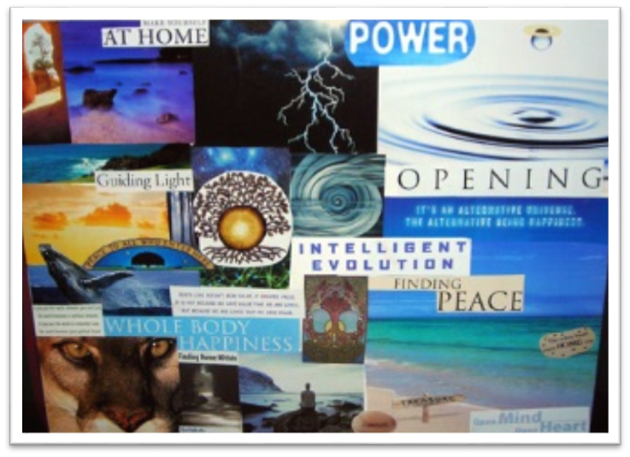
Develop your company’s Visual Story
Use your answers to create a collage of images that represents your company.
Pinterest boards –
pinning images using
your words
Poster board - cutting out
pictures and pasting them

Slide 13
Develop your company’s Visual Story
Keep your answers and image ideas together so you'll be able to pull them out the next time you're planning a marketing campaign.

Slide 14
When your marketing message has a consistent look and feel, your campaigns will begin to connect with more people. They'll see your company as more than just the latest special you're running this month.
When that happens, your customers won't just tell others about your products or services.
They'll share your story.

Slide 15
Your Assignment: 3 Week Timeline
CREATE A VISUAL BRANDING CAMPAIGN
(Vector Logo, Business Card, 11 x 17 Poster,
& Brochure/or A One Minute Video For:
An Existing/or Imaginary Business
a School Group/Club/ or Class
an Organization in our Community that
needs some visual branding….

Slide 16
Your Assignment: 3 Week Timeline
CREATE A VISUAL BRANDING CAMPAIGN
(Vector Logo, Business Card, 11 x 17 Poster,
& Brochure/or A One Minute Video——
That is 3 required deliverables & 1 deliverable where you have a choice

Slide 17
Weekly Checklist Grade is 20 Points-
Submission Approval of Your Designs is required
by Mr Shelor
Assignment Starts - Monday April 6th, 2015
Final Deliverables Due- on Friday April 24th, 2015
Daily Participation Grade is 10 Points unless absence is excused
Final Project Submission is worth 200 points

