Slide 1
AC Core
What I Learned
Nai’a Bentley Hemsher
Pd 5

Slide 2
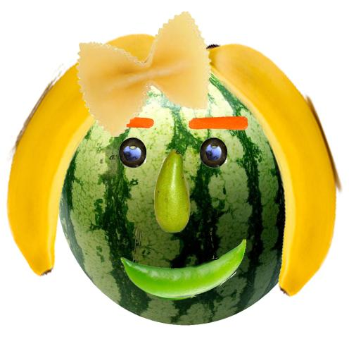
Veggie
Woman
This was one of the first “real” assignments we did, we learned how to cut out shaped/pictures and how to layer photos to make one photo as a whole.

Slide 3
Flash Animation
This flash animation was very tedious, and way too much work for how short it was. This assignment made me appreciate cartoons and animations much more.

Slide 4
Lighthouse
In this assignment we learned how to use many features on Photoshop, including spot healing brush, layers, and text tool.

Slide 5
Justin
Bieber
For this assignment, we learned how to use the spot healing tool, layers, and how to cut out specific pieces of photos.

Slide 6
Magazine Cover
In this assignment, we learned the importance of using one font for a title and one font for everything else, we also used layers, and cut a picture out.

Slide 7
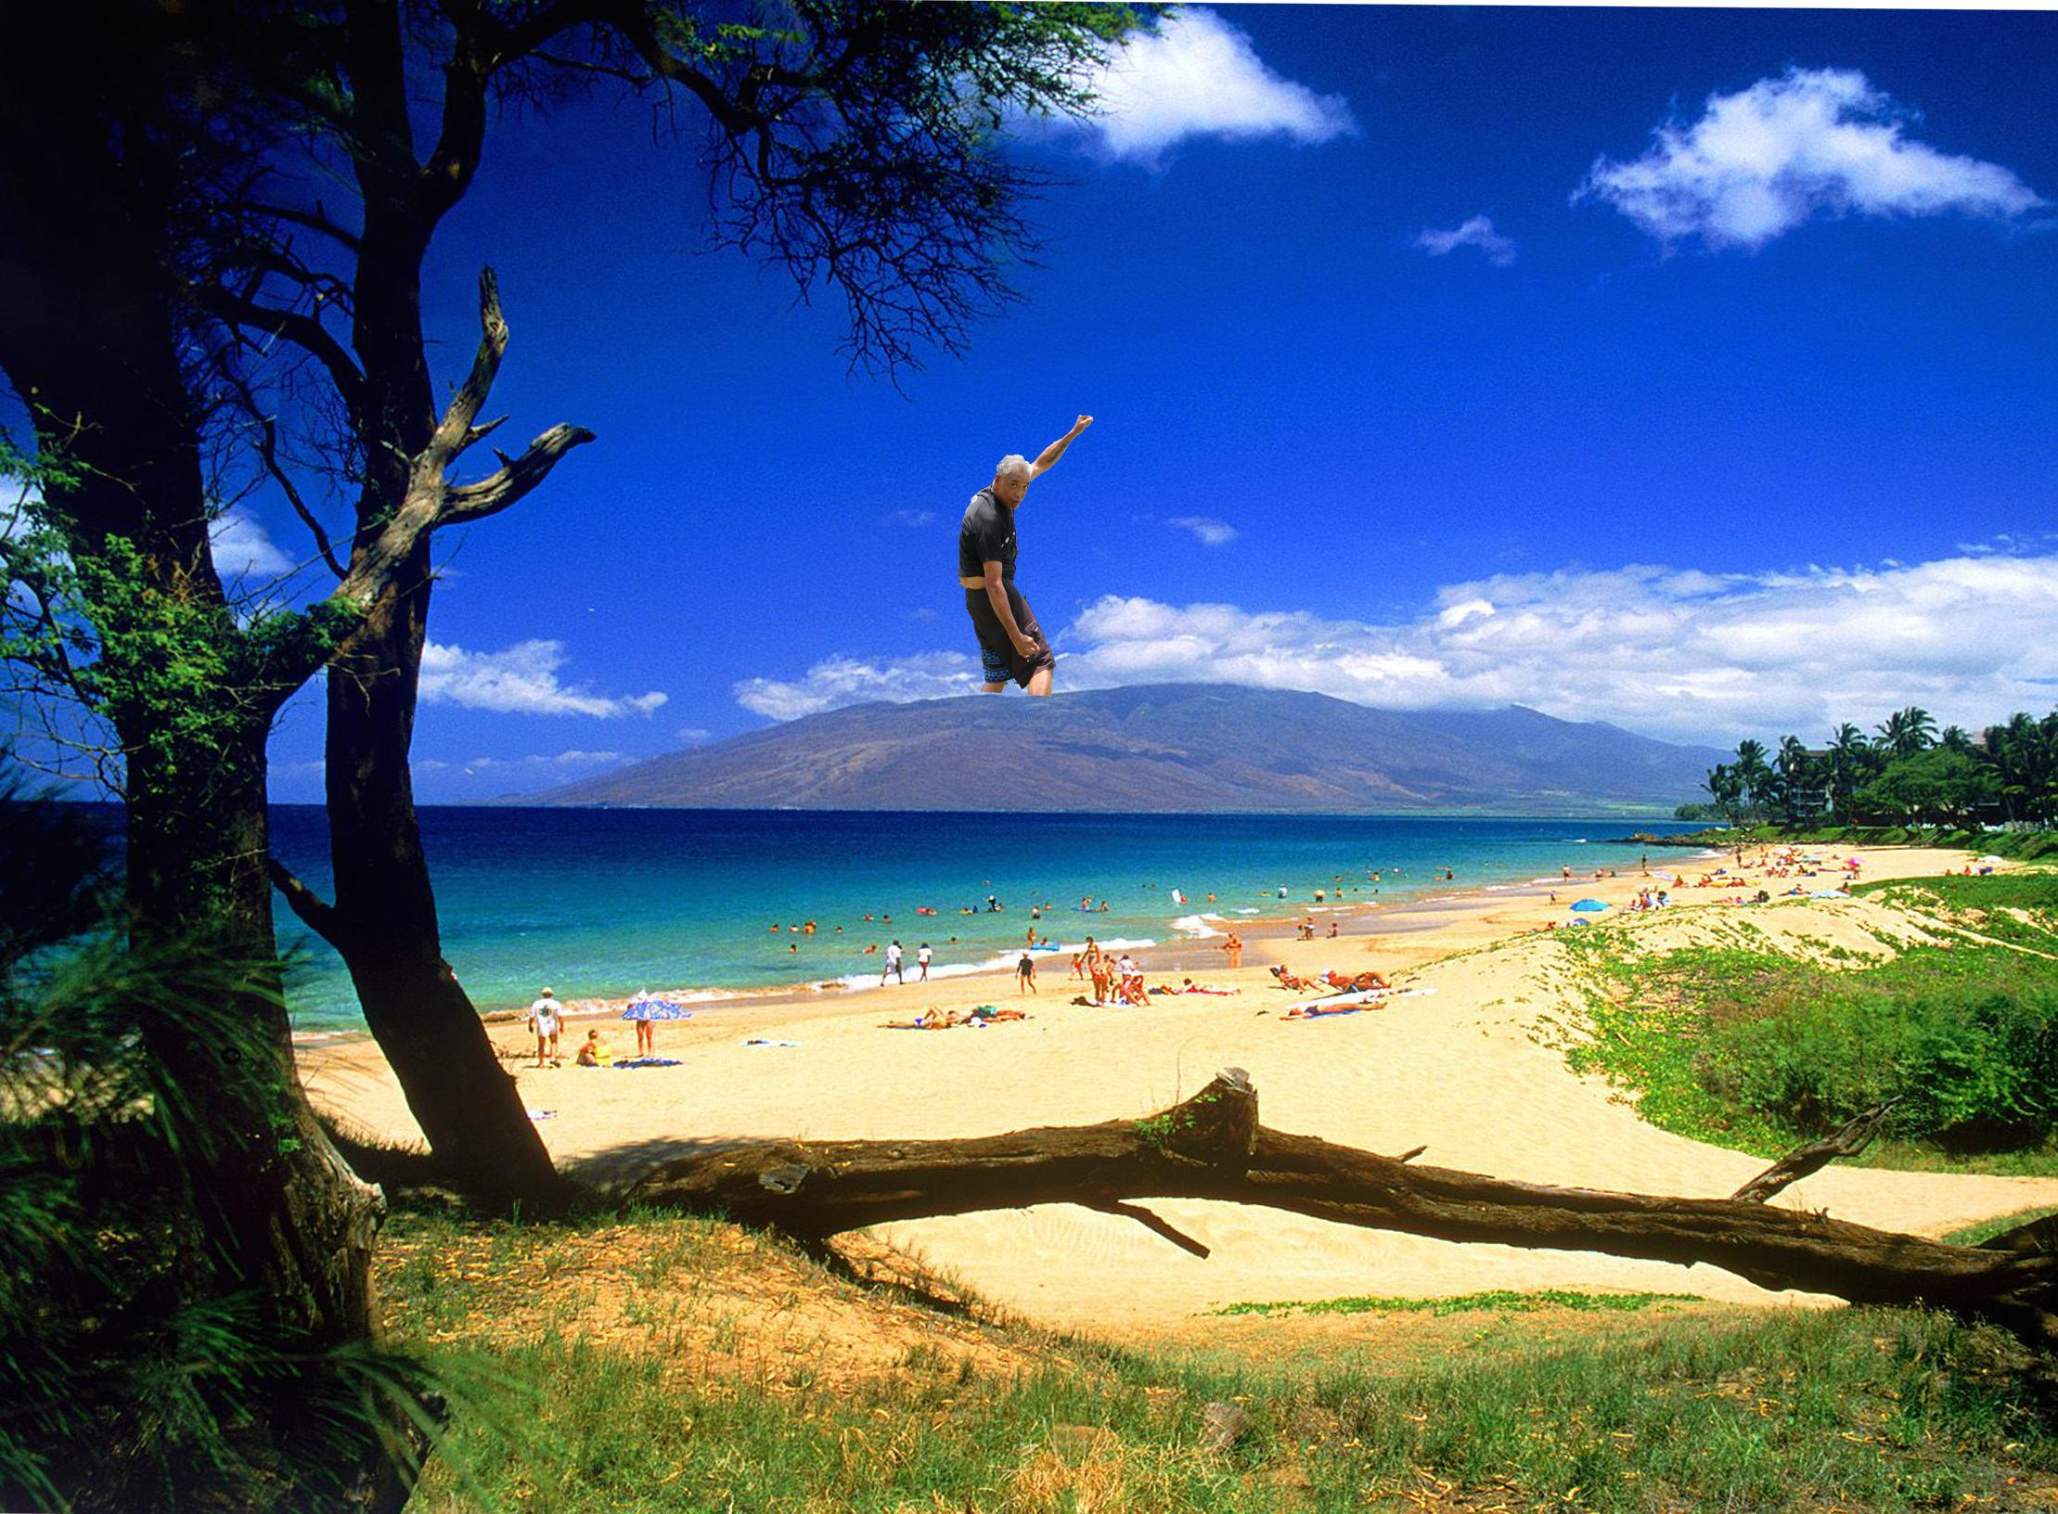
Kalei
on Maui
In this project we learned how to cut someone out with a messy background.

Slide 8
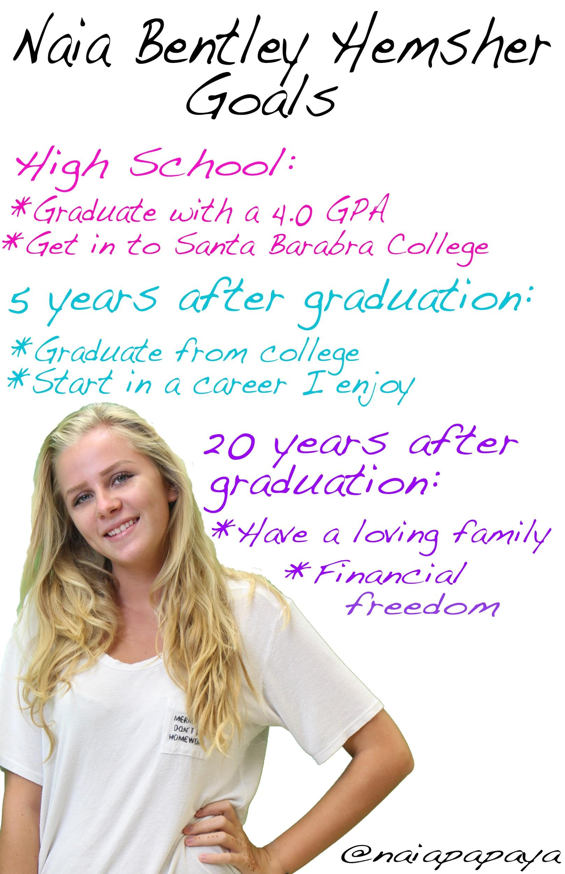
Goals
Poster
This project dealt mostly with the text tool but also helped finalize our skills of layers and cutting out an image.

Slide 9
Brush
Tool
This assignment was us just playing around and experimenting with different types of brushes.

Slide 10
Thanksgiving
Card
This assignment had us be really creative and we all used different techniques to create our final project. My card was mostly the text tool, but I also cut out an image.
Outside of card
Inside of card

Slide 11
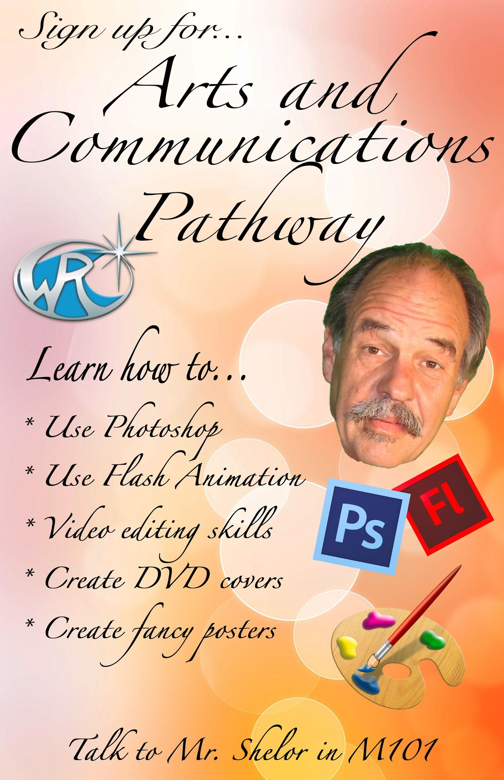
AC Core
Poster
This project was to create a poster reaching out to the appropriate audience and to try to get them to sign up for AC Core. We used the text tool and had to cut out images.

Slide 12
DVD
Cover
This project put all we have learned to the test. We used just about every skill we had learned all year. This project took the most time and effort, definitely is my best work for this class so far.
HOM used:
Creating-Imagining- Innovating

Slide 14
My “Side Projects”

Slide 15
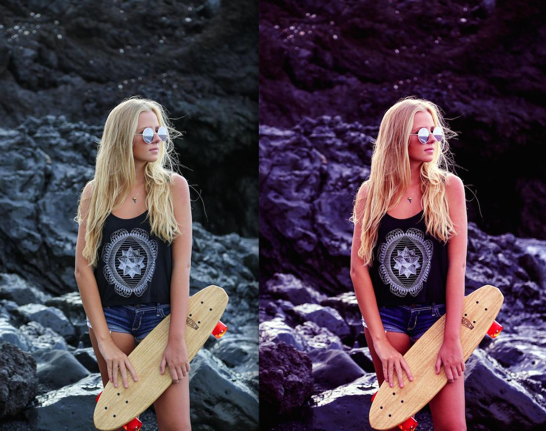
Layers
and Colors
I did this while experimenting with layers, levels, colors, and all that sort of stuff.

Slide 16
Cut
and Place
I did this while learned how to cut out images and place it on another image.

Slide 17
Tyzay
Sticker
This is when I learned how to use the sticker tool to create my own sticker out of an image.

Slide 18
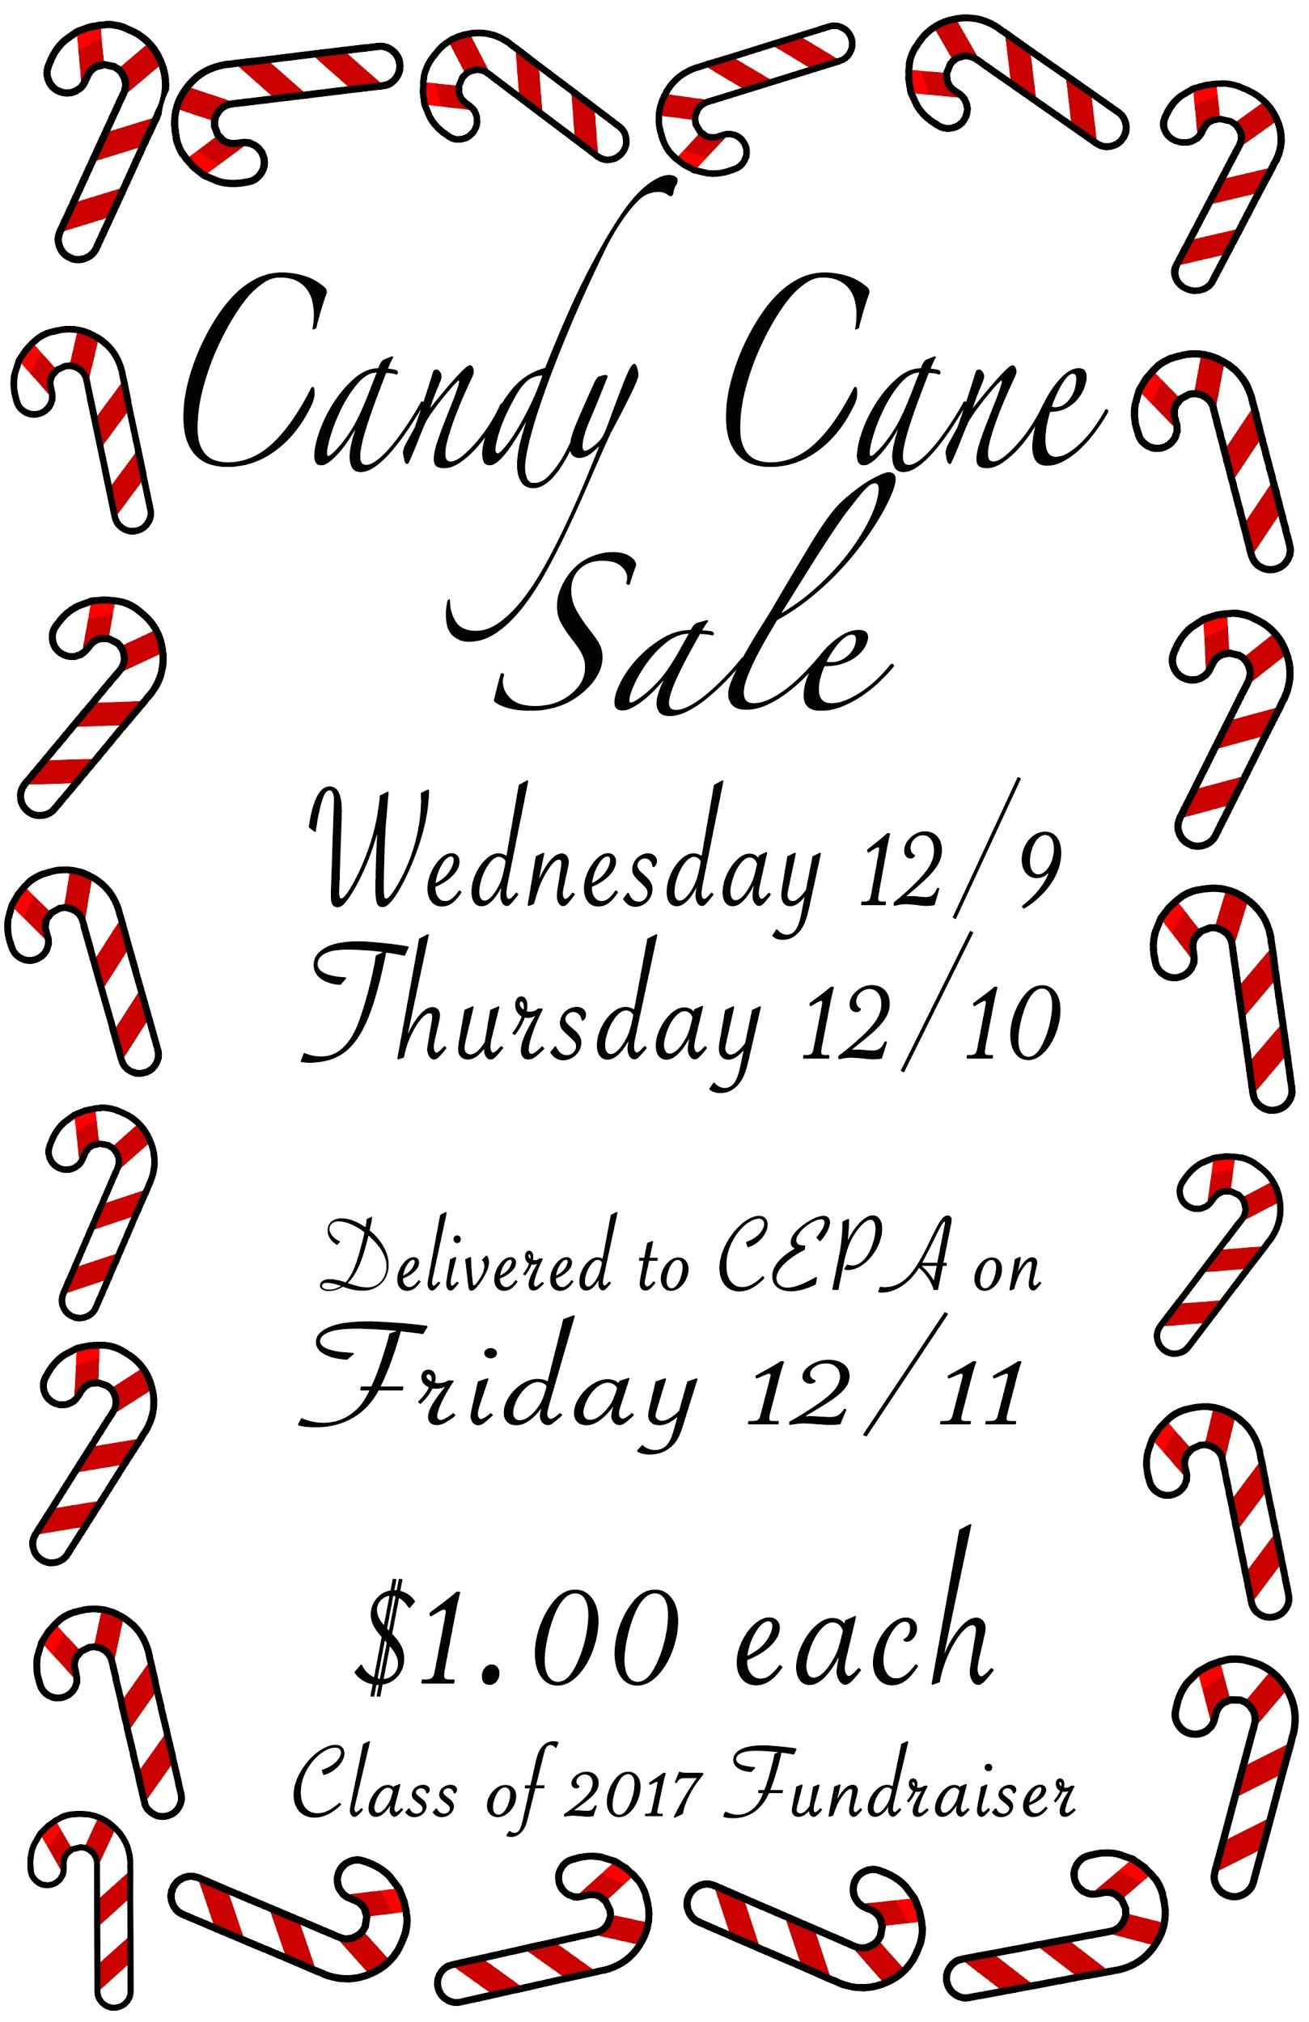
Candy Cane
Poster
This little poster was done for the Junior fundraiser i'm holding, we were selling candy canes.

