Slide 1
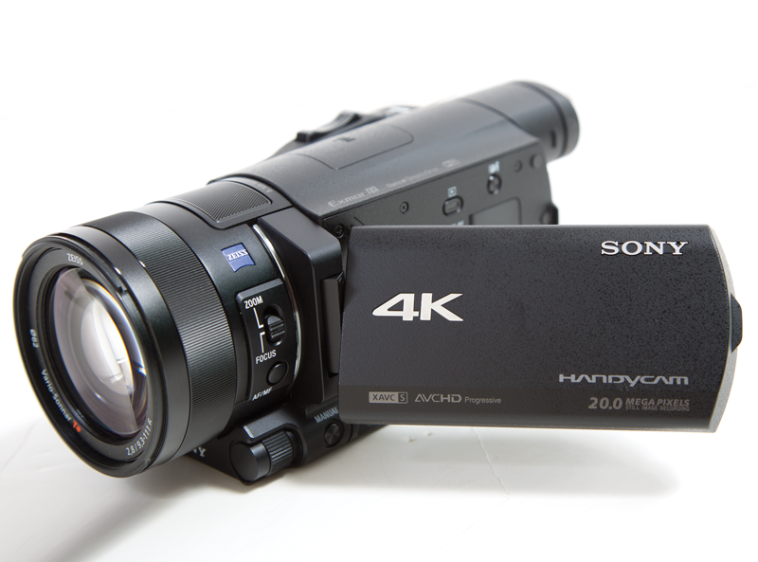

Video Production 101

Slide 2
Contents
3 Phases of Production
Gear/Equipment
Terms
Rules
Camerawork basics
Tips

Slide 3
3 Production Phases
Pre-Production
Production
Post Production

Slide 4

3 Production Phases
1. Pre-Production
It covers everything that happens before the cameras roll.
This is when you brainstorm, storyboard, solidify the idea, develop a concept,
write the script, create a shot list, location scouting, securing props and sets.
Brainstorm-Develop Story/Video Idea
Storyboard
Write The Script
Find/Secure Actors/Talent
Shot List
Wardrobe/Prop Needs
Location Scouting
Equipment Prep/Checklist

Slide 5

3 Production Phases
2. Production
On the actual shoot, the “Production” phase, someone is responsible for camera operation, lighting, sound, make-up and directing the action while being certain the planned scenes transition properly (continuity). Someone also may be logging (keeping track) of which recorded shots are the ones that will be used and monitoring the script to be certain every required shot is accomplished
Acting-Shooting-Lighting-Sound
Make-Up-Directing

Slide 6
3 Production Phases
3. Post Production
This is the editing phase and today this is done on computers with lots of hard drive storage.
The selected takes are digitized, trimmed, and arranged on a timeline in editing software. Animations, transitions between shots, graphics, voiceovers, music and all the other required pieces are created, added, timed, paced and manipulated in the computer. If a voice-over (VO) for narration is done, it will typically be in a sound booth or sound studio with the voice timed to the action in the script. It is also in this phase where the finished video can be encoded into a format where it can be viewed on the web and possibly streamed.
Editing-Animating-Voice-Overs-Color & Sound Correction
Rendering-Exporting-Distributing for Web/HD

Slide 7
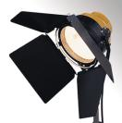
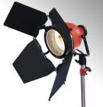
Types of Lights
Blonde
2000 watts
yellow
Redhead
800 watts
red

Slide 8
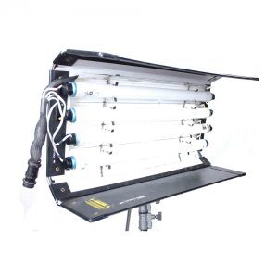
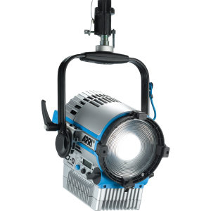
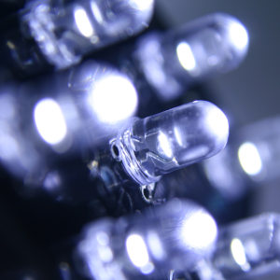
Lighting For Video Production
Fluorescent Lights
A fluorescent lamp uses the excitement of low pressure mercury vapor to produce ultra-violet light, in turn causing a phosphor coating on the inside of the glass tube to glow giving off light in the visible spectrum.
LED Lights
LED stands for light emitting diode and is a solid-state semiconductor device. Only recently, LED’s of sufficient power have become available to make practical LED film lighting possible. LED’s are extremely efficient but are still limited in overall light output when compared to any of the other light sources.

Slide 9


What is a Dolly?

Slide 10
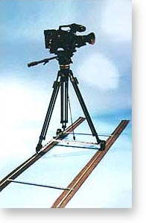
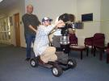


Dolly
A cart/wheels that the camera and crew sits on to create smooth camera movement over uneven surfaces.

Slide 11
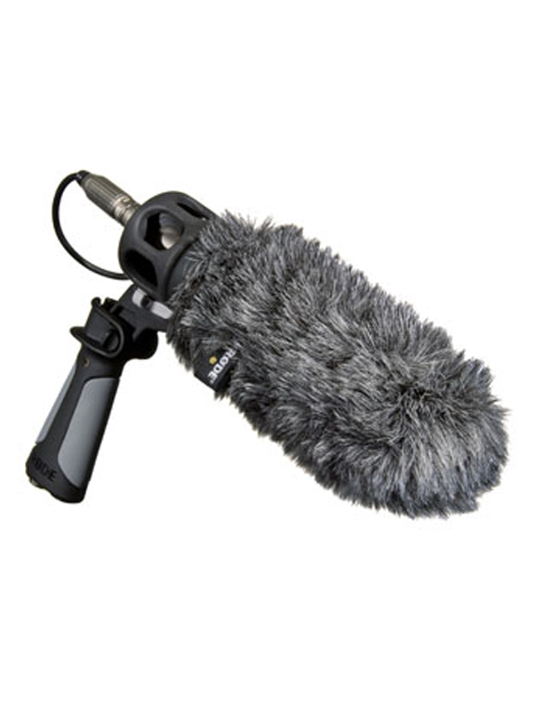
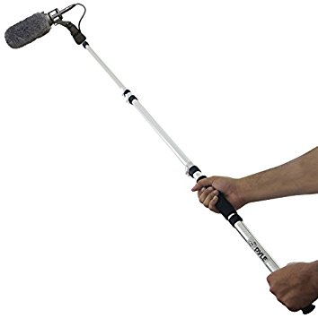
Boom Microphone.
  A microphone attached to a rod or boom pole, and held close to the subject without getting into the shot. To get better sound quality

Slide 12
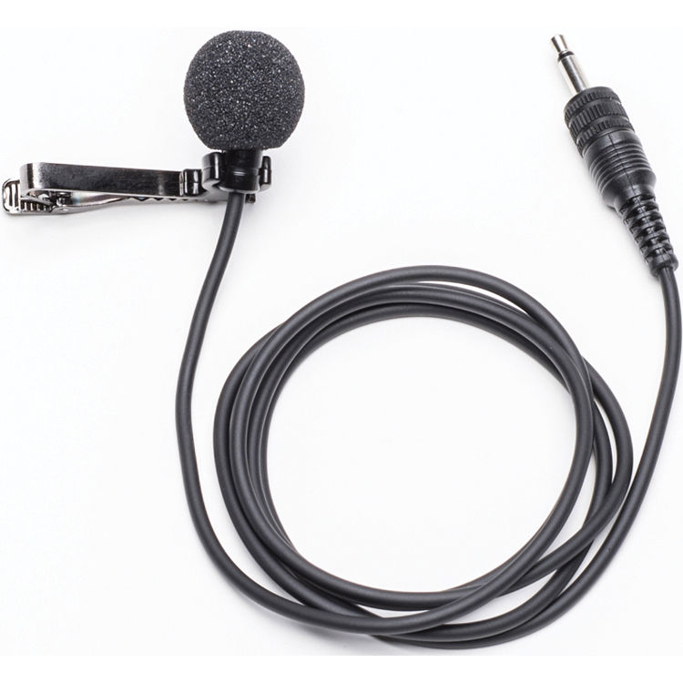
A lavalier microphone (or lavalier (also known as a lav, lapel mic) is a small microphone used for speaking applications in order to allow for hands-free operation. They are most commonly provided with small clips for attaching to collars, ties, or other clothing.

Slide 13
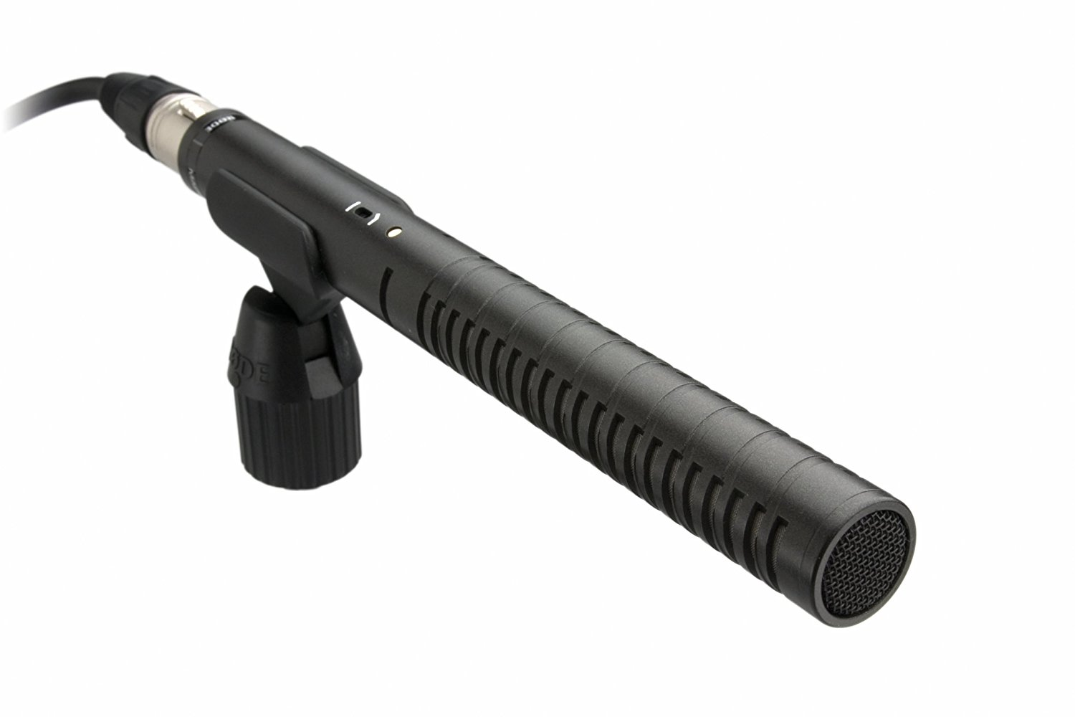
Yo
Shotgun Microphone
* Effective on-camera tool for sound capture,
* Ability to reject sound from the sides and rear
* Prioritizes the sound in front of the mic.
https://www.bhphotovideo.com/explora/audio/buying-guide/shotgun-microphones

Slide 14
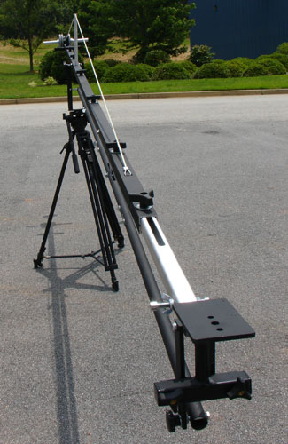
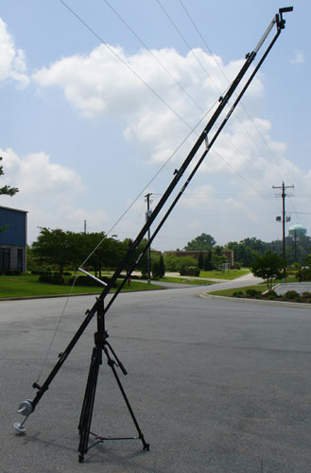
Jimmy Jib
A mini crane which creates high angle and low angle shots.

Slide 15
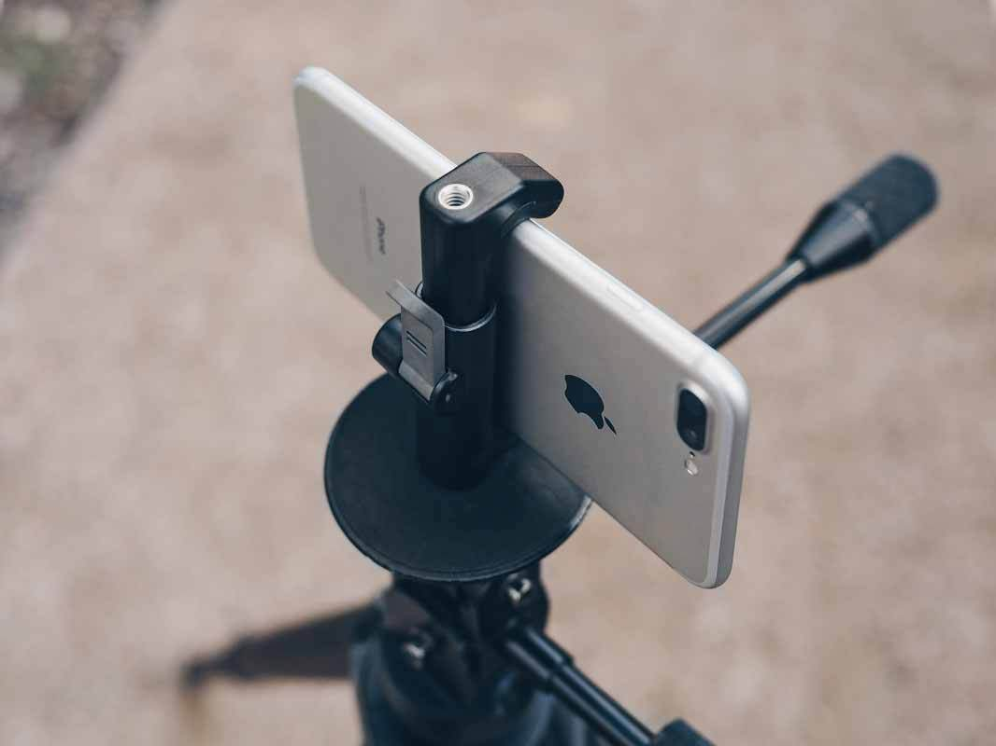
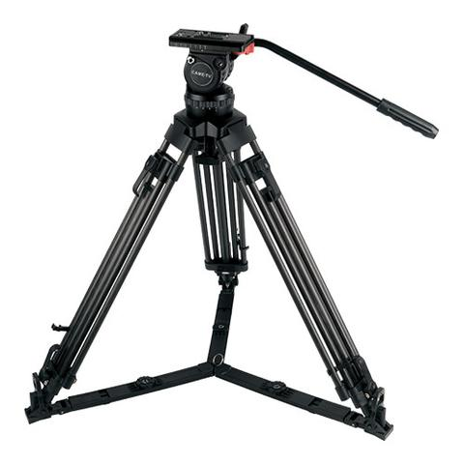
Tripod
a three-legged stand for supporting a camera or other apparatus

Slide 16
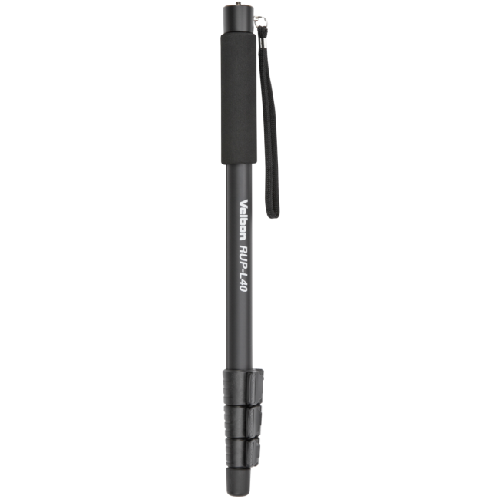
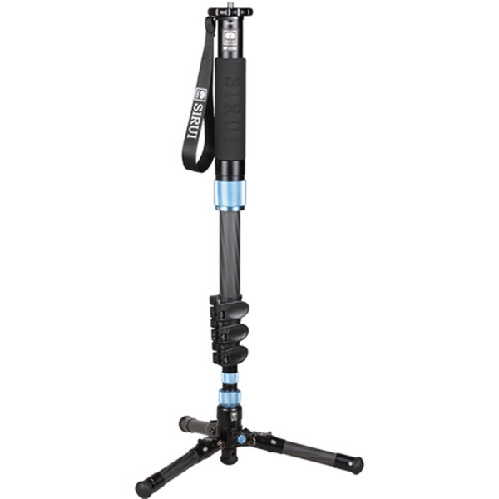
Monopod
a one-legged support for a camera or fishing rod.
New Type of Monopod
w/Feet

Slide 17
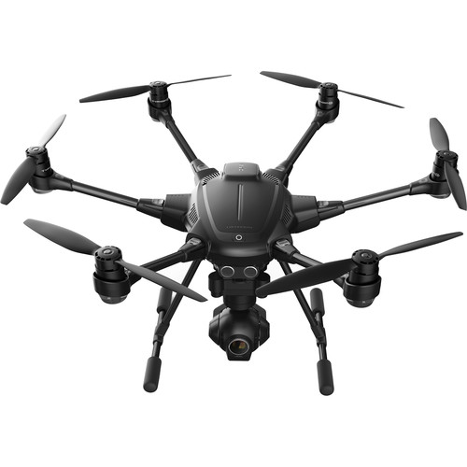
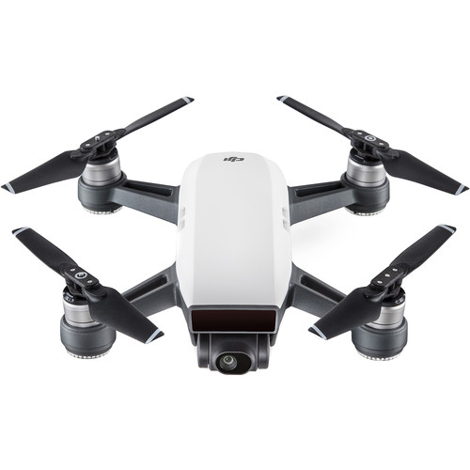
Aerial Drone
Drone aerial photography is the latest way to film from above
(Birds Eye View)..and is relatively inexpensive

Slide 18

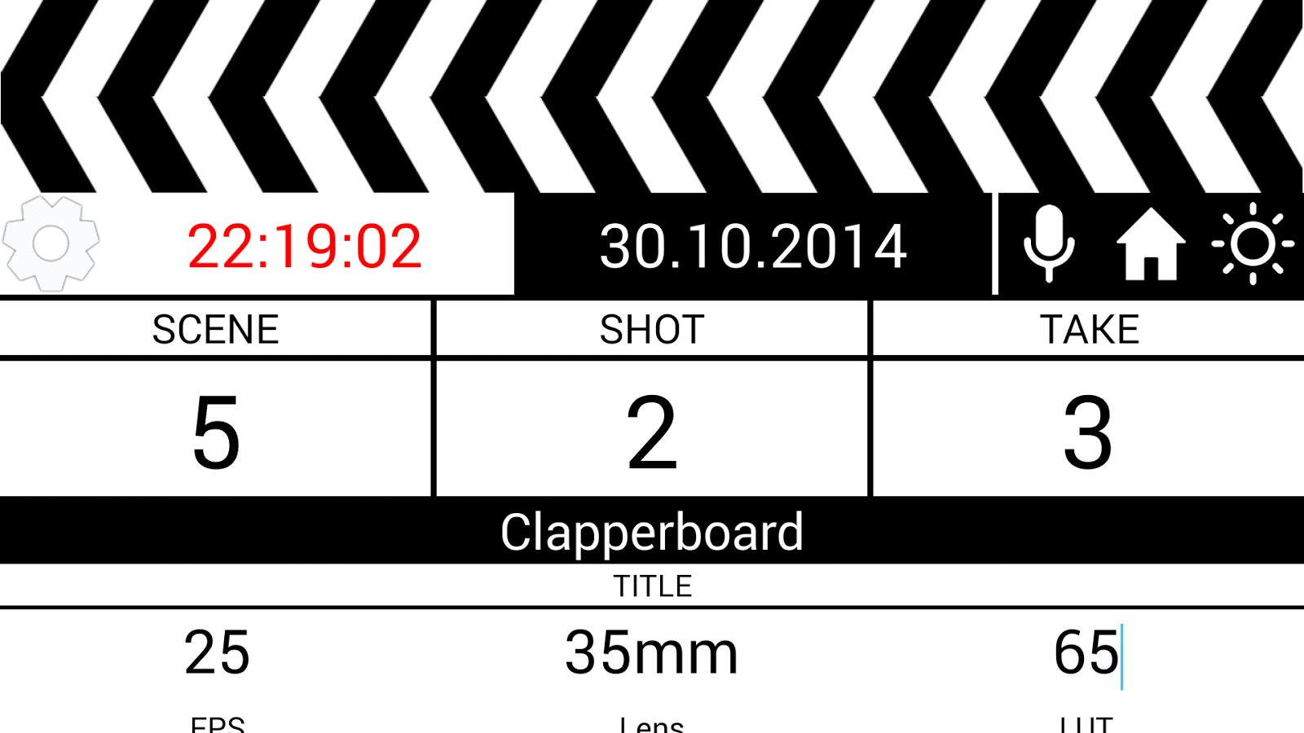
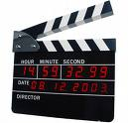
A Clapperboard/Slateboard
  Records all the vital info for the editor.
  (scenes, shots, takes,)

Slide 19
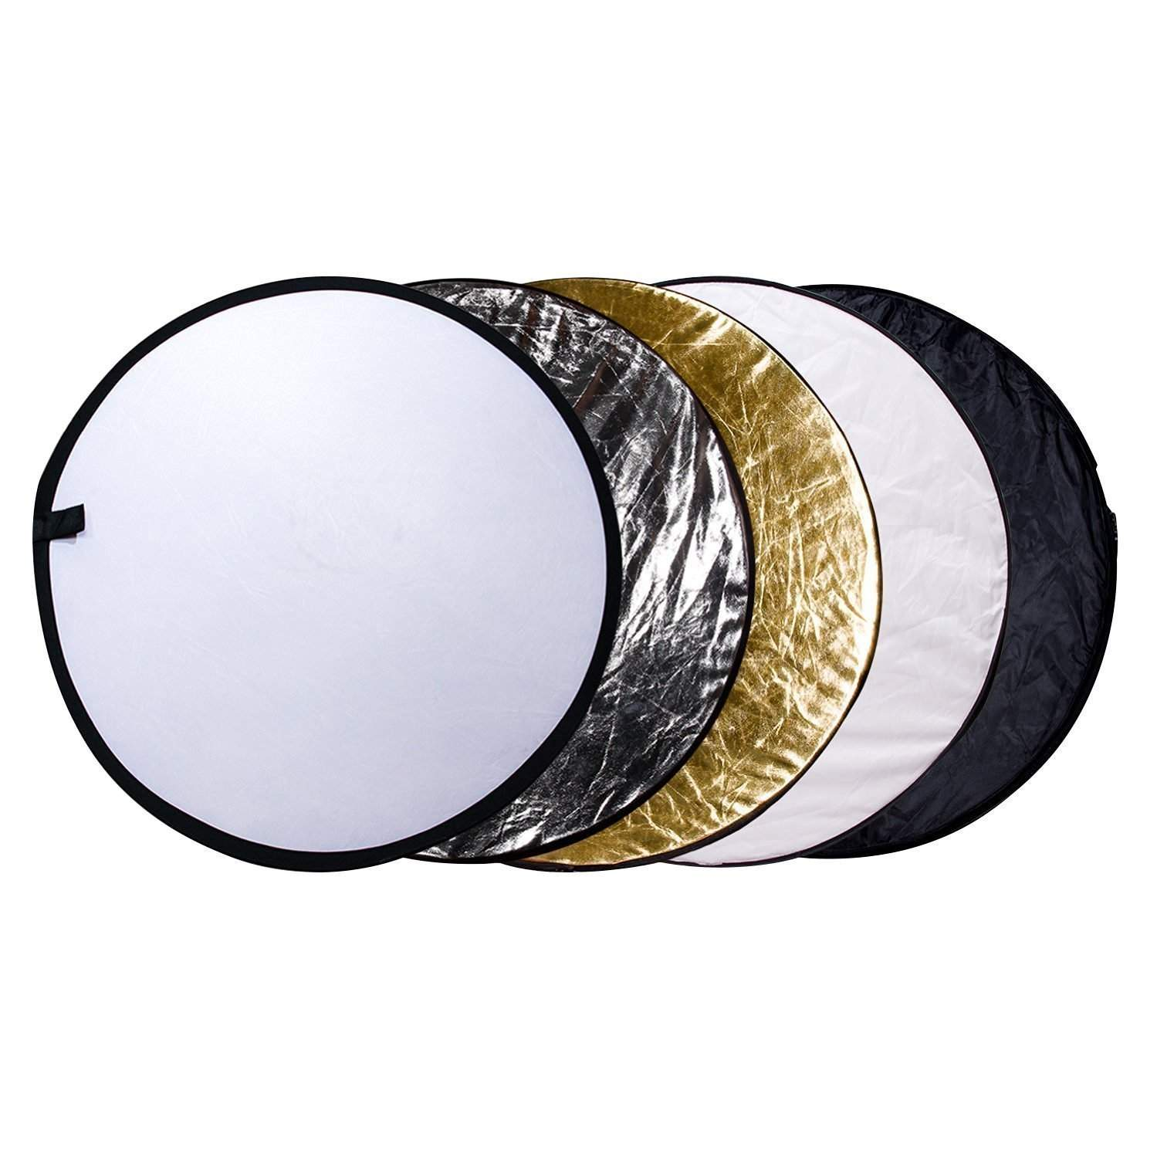

Reflector Board/Polyboard
Used outdoors to reflect sunlight or lights onto the subject

Slide 20
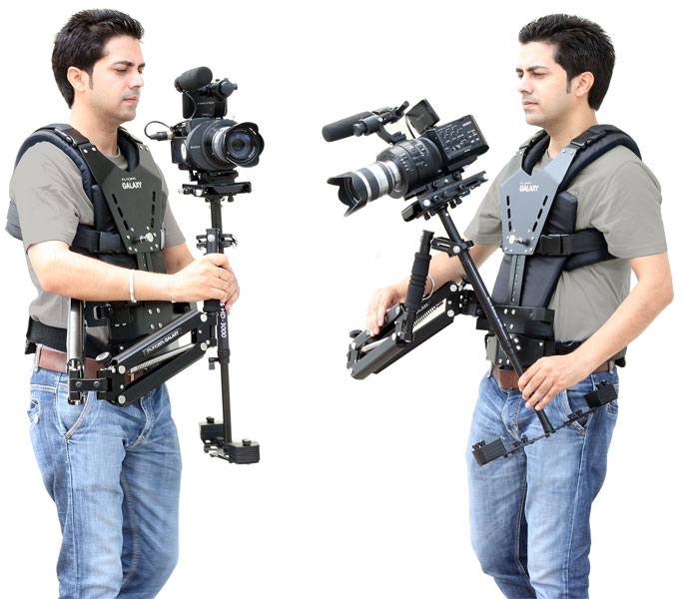
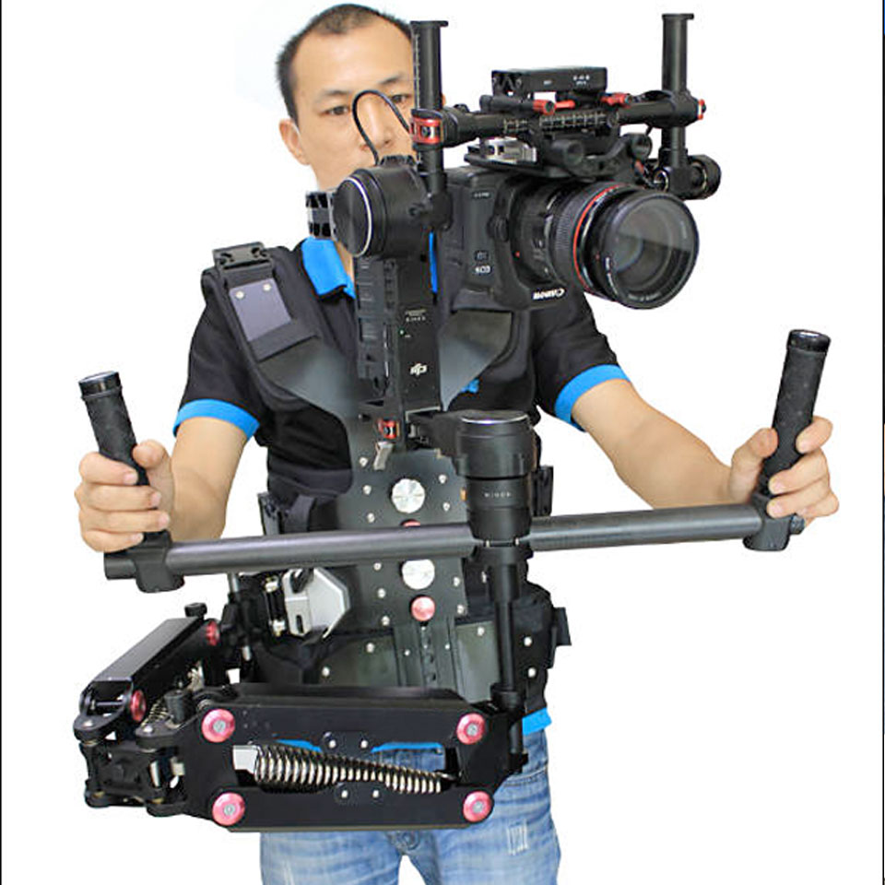
Steadycam Operator
Camera is harnessed to the body to create smooth, free movement without tracks.

Slide 21
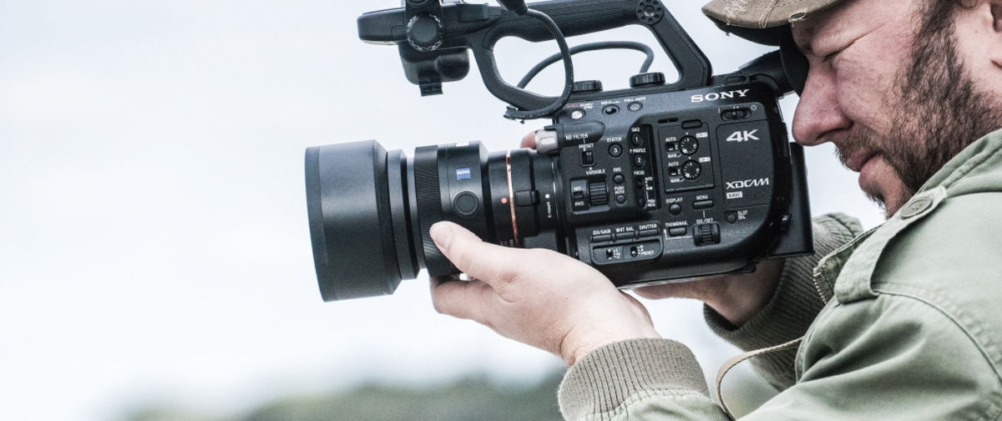
Basic Terminology
A Shot
A shot is the amount of video you shoot from the second you press record to when you stop recording.

Slide 22
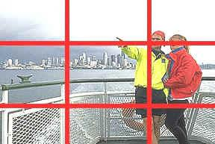
“Rule of Thirds”
  Imaginary lines which divide the picture into thirds
Place your points of interest where the lines
intersect

Slide 23
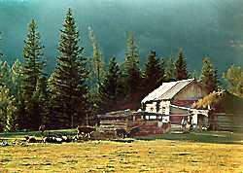
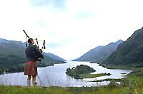



Slide 24
Rule of Thirds
Except for people looking directly at the camera, place your point of interest either on or alongside the imaginary horizontal or vertical lines, or on 1 of the 4 Intersecting points.

Slide 25


Moving-room and Looking-room
Amount of room in shot left empty to make shot look comfortable.
Leaves space for the action or eye line.

Slide 26




Avoiding Mergers
Tonal Merger
Where objects blend together in a picture and
lose their identity.

Slide 27

Issue #1
Dark hair blending into a dark background
Solution
Use a back light to separate the girl’s hair from the background.
Frame the shot from another angle to change the dark background

Slide 28
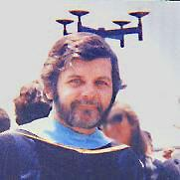
Dimensional Mergers
When different elements in your picture
“run together” and looks odd.
Close your one eye, and check your composition

Slide 29


Basic Camera Movements
Pan - Turning left or right
Tilt - Pointing camera up or down
High angle - shot above eyeline, looking down on subject
Low angle - shot below eyeline, looking up at subject

Slide 30
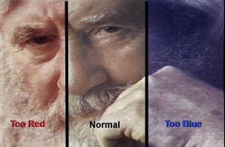
White Balance
Gives the camera a reference to “true white color”
It tells the camera what white looks like, and it
records all other colors correctly.
An incorrect white balance will show video with
a blue or orange tint.

Slide 31
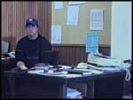
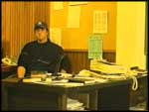
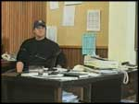
Most Cameras have
Auto White Balance!
Too blue
Too yellow
White-balanced

Slide 32



Indoor Setting
Sony Handycams
White Balance Settings
Outdoor Setting
Automatic Setting

Slide 33
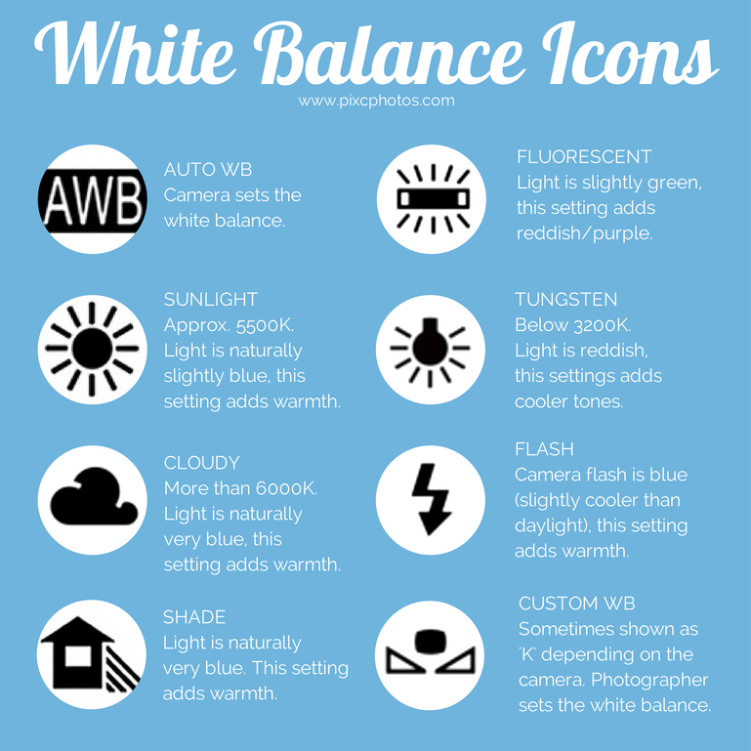

Slide 34
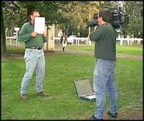
How to do a manual white balance
Point the Camera at a pure white
matte surface.
Zoom in to fill the screen with
“white” and set focus with dominant
light source on the sheet.
Press White Balance button.
Camera will take a few seconds to
white balance.
Watch for WB icon to appear in
viewfinder to confirm.
N.B. Perform this function at the beginning of every shoot, and every time the lighting conditions change.
eg inside vs outside.

Slide 35
Bad Habits…Don’t Learn These
DON’T zoom all the time!!! Zoom is BANNED
DON’T shoot with effects. Add it in the edit.
DON’T add date stamp. Home video.
DON’T leave camera unattended in car or on
tripod.
DON’T leave camera on sand/beach.
DON’T point the camera at a bright light source
DON’T shoot subject in front of window during
daylight
DON’T touch the lens. Smudges.

Slide 36
Good Video Habits
1. Use a Tripod/Stabilizer When Can
2. Check Audio/Sound When Shooting
3. Check Video Quality after 1st take/shoot
4. Shoot the same scene more than once-a new take
5. Try different angles-shots when making a clip
6. Carry extra batteries/SD Cards on a shoot
7. Use an external microphone for interviews/important scenes

