Slide 1
Creating A Visual Hierarchy
Mr Shelor’s Graphic Design Class – M-101 Lab

Slide 2
Creating A Visual Hierarchy
Visual Hierarchy is the arrangement or presentation of elements in a way that implies importance.

Slide 3
What is most important for your audience to notice?
What is the 2nd most important thing for your audience to notice?
What is the 3rd most important thing you want your audience to see?
Visual Hierarchy-Arranging the Elements of Design in the ORDER OF IMPORTANCE To Get Your Design Noticed

Slide 4
Primary Focal Point- Main Point of Emphasis
Secondary Focal Points-

Slide 5
Creating A Visual Hierarchy in Design
1st Thing
2nd thing
3rd thing
3rd thing
3rd thing

Slide 6
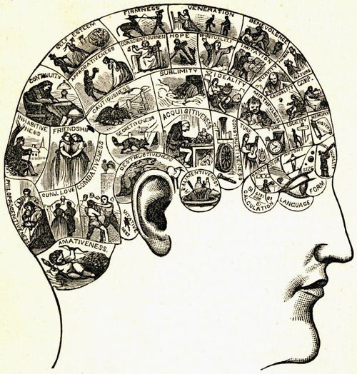
Creating A Visual Hierarchy in Design
Objects with the
Highest Contrast
to their surroundings
are recognized
first by the human mind

Slide 7
Visual Hierarchy is really a pretty simple concept.
By using color, contrast, texture, shape, value, proximity, and size,
you can organize elements on a page so that users gets a sense of visual importance. Look at this graphic below
Where did you eyes go 1st? The point is, nothing guided your eyes because all of the circles are the same.
If you make everything bold, nothing is bold.

Slide 8
Let’s make a slight change to that graphic
Now where did your eyes go? My guess is the first circle.
With only shading, I was able to direct your eye to
the circle that, for whatever reason,
I believed to be the most important.
This is visual hierarchy.

Slide 9
1. Primary Focal Point or EMPHASIS in this ad
XXX Not A Good ExampleXXX
Example Ad 1
NOT SO GOOD

Slide 10
Better Ad-Has A Visual Hierarchy
Where does your eye go first? LOWEST PRICE EVER
Where does your eye go 2nd? To The Widget-(shape)
Where does your eye go 3rd?
Sale End Monday
>>A Better use of SPACE around the text and pictures<<

Slide 11
Visual Hierarchy

Slide 15
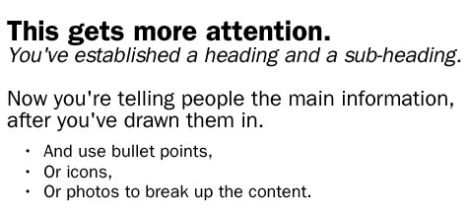

Slide 16
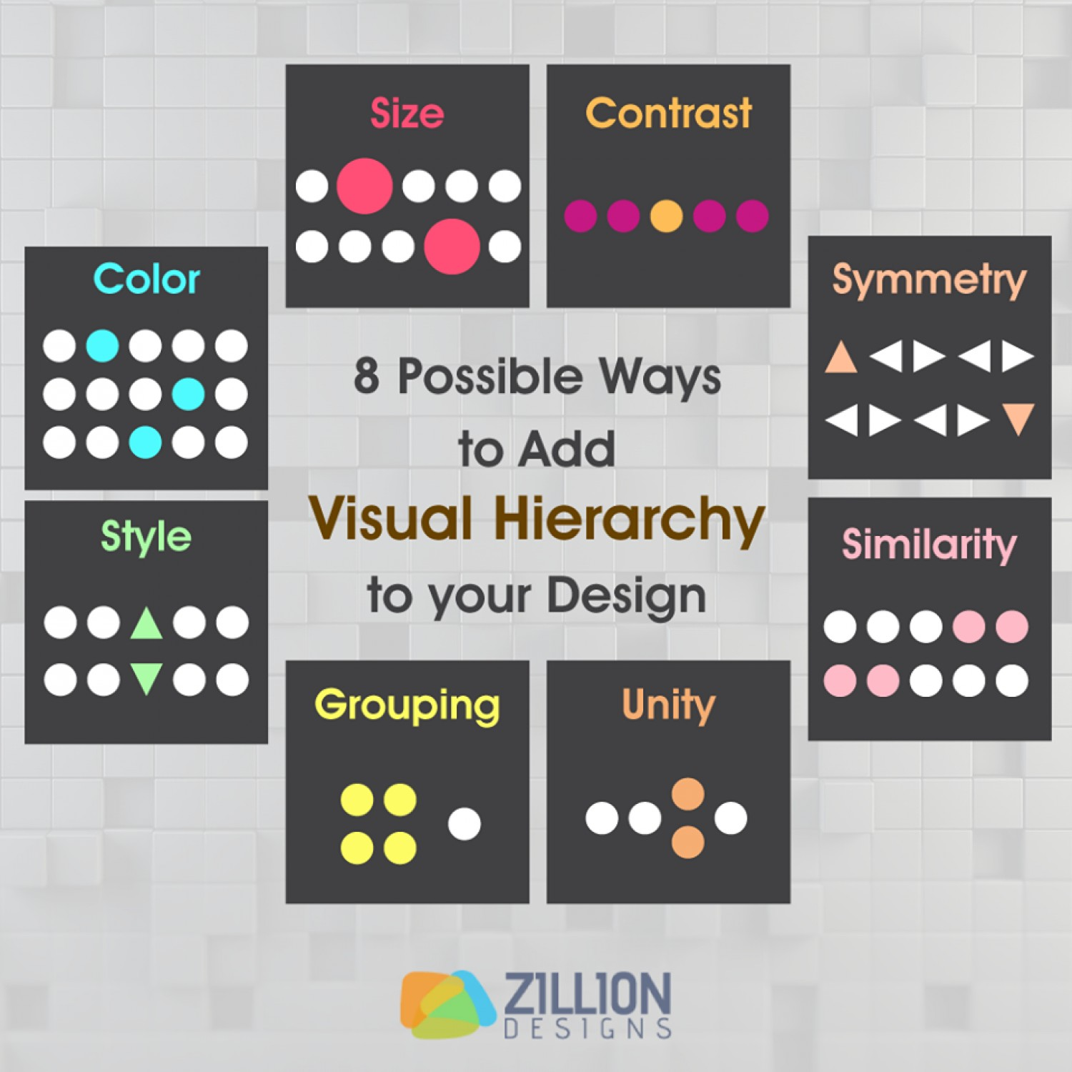

Slide 22
Easy and legible = comprehension and message received.

Slide 23
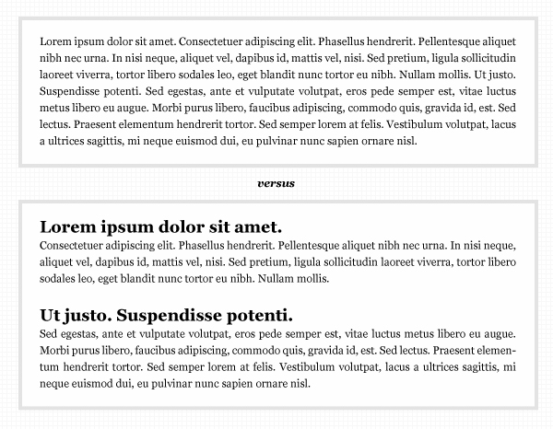

Slide 25
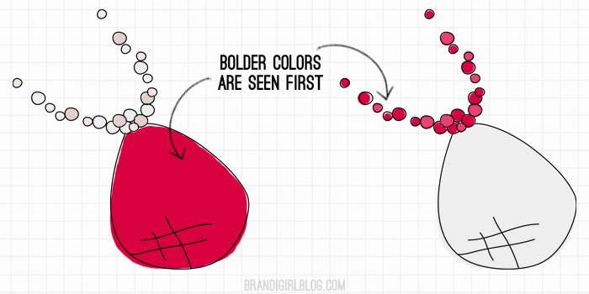

Slide 26
