Slide 2
VISUAL HIERARCHY
Examples Of

Slide 3
VISUAL HIERARCHY We can call it the order of importance -
• where does the eye look at First (primary message)
• where does the eye look at Second (secondary message)
• where does the eye look at Third - (tertiary message)

Slide 4
Hierarchy by Placement
An object placed in the center will often be perceived as a focal point. If all eyes in the painting look at one object, or if an object is placed at the center of the lines of perspective, that object will be perceived as the focus of the work.

Slide 5
Hierarchy by Isolation
If most of the elements in a work of art are grouped closely together, an object by itself stands out as a focal point

Slide 6
VISUAL HIERARCHY
Hierarchy by Contrast
Emphasis can be created by contrast. An element in contrast with something else is more easily seen and understood; something different attracts the eye.

Slide 7
VISUAL HIERARCHY
Any of the elements can be contrasted:
• LINES (a curve in the midst of straight lines), shape ie….(a circle in a field of squares)
• COLOR (one red dot on a background of grays and blacks)
• VALUE-Tone (a light or dark area in the middle of its opposite
• TEXTURE (rough vs. smooth)
• Contrast can also be created by contrasting orientation in space (horizontal, vertical, diagonal)
• SHAPES (a geometric shape in an otherwise naturalistic image) and size.
• An anomaly, or something that departs from the norm, will also stand
out and grab our attention, for example a person wearing a snowsuit
on a tropical beach.

Slide 8
What do you notice 1st? What do you notice 2nd?

Slide 13
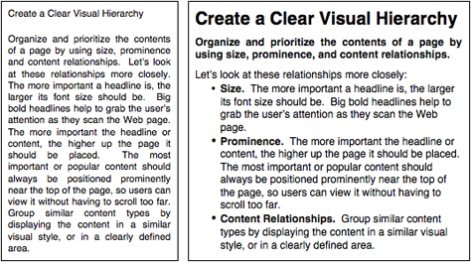
VISUAL HIERARCHY

Slide 14
VISUAL HIERARCHY

Slide 15
VISUAL HIERARCHY

Slide 16
VISUAL HIERARCHY

Slide 17
VISUAL HIERARCHY
WHERE DO YOU WANT YOUR READER’S EYE TO GO 1st?
WHERE DO YOU WANT YOUR READER’S EYE TO GO 2nd?

Slide 18
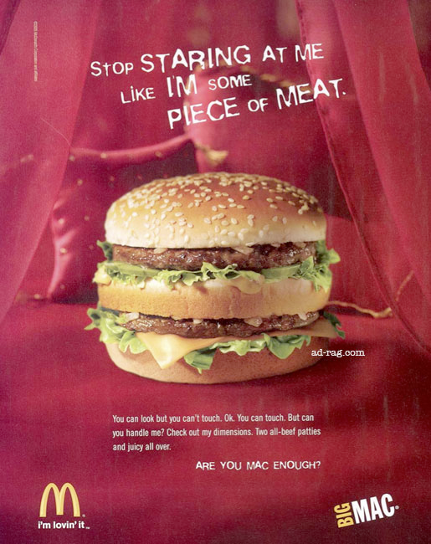
VISUAL HIERARCHY

Slide 19
VISUAL HIERARCHY

Slide 20
VISUAL HIERARCHY

Slide 21
VISUAL HIERARCHY

Slide 22
VISUAL HIERARCHY

Slide 23
VISUAL HIERARCHY

Slide 24
VISUAL HIERARCHY
WHERE DO YOU WANT YOUR READER’S EYE TO GO 1st?
WHERE DO YOU WANT YOUR READER’S EYE TO GO 2nd?
How do you get them to SEE your message?

Slide 28
Bad Design…Just Too Much and
No VISUAL HIERARCHY

Slide 29
A Little Better Design- more emphasis-

Slide 33
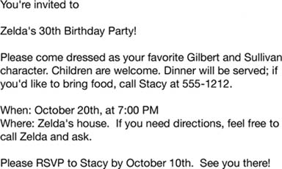

Slide 36
Need Mo’ Contrast on Backgrounds

Slide 37
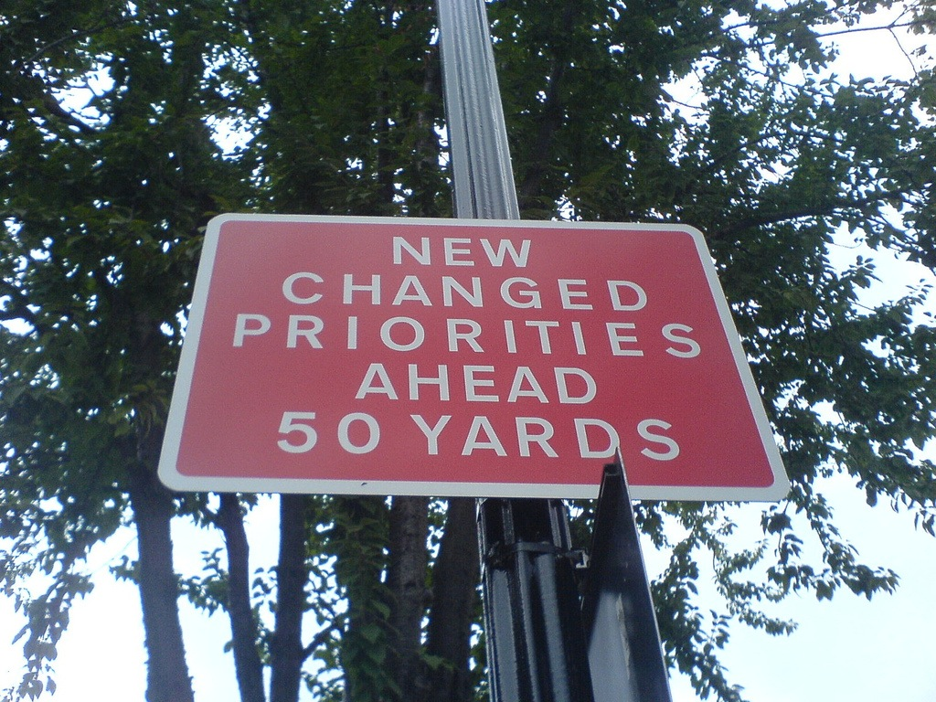

Slide 38
Visual Hierarchy Examples
& Principles
M-101 Lab Mr Shelor

