Slide 1
&
Brand
Branding

Slide 2
TABLE OF CONTENTS
> Overview
> Brand ranking
> Key factors of branding
> Conclusion

Slide 3
Part
1
Overview
>
What is a brand?
What is branding for?

Slide 4
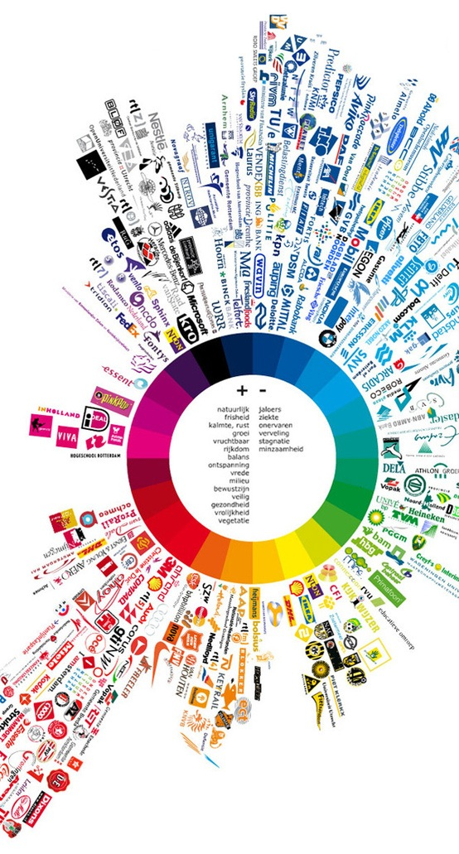
Overview
>
What is a brand?
In our daily life, we see brands here and there.

Slide 5
WHAT IS A BRAND

Slide 6
Overview
>
What is brand?
FamilyMart
Name?
Logo?
Tagline?
Product?
Advertisement?
Is it the name?

Slide 7
Overview
>
What is brand?
Name?
Logo?
Tagline?
Product?
Advertisement?
Is it the logo?

Slide 8
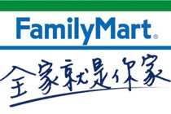
Overview
>
What is brand?
Name?
Logo?
Tagline?
Product?
FamilyMart,
Where You Are One of the Family.
Advertisement?
Is it the tagline?

Slide 9
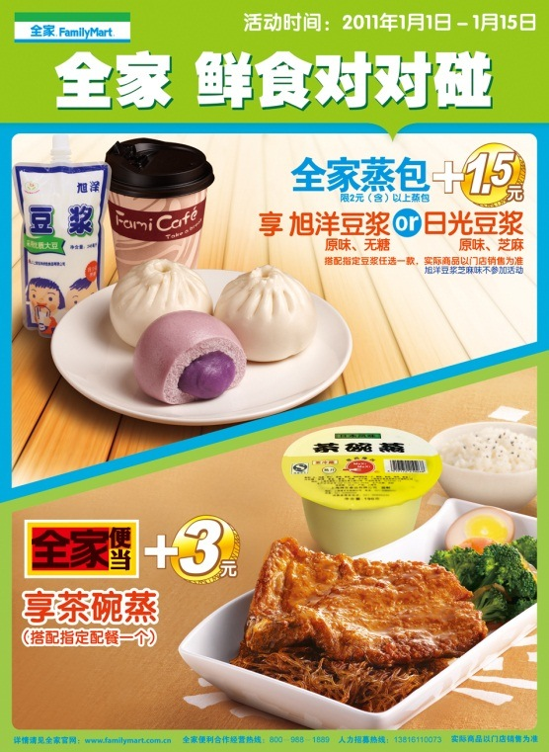
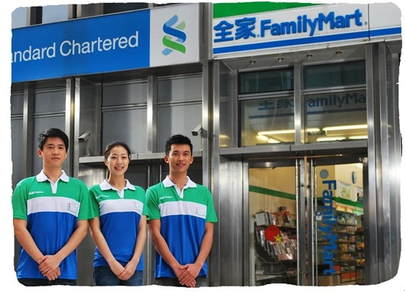
Overview
>
What is brand?
Name?
Logo?
Tagline?
Product?
Advertisement?
Is it the product or service?

Slide 10
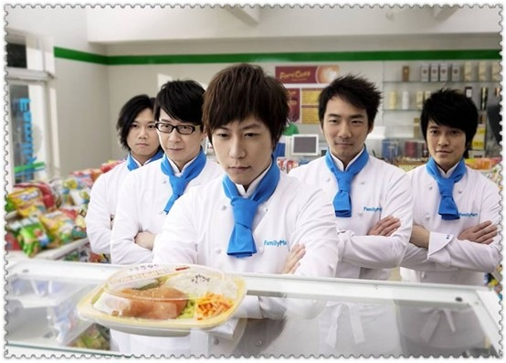
Overview
>
What is brand?
Name?
Logo?
Tagline?
Product?
Advertisement?
Is it the advertisement?

Slide 11
Overview
>
What is brand?
Name
Logo
Tagline
Product
Advertisement
The answer is YESSSSS!!!
But what a brand means is more than these five aspects.

Slide 12
RELATIONSHIP
WHAT IS A BRAND?
A brand is a relationship between an organization, product, or service and a potential buyer.
WHAT IS BRANDING?
Branding is the process involved in creating, maintaining and developing a brand.
Branding aims to establish a significant and differentiated presence in the market that attracts and retains loyal customers.

Slide 13
WHAT IS
?
BRANDING
FOR

Slide 14
Overview
>
What is branding for ?
$
1
Premium
Customer Loyalty
2
3
Potential Customers
POTENTIAL CUSTOMERS
Your customers will pass on this information to other consumers and leave them the first impressions on your brand.
PREMIUM
Branded products can charge more than unbranded ones though they are of the same quality, because your consumers believe your product is worth a higher price and therefore is willing to buy it.
>> A BRAND CREATES VALUE.
CUSTOMER LOYALTY
Customers loyal to brand X are more likely to continue to buy from this brand rather than brand Y.

Slide 15
Part
2
Brand ranking
>
Top 10 brands in the world
How to construct the list
Chinese brand ranking

Slide 16
Brand ranking
>
TOP 10 brands in the world
One of the largest brand consultancies in the world
Interbrand releases an annual ranking of the best global brands by value, known as
“The Best Global Brands”
INTERBRAND
A global branding consultancy, specializing in vast brand services, including brand analytics, brand strategy, brand valuation, corporate design, digital brand management, and naming.

Slide 17
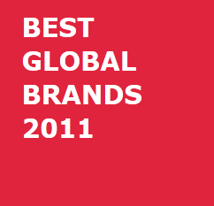
Brand ranking
>
TOP 10 brands in the world
HEWLETT-PACKARD or HP, an American information technology corporation.
DISNEY, an American mass media company.
APPLE, an American technology company that designs and sells consumer electronics, computer software, and personal computers.
INTEL, an American semiconductor chip maker corporation.
MCDONALD’S, the world's largest chain of hamburger fast food restaurants.

Slide 18
Brand ranking
>
TOP 10 brands in the world
GE or GENERAL ELECTRIC COMPANY, an American conglomerate corporation, The company operates through four segments: Energy, Technology Infrastructure, Capital Finance and Consumer & Industrial.
GOOGLE, an American corporation which provides Internet-related products and services.

Slide 19
Brand ranking
>
TOP 10 brands in the world
MICROSOFT, an American corporation that develops, manufactures, licenses, and supports a wide range of products and services predominantly related to computing through its various product divisions.
IBM, an American technology and consulting corporation.
COCA-COLA, an American beverage corporation and manufacturer, retailer and marketer of non-alcoholic beverage concentrates and syrups.

Slide 20
Brand ranking
>
TOP 10 brands in the world
Coca-Cola
Coca-Cola
Coca-Cola
Coca-Cola
Coca-Cola
Microsoft
Microsoft
Microsoft
Microsoft
Microsoft
IBM
IBM
IBM
IBM
IBM
GE
GE
GE
GE
GE
Intel
Intel
Intel
Intel
Intel
Nokia
Nokia
Disney
Nokia
Nokia
Disney
Disney
McDonald’s
Disney
Toyota
McDonald’s
McDonald’s
Nokia
McDonald’s
Disney
Mercedes-Benz
Mercedes-Benz
Toyota
Toyota
McDonald’s
Toyota
Toyota
Mercedes-Benz
Mercedes-Benz
Mercedes-Benz
2002
2003
2004
2005
2006
There were slight changes in the ranking, but NO COMPANY appeared or disappeared.

Slide 21
Brand ranking
>
TOP 10 brands in the world
Coca-Cola
Coca-Cola
Coca-Cola
Coca-Cola
Coca-Cola
Microsoft
IBM
IBM
IBM
IBM
IBM
Microsoft
Microsoft
Microsoft
Microsoft
GE
GE
GE
Google
Google
Nokia
Nokia
Nokia
GE
GE
Toyota
Toyota
McDonald’s
McDonald’s
McDonald’s
Intel
Intel
Google
Intel
Intel
McDonald’s
McDonald’s
Toyota
Nokia
Apple
Disney
Disney
Intel
Disney
Disney
Mercedes-Benz
Google
Disney
Hewlett-Packard
Hewlett-Packard
2007
2008
2009
2010
2011
We can see a greater change, such as Google’s enter and Nokia’s dropout.

Slide 22
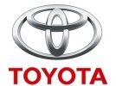
Brand ranking
>
TOP 10 brands in the world
TOP10
2011
2002

Slide 23
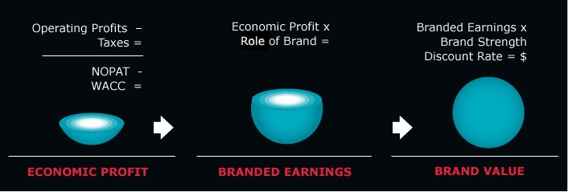
Brand ranking
How to construct the list
>
BRAND VALUE
We have to ask a question: how does Interbrand construct this ranking? Why does Coca-Cola rank higher than any other brand? And are the criteria fair enough?

Slide 24
What is it ???
-_-|||
1
2
3

Slide 25
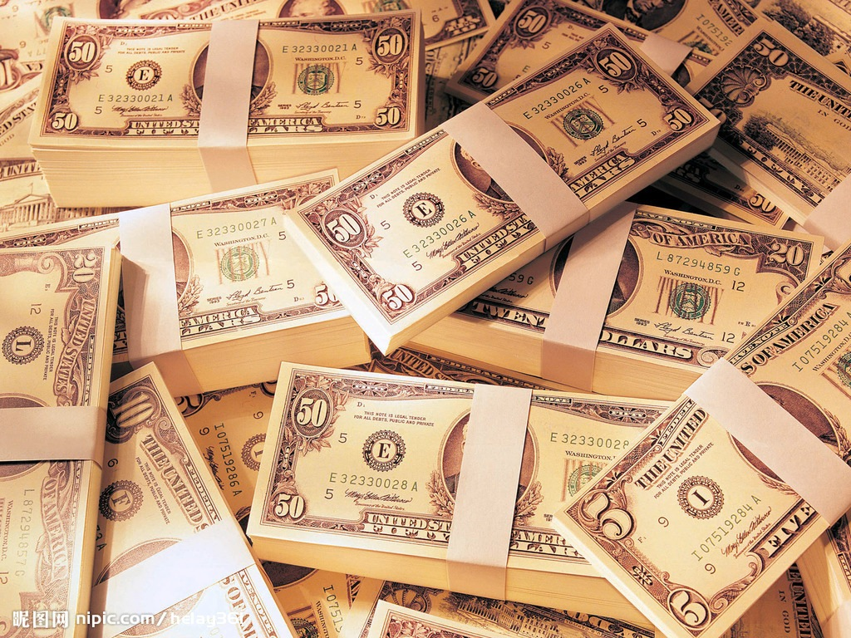
Brand ranking
How to construct the list
>
Financial Performance
1
FINANCIAL PERFORMANCE
It measures an organization’s raw financial return to the investors.

Slide 26
Brand ranking
How to construct the list
>
Role of Brand
2
ROLE OF BRAND
It measures the portion of the decision to purchase that is attributable to brand.
Conceptually, role of brand reflects the portion of demand for a branded product or service that exceeds what the demand would be for the same product or service if it were unbranded.

Slide 27
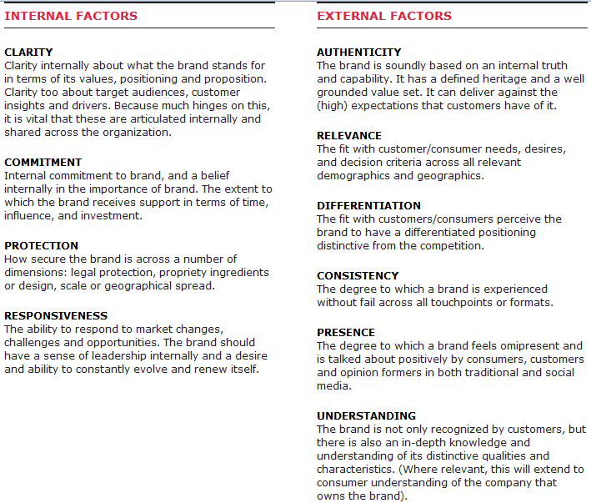
Brand ranking
How to construct the list
>
Brand Strength
3
BRAND STRENGTH
It measures the ability of the brand to secure the delivery of expected future earnings.

Slide 28
Financial Performance
BRAND VALUE
Role of Brand
Brand Strength

Slide 29
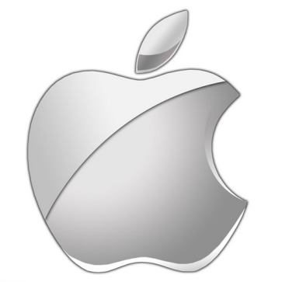
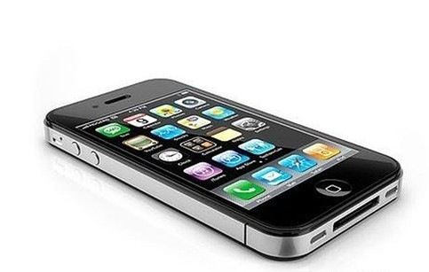
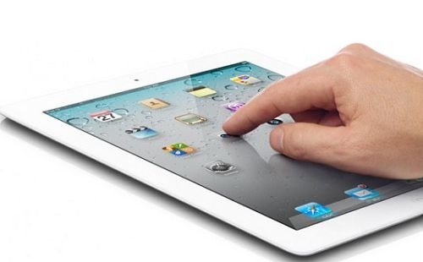
Brand ranking
How to construct the list
>
APPLE PRODUCT
APPLE does very well in ROLE OF BRAND.
Now many people, especially young people, call themselves “apple fans”, 果粉 in Chinese.
Maybe, what they really want and need is not i-phone or i-pad but apple products.
So its ranking rises very rapidly in recent years.

Slide 30
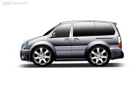
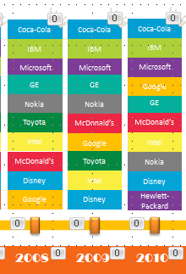
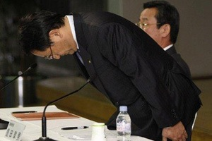
Brand ranking
How to construct the list
>
10,000,000
On the contrary, TOYOTA failed in BRAND STRENGTH
Due to the products’ quality, some safety problems were found in their cars. TOYOTA had to recall nearly 10 million cars globally. Though Toyota’s president made apologies again and again, consumers have lost their confidence. And TOYOTA is not expected to do well in the near future..
As a result, it dropped out of TOP 10.

Slide 31
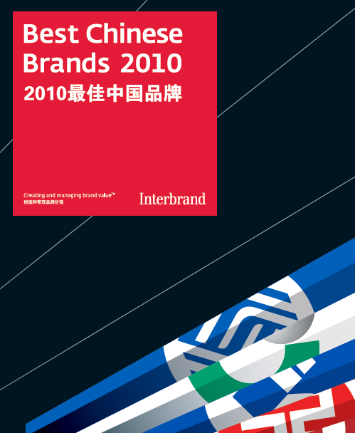
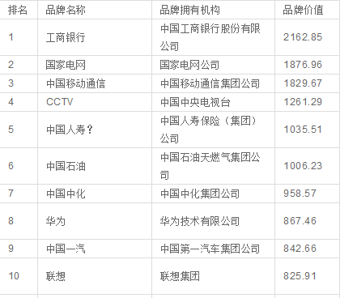
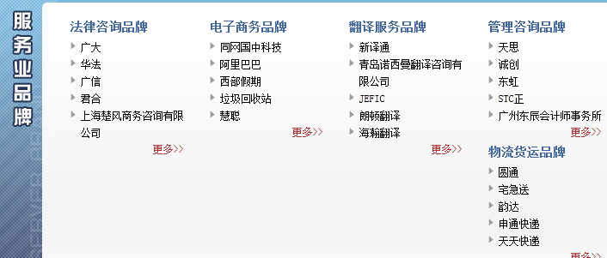
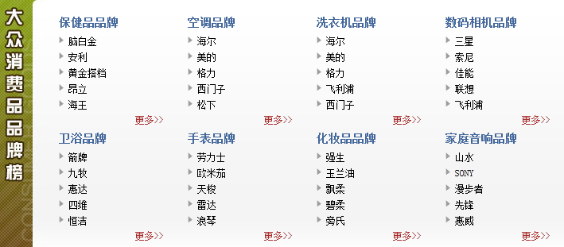
Brand ranking
>
Chinese brand ranking
As for Chinese brands, we have some similar rankings, too.

Slide 32
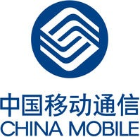
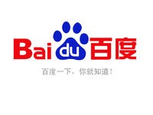
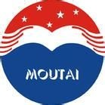
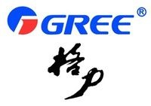
Brand ranking
>
Chinese brand ranking

Slide 33
Part
3
>
Key factors of branding

Slide 34
Some house-holding brands keep famous for more than 100 years.
However, some brands vanish from the sight of public.
What are decisive factors?
We conclude 5 factors. They are
1. Clear market positioning for brand
2. Build brand loyalty
3. Create good name
4. propaganda
5. Crisis public relations
All successful brands are same.
However, failing brands are often different from each other.

Slide 35
Clear market positioning
Market positioning reflects what kinds of clients a brand aiming at.
A clear market positioning will lead to a effective propaganda and price strategy.
We use Coca-Cola and Lenovo as example.

Slide 36
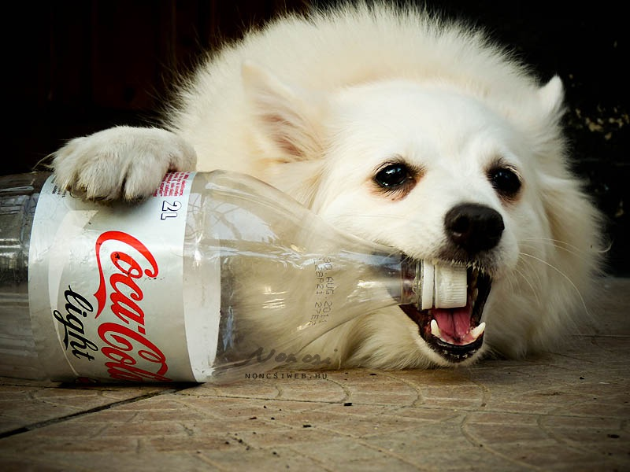
Coca-Cola
Coca-cola has a clear market positioning. It’s a brand for common people.
Coca-cola use 3P management strategy to strength their influence in the aiming market.
3P:
Pervasive
(can be bought easily)
price relative to value
(low price)
preferred.
(client loyalty)

Slide 37
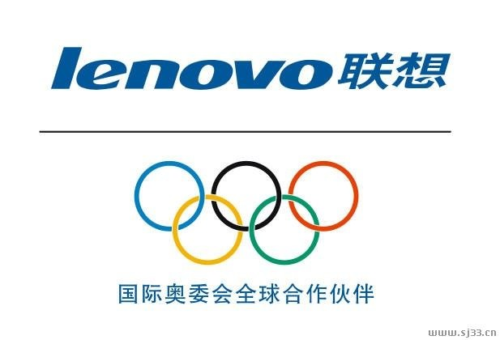
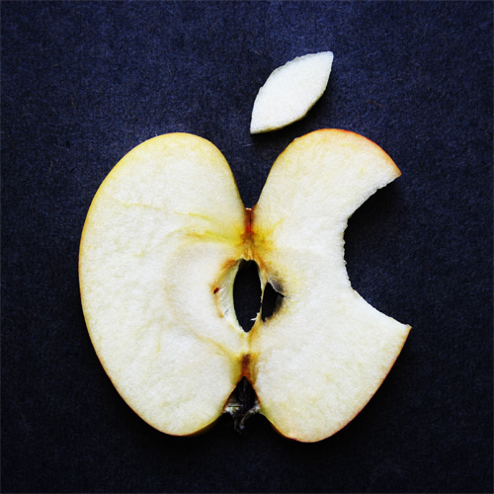
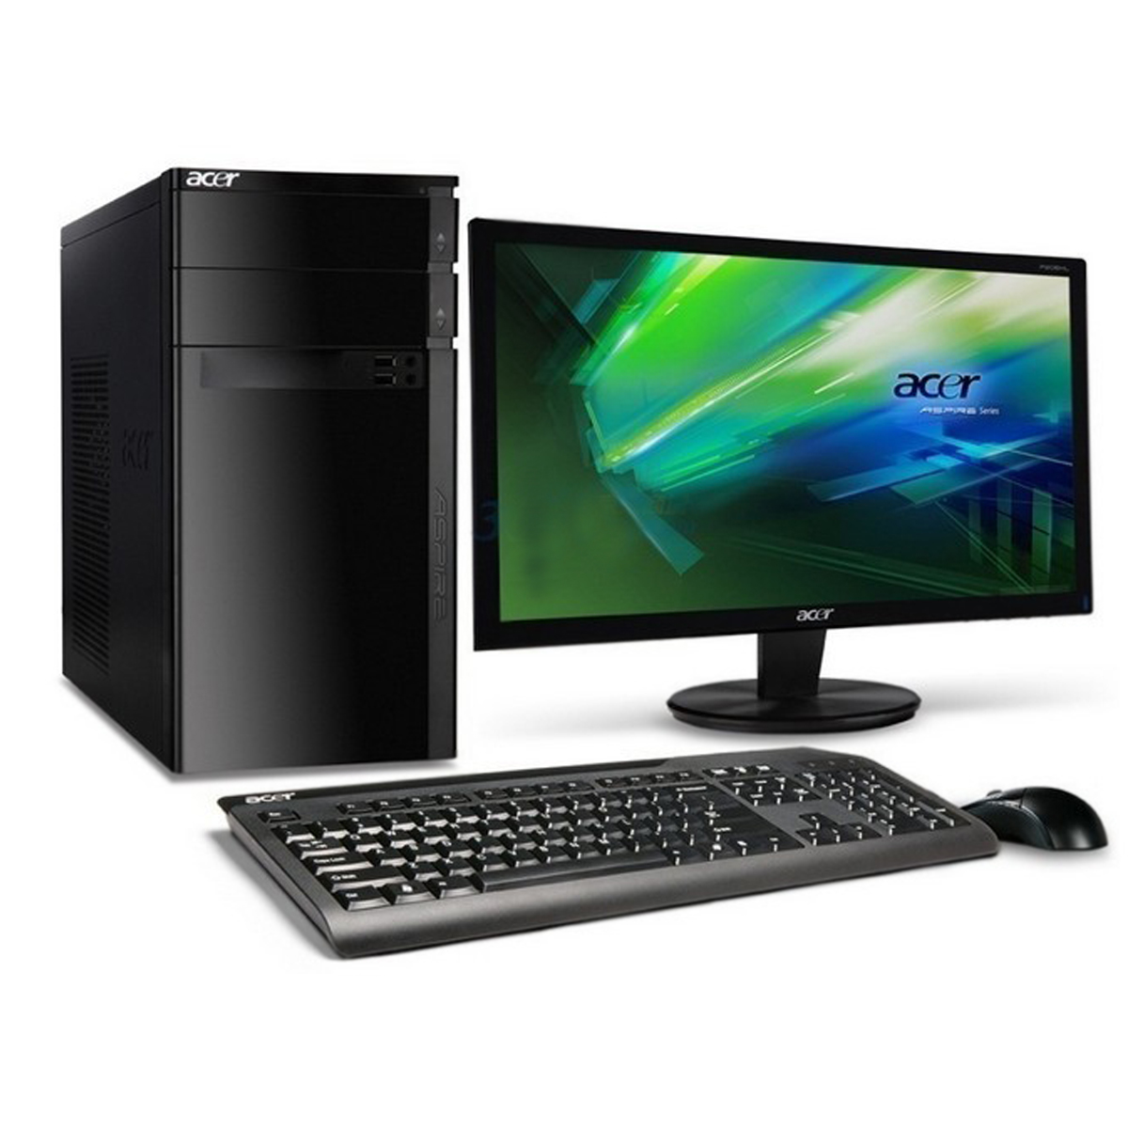
Lenovo
Lenovo doesn’t have a clear market positioning for brand.
They doesn’t aim at rich people.
The market is captured by -------- , not think pad
They doesn’t aim at common people.
The market is occupied by-------- , not think pad
Their market positioning for product is clear. So they are fed
well by government purchasing.
However, think pad is not a house-holding brand.

Slide 38
Build brand loyalty.
Brand loyalty can be divided into 5 classes, irrational, curious, buy, buy again, make propaganda automatically.
A good client loyalty equals a stable profit.
Client loyalty is determined by product and propaganda.
We use Coca-Cola and Johnson&Johnsom as example.

Slide 39
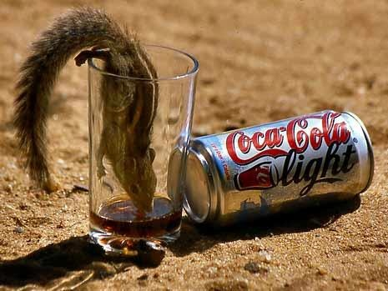
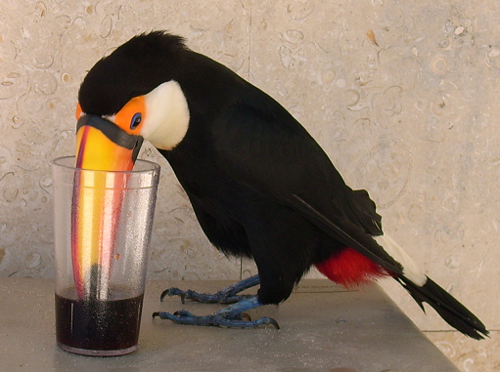
Coca-Cola
Coca-Cola tries to make clients be preferred to their products.
Coca-Cola makes particular products which can make consumer feel specially.
So, they buy Coca-Cola again. They don’t buy Pepsi.

Slide 40
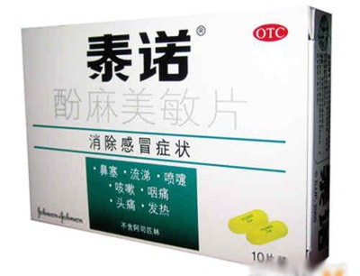
Johnson & Johnson
Brand loyalty is built by good propaganda.
Brand loyalty can be ruined by bad product.
Johnson & Johnson called about 10 million bottle of Tyno back in 2010.
Such accident tarnishes their repute and makes their profit declined.

Slide 41
Good Name
A memorable name will help consumer to memory it.
A cool name will promote the speed of transmission of the brand.
We use Coca-Cola and Pocari Sweat（ポカリスエット）as example

Slide 42
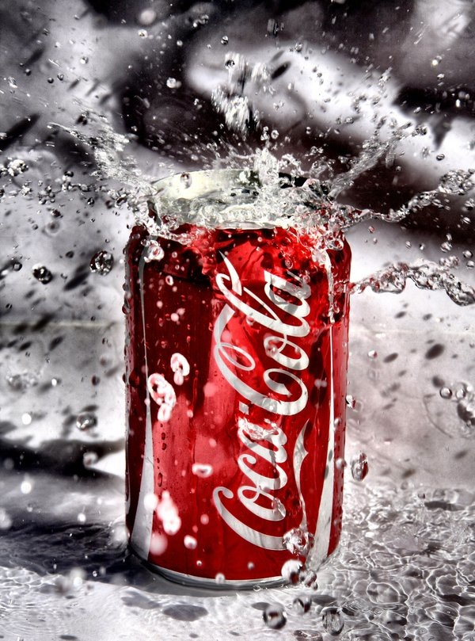
Coca-Cola
Coca-Cola can be memorized easily.
In English, it’s called Coke.
The first Chinese name of Coca-Cola is 蝌蚪啃蜡.
Only after changing its name in China,
Coca-Cola becomes famous.

Slide 43
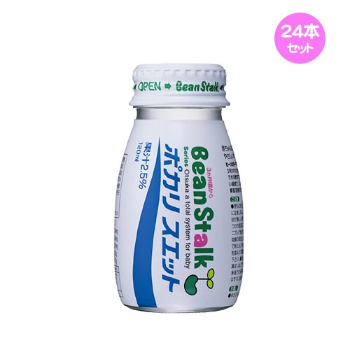
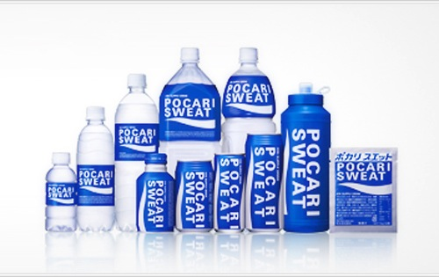
Pocari Sweat
Pocari Sweat is made by Otsuka Pharmaceutical Co（大塚製薬）in Japan.
It’s a famous beverage in Japan.
It doesn’t gain success in China because of the length of its name. It needs more advertisement to make consumers memorize it.

Slide 44
Propaganda
Propaganda is the most fateful factor.
Propaganda contains advertisement and display and public relation.
A house-holding brand can’t keep famous only by propaganda.
A brand even can’t be famous without good propaganda.

Slide 45
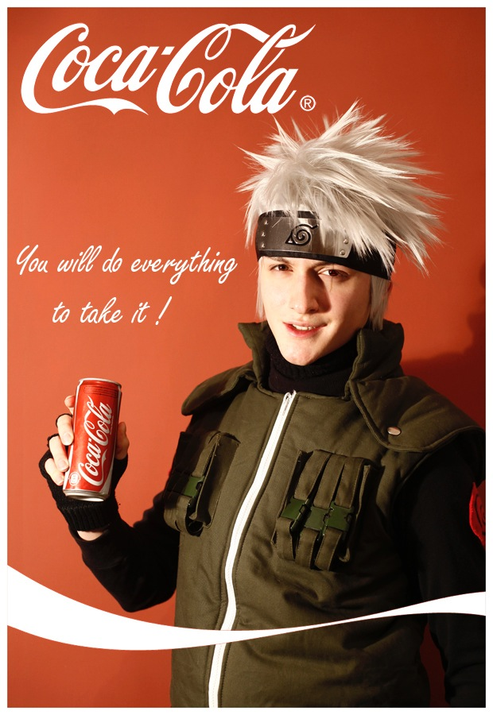
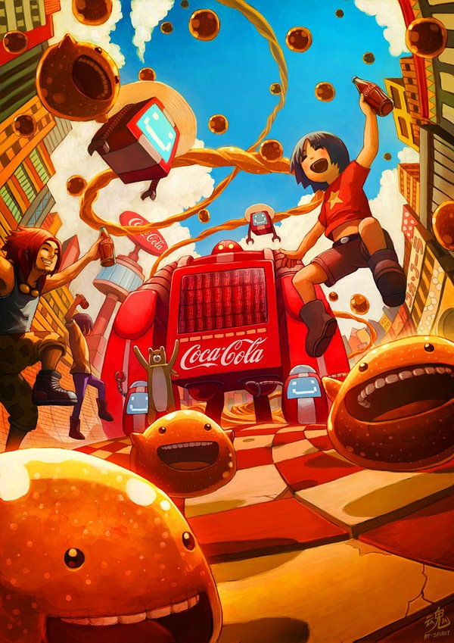
Coca-Cola
Coca-Cola spends a great amount of money in TV advertisement.
Coca-Cola also spends a lot of money to keep good relationship with their agency
Coca-Cola designs creative poster in net to attract the young
America
Vietnam

Slide 46
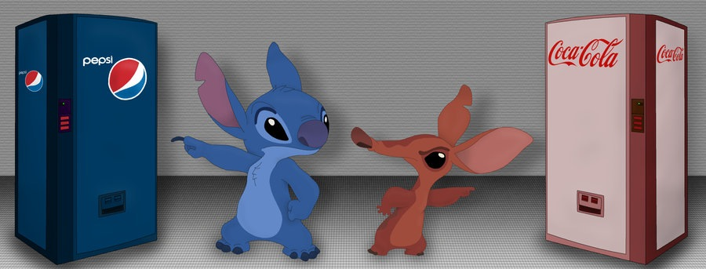
Propaganda is very very significant.
No company can be famous without that.

Slide 47
Crisis Public Relation
Crisis public relation is very important to a brand that falls into swamp.
Failing crisis public relation always ruins a brand.
Wonderful crisis public relation can turn crime to virtue.
We use Coca-Cola and Yukijirusi (雪印) Dairy as example.

Slide 48
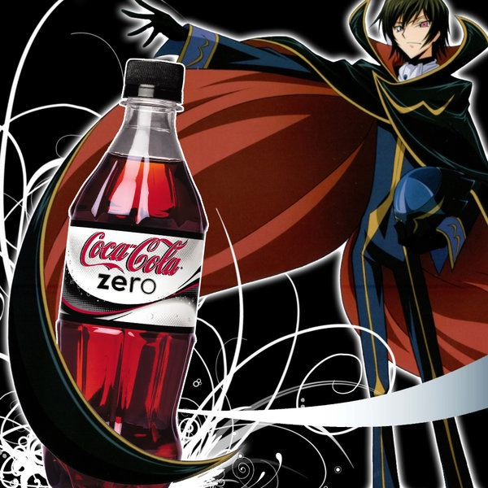
Coca-Cola
June,1999, Coca-Cola fell into a scandal of food poisoning in Belgium. The government of Belgium banned Coca-Cola.
Iswell (the CEO of Coca-Cola) went to Belgium soon to offer an explanation and apologize to the public.
Coca-Cola recalled more than 15 million bottles of Coke and make compensation to consumers.
The crisis public relations made their repute recover.
Crisis republic relation has the power to invert right and wrong.

Slide 49
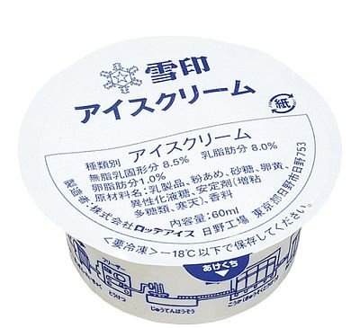
Yukijirusi Dairy
Yukijirusi Dairy used to be one of the 3 dominant companies in Japanese dairy market.
More than 15 thousand people around Osaka became ill after drinking milk made by the company in 2000.
Isikawatetsuro, the CEO of Yukijirusi Dairy, led a failing crisis public relation. He complaint that journalists bother him.
The public queried about his sincerity and boycotted their product.
After another scandal was exposed in 2002, the company bankrupted.

Slide 50
Part
4
Conclusion

Slide 51
Brand is very important for fast moving consumer goods and luxury.
First, make a suitable market positioning for brand and create a good name.
Second, propagate your brand.
If the product is high-quality, client loyalty will be established.
If the product falls in trouble, crisis republic relation is necessary.
Differentiation > propaganda > Crisis public relation > Client loyalty > Good name

Slide 52
Thank You~❤

