Slide 1
Chasity Haleamau - Silva
Graphic Tech Presentation

Slide 2
Art Work # 1 Iris Vision

Slide 3
Art Work # 2 Jamba Juice

Slide 4
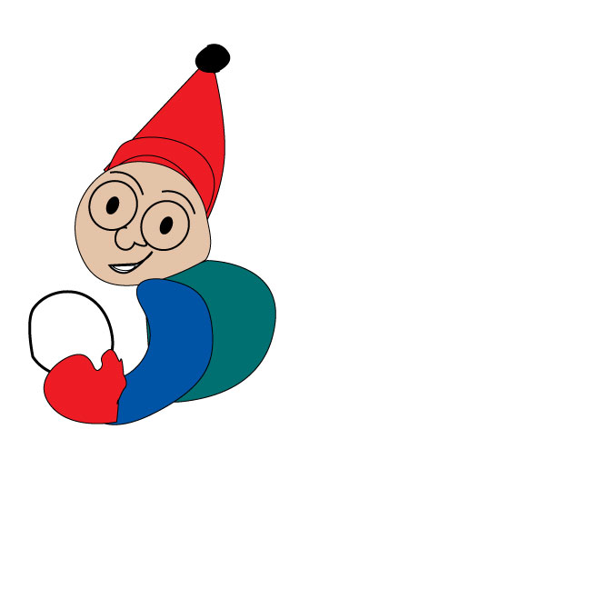
Art Work #3 S n o w M a n

Slide 5
Art WorK # 4 Three Berry Rivers

Slide 6
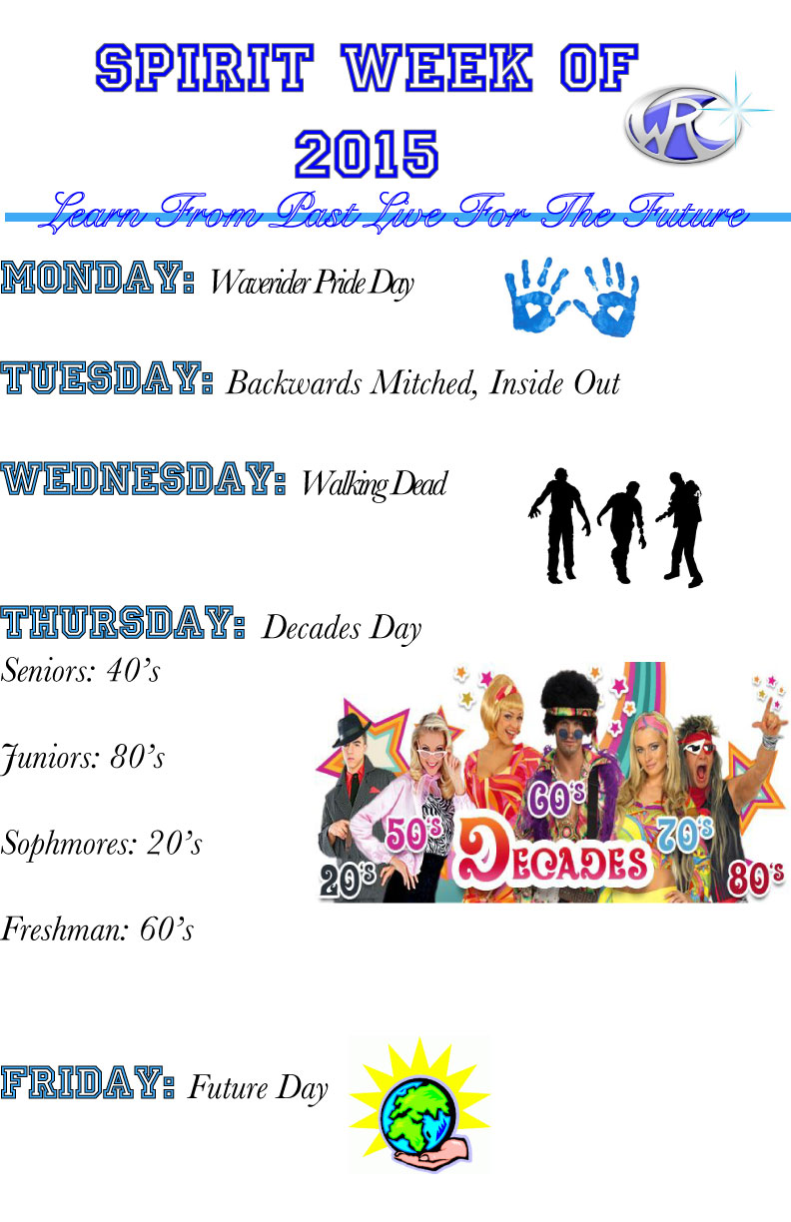
Art Work # 5 Spirit Week

Slide 7
Art Work # 6Bumper Sticker

Slide 8
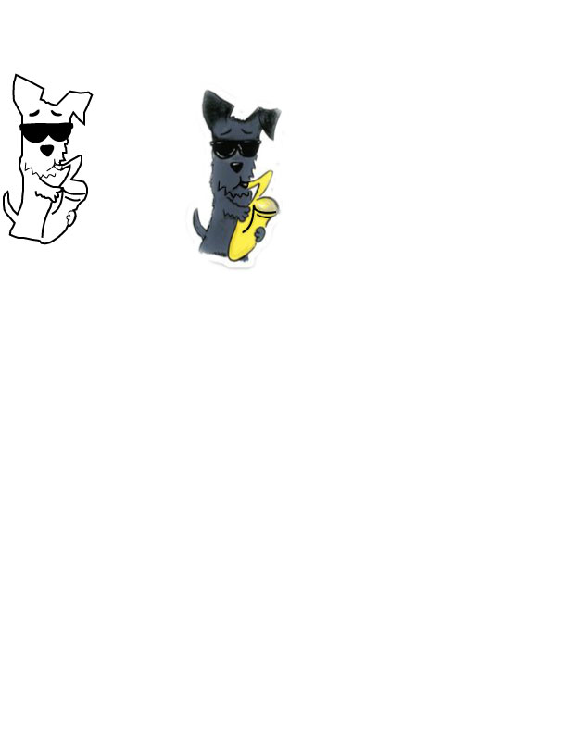
Art Work # 7 My Doggy

Slide 9
Art Work # 8 Business Card

Slide 10
Art Work # 9 Coffee Vector

Slide 11
Art Work # 10 Coffee Label

Slide 12
Art Work # 11 Personal Logo

Slide 13
Art Work # 12 Pumpkin

Slide 14
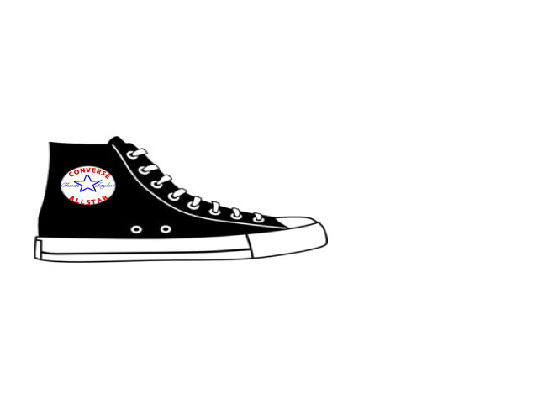
Art Work # 13 My Converse Shoe

Slide 15
Art Work # 14 Shapes

Slide 16
Art Work # 15 Arts & Comm

Slide 17
Art Work # 16 Student Logo

